Slide 1




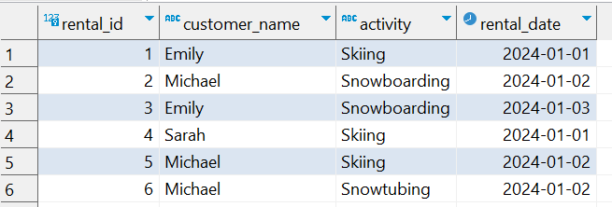

Question No: 1
School of IT
+91 98403 26240
A ski resort company want to know which customers rented ski equipment for more than one type of activity (e.g., skiing and snowboarding). List the customer names and the number of distinct activities they rented equipment for.
Source table : rentals

Slide 2
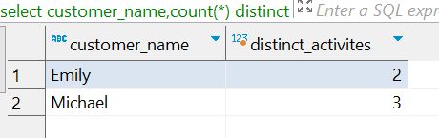
Question No: 1
Answer
School of IT
+91 98403 26240
A ski resort company want to know which customers rented ski equipment for more than one type of activity (e.g., skiing and snowboarding). List the customer names and the number of distinct activities they rented equipment for.
Result
Source table : rentals
SQL Query
SELECT customer_name, Count(*) distinct_activites FROM rentals GROUP BY customer_name HAVING Count(DISTINCT activity) > 1

