Slide 1




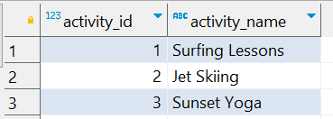

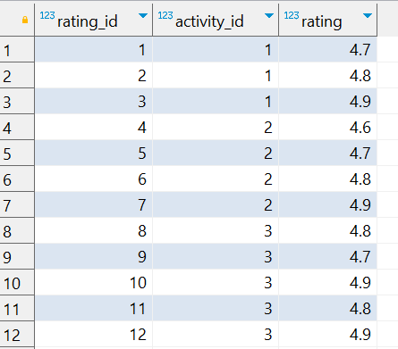
Question No: 18
School of IT
+91 98403 26240
Today's Question:
A travel agency is promoting activities for a "Summer Christmas" party. They want to identify the top 2 activities based on the average rating. Write a query to rank the activities by average rating.
Source Table :school_of_it_2025.activities
Source Table :school_of_it_2025.activity_ratings

