Slide 1





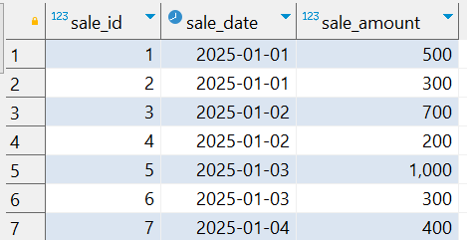
Interview Questions : 3
School of IT
+91 98403 26240
Write a query to calculate the percentage of sales contributed by each day over a given date range. The result should show the date, total sales for that date, and the percentage contribution of each date to the total sales during the period.
Note: Try to solve this problem using Window function
Source Table :school_of_it_2025.sales_interview_question_3

