Slide 1




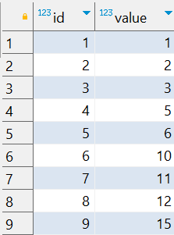

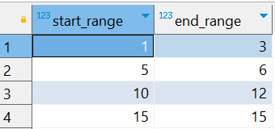
Interview Questions : 4
School of IT
+91 98403 26240
How can I find continuous ranges of numbers in a PostgreSQL table
Source Table :school_of_it_2025.sequence_table
The expected output should group consecutive numbers into ranges

