Slide 1




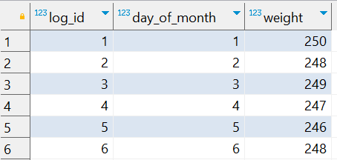

Question No: 23
School of IT
+91 98403 26240
Today's Question:
The Grinch tracked his weight every day in December to analyze how it changed daily. Write a query to return the weight change (in pounds) for each day, calculated as the difference from the previous day's weight.
Source Table :school_of_it_2025.grinch_weight_log

Slide 2
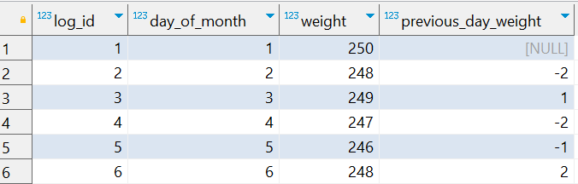
Question No: 23
School of IT
+91 98403 26240
Today's Question:
The Grinch tracked his weight every day in December to analyze how it changed daily. Write a query to return the weight change (in pounds) for each day, calculated as the difference from the previous day's weight.
SQL Query
SELECT log_id,
day_of_month,
weight,
weight - Lag(weight)
OVER(
ORDER BY log_id ) previous_day_weight
FROM school_of_it_2025.grinch_weight_log ;
Answer

