Slide 1


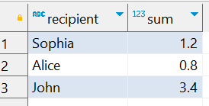
Question No: 13
School of IT
+91 98403 26240
Today's Question:
We need to make sure Santa's sleigh is properly balanced. Find the total weight of gifts for each recipient.
SQL Query
SELECT recipient, Sum(weight_kg) FROM school_of_it_2025.gifts_q_13 GROUP BY recipient;
Answer

