Slide 1




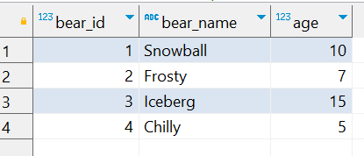

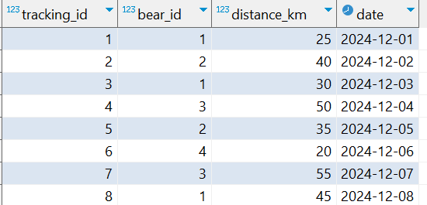
Question No: 6
School of IT
+91 98403 26240
Today's Question:
Scientists are tracking polar bears across the Arctic to monitor their migration patterns and caloric intake. Write a query to find the top 3 polar bears that have traveled the longest total distance in December 2024. Include their bear_id, bear_name, and total_distance_traveled in the results.
Source Table :school_of_it_2025.polar_bears
Source Table :school_of_it_2025.tracking

