Slide 1





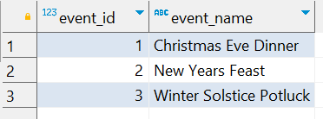
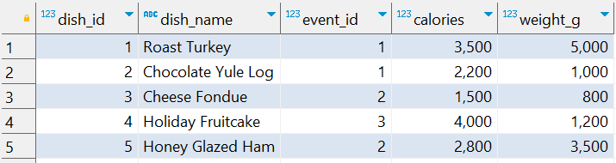
Question No: 9
School of IT
+91 98403 26240
Today's Question:
A community is hosting a series of festive feasts, and they want to ensure a balanced menu. Write a query to identify the top 3 most calorie-dense dishes (calories per gram) served for each event. Include the dish_name, event_name, and the calculated calorie density in your results.
Source Table :school_of_it_2025.events
Source Table :school_of_it_2025.menu

