Slide 1





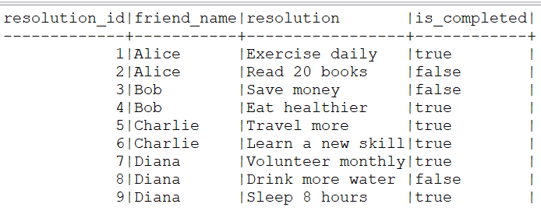
Question No: 10
School of IT
+91 98403 26240
Today's Question:
You are tracking your friends' New Year’s resolution progress. Write a query to calculate the following for each friend: number of resolutions they made, number of resolutions they completed, and success percentage (% of resolutions completed) and a success category based on the success percentage: - Green: If success percentage is greater than 75%. - Yellow: If success percentage is between 50% and 75% (inclusive). - Red: If success percentage is less than 50%.
Source Table :school_of_it_2025.resolutions

