Slide 1


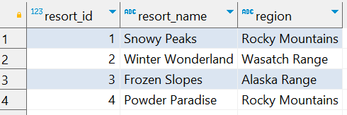
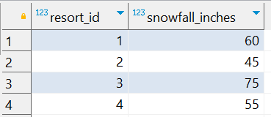
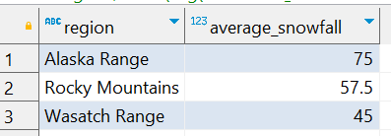
Question No: 4
School of IT
+91 98403 26240
Today's Question:
You’re planning your next ski vacation and want to find the best regions with heavy snowfall. Given the tables resorts and snowfall, find the average snowfall for each region and sort the regions in descending order of average snowfall. Return the columns region and average_snowfall.
SQL Query
Source table : school_of_it_2025.ski_resorts
SELECT
sr.region, round(avg(sf.snowfall_inches), 2 ) average_snowfall
FROM
school_of_it_2025.ski_resorts sr INNER JOIN
school_of_it_2025.snowfall sf
ON sf.resort_id = sr.resort_id GROUP BY sr.region ORDER BY 2 DESC
Source table : school_of_it_2025.snowfall
Answer

