Slide 1





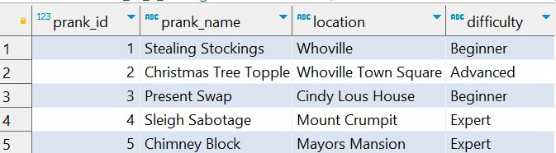
Question No: 17
School of IT
+91 98403 26240
Today's Question:
The Grinch is planning out his pranks for this holiday season. Which pranks have a difficulty level of “Advanced” or “Expert"? List the prank name and location (both in descending order).
Source Table :school_of_it_2025.grinch_pranks

Slide 2
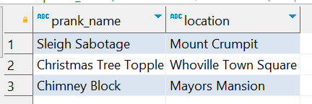
Question No: 17
School of IT
+91 98403 26240
Today's Question:
The Grinch is planning out his pranks for this holiday season. Which pranks have a difficulty level of “Advanced” or “Expert"? List the prank name and location (both in descending order).
SQL Query
SELECT prank_name,
location
FROM school_of_it_2025.grinch_pranks
WHERE difficulty IN( 'Advanced', 'Expert' )
ORDER BY 1 DESC,
2 DESC ;
Answer

