Slide 1




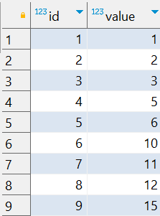

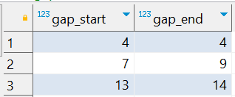
Interview Questions : 5
School of IT
+91 98403 26240
How can I find missing ranges (gaps) between consecutive numbers in a PostgreSQL table?
Source Table :school_of_it_2025.sequence_table
The expected output should be

