Slide 1



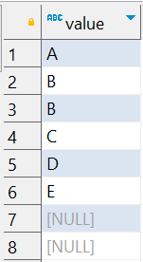
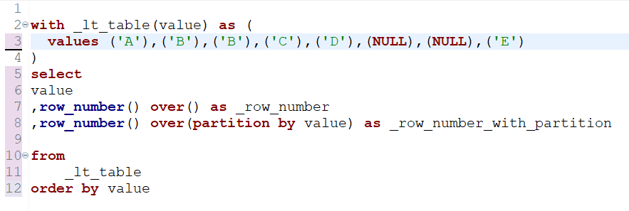

Question : 9
Understanding NULL
School of IT
+91 98403 26240
lt_table
What does this query return?
Question : 1

