Slide 1



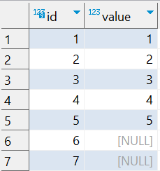

Question : 3
Understanding NULL
School of IT
+91 98403 26240
school_of_it_2025.null_test
What does query this query return?
select * from school_of_it_2025.null_test where value not in (1,null)

