Slide 1



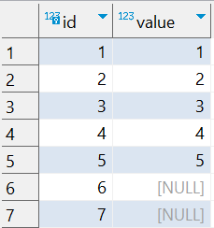

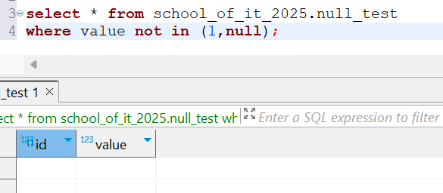
Question : 3
Understanding NULL
School of IT
+91 98403 26240
school_of_it_2025.null_test
What does query this query return?
select * from school_of_it_2025.null_test where value not in (1,null)
Answer : No Rows
Because any NULL in the NOT IN list makes the
entire condition UNKNOWN.
Fix: Use value NOT IN (1) OR value IS NULL.

