Slide 1



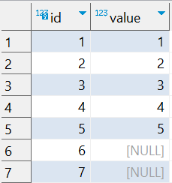

Question : 5
Understanding NULL
School of IT
+91 98403 26240
school_of_it_2025.null_test
What does this query return?
select value from school_of_it_2025.null_test
order by value asc;
select value from school_of_it_2025.null_test
order by value desc;

