Slide 1


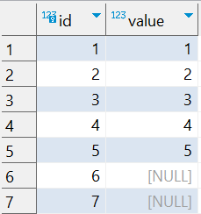


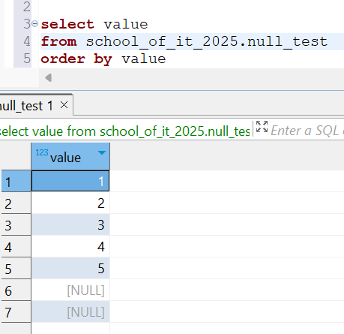
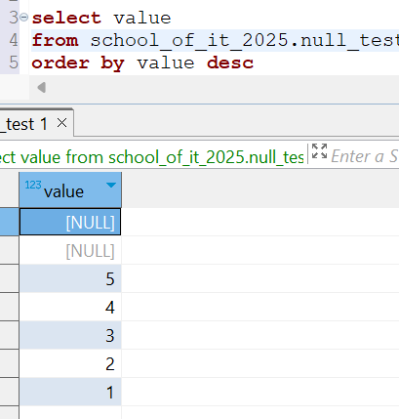
Question : 5
Understanding NULL
School of IT
+91 98403 26240
school_of_it_2025.null_test
What does this query return?
select value from school_of_it_2025.null_test
order by value asc;
select value from school_of_it_2025.null_test
order by value desc;
By default, NULL appears last in ascending
order and first in descending order
To control this, use
ORDER BY col ASC NULLS FIRST;
ORDER BY col DESC NULLS LAST;

