Slide 1





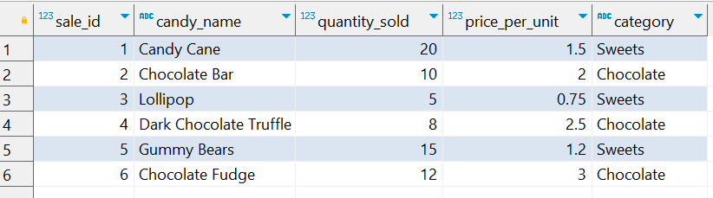
Question No: 16
School of IT
+91 98403 26240
Today's Question:
As the owner of a candy store, you want to understand which of your products are selling best. Write a query to calculate the total revenue generated from each candy category.
Source Table :school_of_it_2025.candy_sales

Slide 2
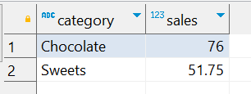
Question No: 16
School of IT
+91 98403 26240
Today's Question:
As the owner of a candy store, you want to understand which of your products are selling best. Write a query to calculate the total revenue generated from each candy category.
SQL Query
SELECT category, Sum(quantity_sold * price_per_unit) sales FROM school_of_it_2025.candy_sales GROUP BY category ORDER BY sales DESC
Answer

