Slide 1





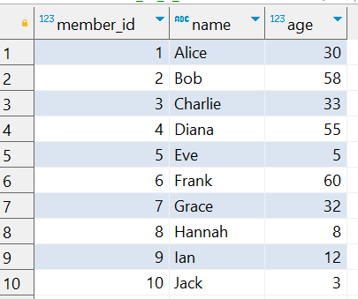
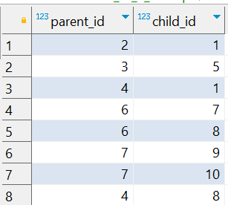
Question No: 15
School of IT
+91 98403 26240
A family reunion is being planned, and the organizer wants to identify the three family members with the most children. Write a query to calculate the total number of children for each parent and rank them. Include the parent’s name and their total number of children in the result.
Source Table :school_of_it_2025.family_members_q_15
Source Table :school_of_it_2025.parent_child_relationships

Slide 2
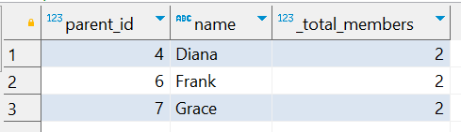
Question No: 15
School of IT
+91 98403 26240
A family reunion is being planned, and the organizer wants to identify the three family members with the most children. Write a query to calculate the total number of children for each parent and rank them. Include the parent’s name and their total number of children in the result.
SQL Query
SELECT parent_id, name, Count(*) AS _total_members FROM school_of_it_2025.parent_child_relationships pcr INNER JOIN school_of_it_2025.family_members_q_15 fm ON fm.member_id = pcr.parent_id GROUP BY parent_id, name ORDER BY _total_members DESC LIMIT 3;
Answer

