Slide 1




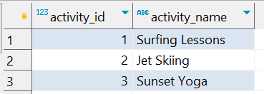

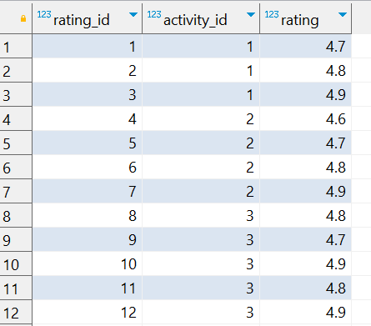
Question No: 18
School of IT
+91 98403 26240
Today's Question:
A travel agency is promoting activities for a "Summer Christmas" party. They want to identify the top 2 activities based on the average rating. Write a query to rank the activities by average rating.
Source Table :school_of_it_2025.activities
Source Table :school_of_it_2025.activity_ratings

Slide 2

Question No: 18
School of IT
+91 98403 26240
Today's Question:
A travel agency is promoting activities for a "Summer Christmas" party. They want to identify the top 2 activities based on the average rating. Write a query to rank the activities by average rating.
SQL Query
SELECT a.activity_id, a.activity_name, Avg(rating) avg_rating FROM school_of_it_2025.activities a INNER JOIN school_of_it_2025.activity_ratings ar ON a.activity_id = ar.activity_id GROUP BY a.activity_id, a.activity_name ORDER BY 3 DESC LIMIT 2;
Answer

