Slide 1



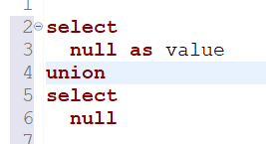
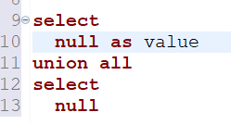

Question : 6
Understanding NULL
School of IT
+91 98403 26240
school_of_it_2025.null_test
What does query this query return?

