Slide 1



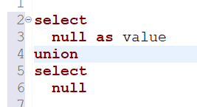
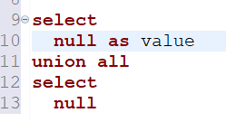

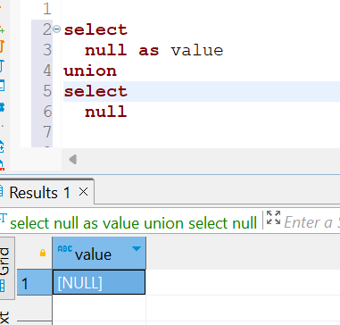
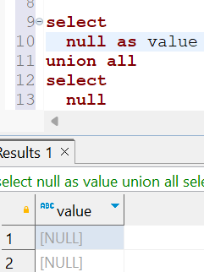
Question : 6
Understanding NULL
School of IT
+91 98403 26240
school_of_it_2025.null_test
What does query this query return?
Answer
NULL appears only once in the result
because UNION removes duplicates,
and NULL is treated as a
single distinct value.

