Slide 1





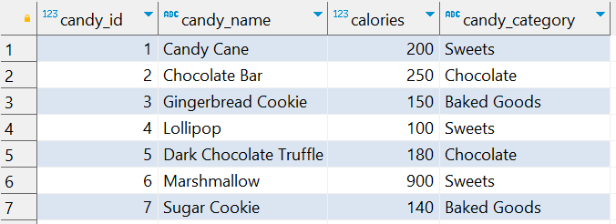
Question No: 3
School of IT
+91 98403 26240
Today's Question:
You’re trying to identify the most calorie-packed candies to avoid during your holiday binge. Write a query to rank candies based on their calorie count within each category. Include the candy_name, candy_category, calories, and rank (rank_in_category) within the category.
Source table : school_of_it_2025.candy_nutrition

Slide 2
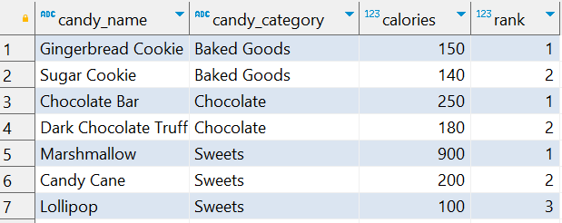
Question No: 3
Answer
School of IT
+91 98403 26240
Today's Question:
You’re trying to identify the most calorie-packed candies to avoid during your holiday binge. Write a query to rank candies based on their calorie count within each category. Include the candy_name, candy_category, calories, and rank (rank_in_category) within the category.
SQL Query
Source table : school_of_it_2025.candy_nutrition
SELECT candy_name, candy_category, calories, dense_rank() OVER( partition BY candy_category ORDER BY calories DESC) AS "rank“
FROM
school_of_it_2025.candy_nutrition;
Result

