Slide 1





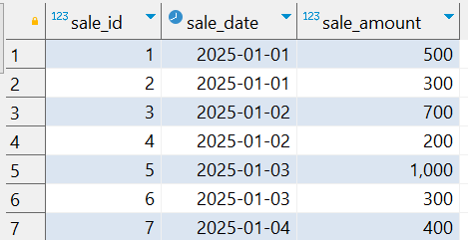
Interview Questions : 3
School of IT
+91 98403 26240
Write a query to calculate the percentage of sales contributed by each day over a given date range. The result should show the date, total sales for that date, and the percentage contribution of each date to the total sales during the period.
Note: Try to solve this problem using Window function
Source Table :school_of_it_2025.sales_interview_question_3

Slide 2
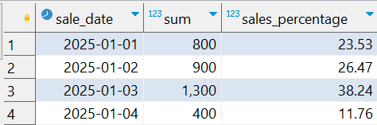
Interview Questions : 3
School of IT
+91 98403 26240
Write a query to calculate the percentage of sales contributed by each day over a given date range. The result should show the date, total sales for that date, and the percentage contribution of each date to the total sales during the period.
Note: Try to solve this problem using Window function
SQL Query
select
sale_date,
sum(sale_amount),
round(
sum(sale_amount)/ sum(
sum(sale_amount)
) over() * 100,
2
) as sales_percentage
from
school_of_it_2025.sales_interview_question_3
group by
sale_date
order by
1;
Answer

