Slide 1




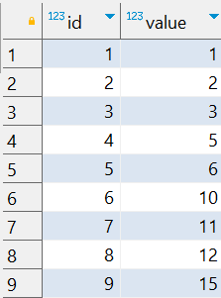

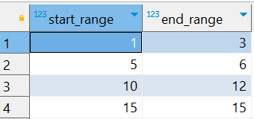
Interview Questions : 4
School of IT
+91 98403 26240
How can I find continuous ranges of numbers in a PostgreSQL table
Source Table :school_of_it_2025.sequence_table
The expected output should group consecutive numbers into ranges

Slide 2
Interview Questions : 4
School of IT
+91 98403 26240
How can I find continuous ranges of numbers in a PostgreSQL table
SQL Query
(SELECT id, value, value - Row_number () OVER( ORDER BY id ) AS _seq_number FROM school_of_it_2025.sequence_table) SELECT Min(value) AS start_range, Max(value) AS end_range FROM _source_data_1 GROUP BY _seq_number ORDER BY _seq_number
Answer

