Slide 1



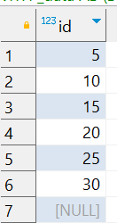


Interview Questions : 7
School of IT
+91 98403 26240
school_of_it_2025.saturday_fun
Based on the table above, answer the question below.
1. Select count(*) from school_of_it_2025.saturday_fun
2. Select count(id) from school_of_it_2025.saturday_fun
3. Select avg(id) from school_of_it_2025.saturday_fun
4. Select id / 5 from school_of_it_2025.saturday_fun
5. Select sum(id)/count(id) from school_of_it_2025.saturday_fun
6. Select sum(id)/ count(*) from school_of_it_2025.saturday_fun

