Slide 1





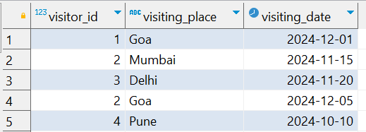
Interview Questions : 2
School of IT
+91 98403 26240
write an SQL query to find the IDs of people who have never visited 'Goa' in their lifetime, based on a visiting table that includes columns visiting_id, visiting_place, and visiting_date?"
Source Table :school_of_it_2025.visiting

Slide 2
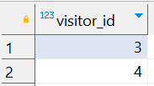
Interview Questions : 2
School of IT
+91 98403 26240
write an SQL query to find the IDs of people who have never visited 'Goa' in their lifetime, based on a visiting table that includes columns visiting_id, visiting_place, and visiting_date?"
SQL Query
select distinct visitor_id
from school_of_it_2025.visiting v1 where not exists
(
select 1 from school_of_it_2025.visiting v2
where v1.visitor_id = v2.visitor_id and v2.visiting_place ='Goa'
)
Answer

