Slide 1



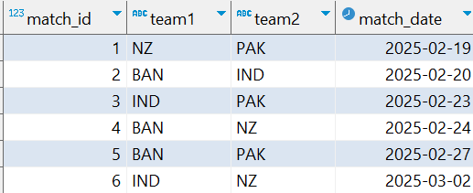


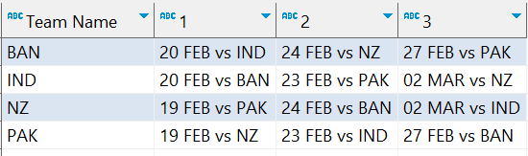
Interview Questions : 9
School of IT
+91 98403 26240
school_of_it_2025. ICC_Champions_Trophy_2025
Question
How can I create a query in PostgreSQL to display a schedule of matches grouped by team, showing each team's matches chronologically across multiple columns? The output should have the team names as rows, and each column should display a formatted string with the match date and opponent (e.g., "20 FEB vs IND"). Here's the input table:
Answer

