Slide 1





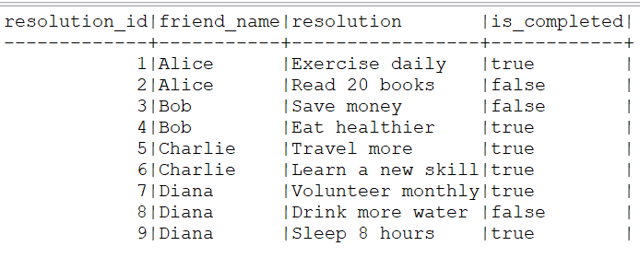
Question No: 10
School of IT
+91 98403 26240
Today's Question:
You are tracking your friends' New Year’s resolution progress. Write a query to calculate the following for each friend: number of resolutions they made, number of resolutions they completed, and success percentage (% of resolutions completed) and a success category based on the success percentage: - Green: If success percentage is greater than 75%. - Yellow: If success percentage is between 50% and 75% (inclusive). - Red: If success percentage is less than 50%.
Source Table :school_of_it_2025.resolutions

Slide 2
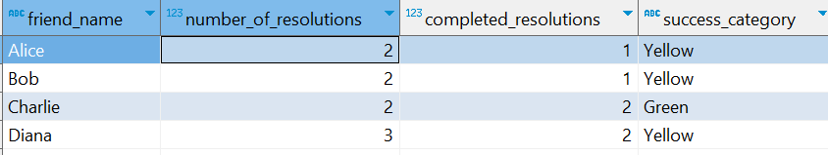
Question No: 10
School of IT
+91 98403 26240
Today's Question:
You are tracking your friends' New Year’s resolution progress. Write a query to calculate the following for each friend: number of resolutions they made, number of resolutions they completed, and success percentage (% of resolutions completed) and a success category based on the success percentage: - Green: If success percentage is greater than 75%. - Yellow: If success percentage is between 50% and 75% (inclusive). - Red: If success percentage is less than 50%.
SQL Query
with _data as (
select
friend_name, COUNT(*) FILTER (WHERE is_completed = TRUE ) AS completed_resolutions, ,count(*) as number_of_resolutions , round( sum( case when is_completed = true then 1 else 0 end ) * 1.0 / count(*), 2 ) * 100 as success_perc from
school_of_it_2025.resolutions
group by friend_name )
select
friend_name, completed_resolutions, number_of_resolutions ,
case when success_perc > 75 then 'Green' when success_perc between 50
and 70 then 'Yellow' else 'Red' end as success_category
from
_data
Answer

