Slide 1





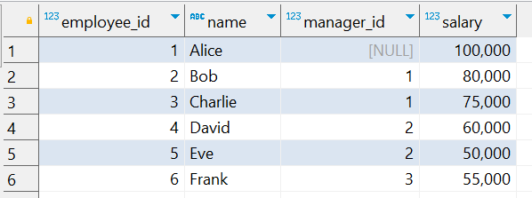
Interview Questions : 1
School of IT
+91 98403 26240
Each employee (except the CEO) reports to a manager, and the CEO's manager_id is NULL. Write a query to calculate:
1 ) The total salary paid under each employee (including their own salary and all the salaries of their subordinates, directly or indirectly).
2) The result should include all employees, sorted by employee_id
Source Table :school_of_it_2025.employee_tiger_q_1

Slide 2

Question No: 22
School of IT
+91 98403 26240
Today's Question:
We are hosting a gift party and need to ensure every guest receives a gift. Using the guests and guest_gifts tables, write a query to identify the guest(s) who have not been assigned a gift (i.e. they are not listed in the guest_gifts table).
SQL Query
select
guest_name
from
school_of_it_2025.guests g
left join school_of_it_2025.guest_gifts gg
on g.guest_id= gg.guest_id
where gift_name is null;
Answer

