Slide 1




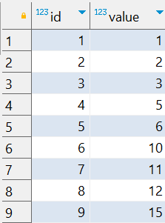

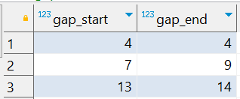
Interview Questions : 5
School of IT
+91 98403 26240
How can I find missing ranges (gaps) between consecutive numbers in a PostgreSQL table?
Source Table :school_of_it_2025.sequence_table
The expected output should be

Slide 2
Interview Questions : 5
School of IT
+91 98403 26240
How can I find missing ranges (gaps) between consecutive numbers in a PostgreSQL table?
SQL Query
WITH gaps AS (
SELECT
value AS start_value,
LEAD(value) OVER (ORDER BY value) AS next_value
FROM school_of_it_2025.sequence_table
)
SELECT
start_value + 1 AS gap_start,
next_value - 1 AS gap_end
FROM gaps
WHERE next_value - start_value > 1;
Answer

