Slide 1



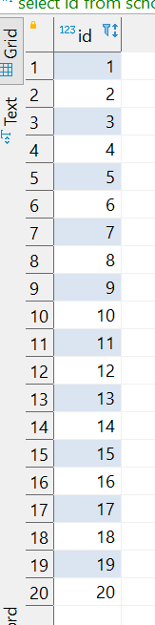
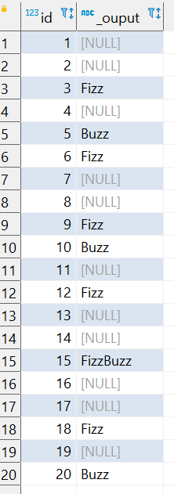
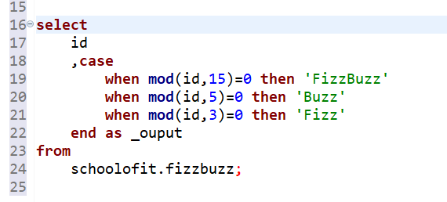
Question No: 43
School of IT
+91 98403 26240
Problem statement: Add another column Output and show Fizz, Buzz and FizzBuzz based on
Below conditions.
if Number is divide by 3 then ‘Fizz’ , Number is divide by ‘5’ then ‘Buzz’,
Number is divide by 3 and 5 then FizzBuzz
Source Table
Expected Output :
ANSWER

