Slide 1




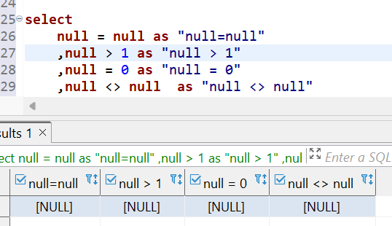
Question No: 56
Series – 1 Episode - 2
School of IT
+91 98403 26240
Problem statement: Understanding NULL
NULL with Comparison
The known Unknown
3 valued logic
True
False
Unknown
The result of following comparisons are UNKNOWN
Comparison | Result
NULL = NULL | Unknown
NULL =0 | Unknown
NULL <> 0 | Unknown
NULL >0 or NULL < 0 | Unknown

