Slide 1
Softmax:
Multinomial logistic regression.
Sigmoid → Softmax
For each output/category, we compute a weighted sum of the x’s, add a bias, and then apply softmax.
Softmax is defined as = Picking out the max probability

Slide 2
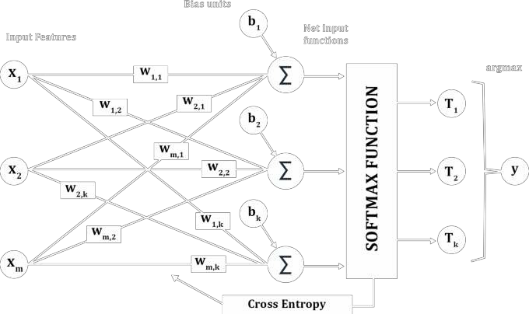
Working of Softmax:

Slide 3
Softmax to Neural Networks:
Neural networks can be considered as a network of multiple logistic regression computations stacked in parallel and in series to each other.
Softmax is applied to the last layer in neural networks.
You will understand these points as we go forward.

Slide 4
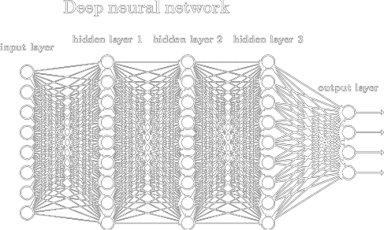
Structure of Artificial Neural Networks:
Input, output and hidden layers.
The layers are arranged sequentially and each layer is made of multiple neurons.
Input layer number of neurons = length of input vector
Output layer number of neurons
= number of classes in the
dependent or target variable.

Slide 5
Assumptions, Parameters and Hyperparameters
Neurons within a layer do not interact with each other.
The layers are densely connected.
For every neuron there is a bias and for every interaction there is a weight.
The parameters are the weights and biases of the network which are to be found.

Slide 6
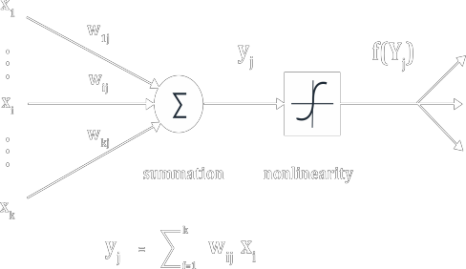
Working of a Neuron:
The input to a neuron is the weighted sum of inputs + bias.
Activation function is used to introduce non-linearity in the network.
If the output is greater than a threshold, the neuron will fire, otherwise not.

Slide 7
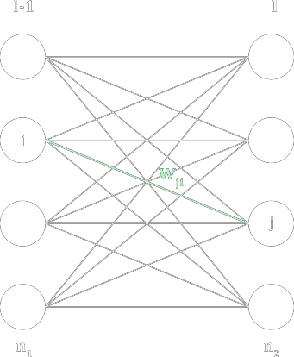
Message passing in NN’s
Consider 2 hidden layers ‘l-1’ and ‘l’.
Total number of interconnections would be (n₁ x n₂). Output of layer ‘l-1’ is a_{l-1} = (a_{l-1 1}, a_{l-1 2}, ….., a_{l-1 n1})
The output of layer l-1 will be the input to layer l.
The input of layer l will be w.a_{l-1}, total number of pixels
Output of layer l is activation applied to the input to layer l.

Slide 8
Activation Functions:
Activation functions are used to introduce non linearity in the network.
It makes neural networks more compact.
Due to this nonlinearity neural networks can approximate any measurable
function.
Activation functions should be smooth.

Slide 9
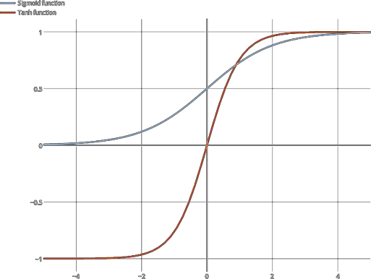
Activation Functions:
Sigmoid = 1/ 1 + e^{-x}
RELU = max(0,z)

Slide 10
Transfer Learning:
Transfer learning is the process of taking a pre-trained model whose weights and parameters have been trained on a large dataset, and fine-tune it according to your own data.
You remove the last layer of the network and replace it with you own classifier; and keep the weights and biases of the rest of the network constant.
The idea is that the pre-trained model will act as a feature extractor.

