Slide 1

AI SNAP

Slide 2
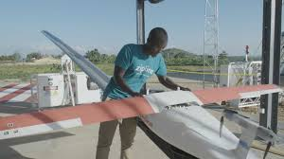
Losing His Whole Family In A Brutal Massacre, This Rwandan Is Now Saving Thousands Of Lives With Drones Abdul Salam Nizeyimana launches drones that carry blood to doctors making efforts to save patients who are in critical condition. He works for a US based startup Zipline, which runs a drone facility located due west from Kigali, the Rwandan capital.

Slide 3
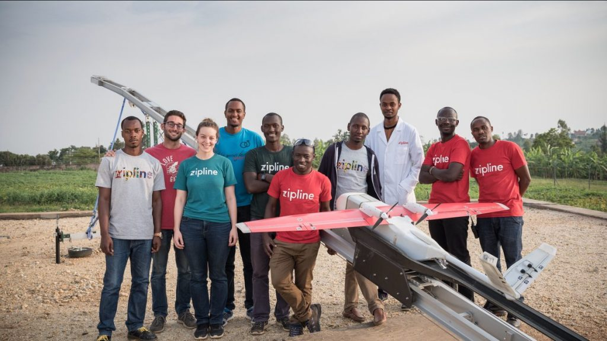
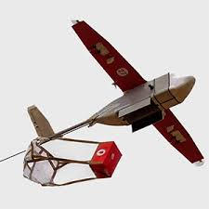
On a good day, if a hospital in Rwanda is low in blood it takes 8hrs to get the blood which leads to loss of many lives. Nizeyimana helps people in remote areas access the vital fluid. Once the request comes in they get moving. In this process, a package is loaded onto a hatch which is fastened with drone’s flying mechanism . This vehicle is driven by GPS and other sensors. Once destination reaches, it drops payload and heads back to base while a hospital staff retrieves the package.

Slide 4
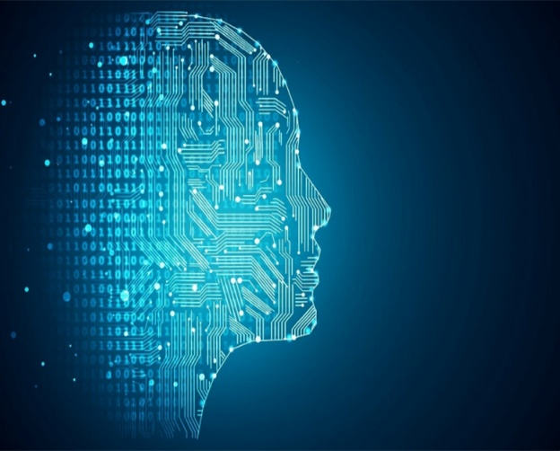
BUDGET 2019: Government announces National Artificial Intelligence Centre, National AI Portal.
Finance Minister, PIYUSH GOYAL in his budget speech 2019 announced that a national AI portal will be developed by the government to improve the benefit from new age technologies.
He also announced that a National Centre for AI is under consideration.

Slide 5
Creating AI portal will help the nation to create more jobs as AI , Machine Learning, Robotics and the integration of ML with Biological sciences where the graduates can play important role in future.
With US and China leading the AI race, India is lagging behind when it comes to both data and availability of skilled professionals who can handle data.
India primarily has startups that are developers of AI. Most of the support to develop this sector comes from government.
Hopefully the interim budget will focus on allocating a large amount of money dedicated for the development of AI in India.

Slide 6
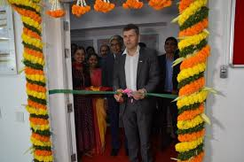
Bosch to invest Rs 20 crore in Artificial intelligence centre at IIT Madras Global technology and service provider Bosch group on Feb 6 inaugurated Robert Bosch centre for AI and Data Science (RBC-DSAI) Centre will undertake foundational research in many areas of AI and data science.

Slide 7
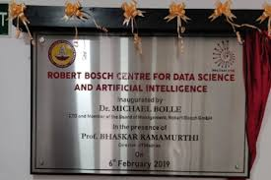
Mission is to create societal impact through multidisciplinary interactions with the government, academic , research and industrial collaborators on core challenges in data science and AI

Slide 8

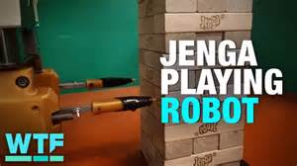
JENGA PLAYING ROBOT
Developed by MIT Researchers.
Equipped with a soft-pronged gripper, a force- sensing wrist cuff, and an external camera.
Jenga-IT has 54 blocks. Each block is removed and kept at the top of the tower. Whoever topples the tower by taking out a block first loses the game.
Snaps

Slide 9
It uses machine learning. The camera collects visual and tactile feedback and learns from it and move accordingly.
It requires not only cognitive skills but also physical skills.
In future researchers hope to use it to separating recyclable objects from landfill trash and in assembly lines like cell phones etc.
Snaps

