Slide 1


Slide 2
WHAT IS SCHOOL OF AI ?
An international school dedicated to studying, teaching, and creating Artificial Intelligence to help solve the world’s most difficult problems.

Slide 3
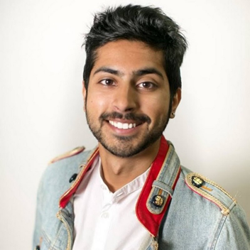
Who is the Director?
Siraj Raval - He lives to serve all Wizards [the shared moniker of the community].Inspiring, educating, and guiding them along their journey to help them maximize their positive impact in the world using AI technology.

Slide 4
SCHOOL OF AI - INTRODUCTION

Slide 5


Who are Deans?
Deans are guardians of our mission - “To offer a world-class AI education to anyone on Earth for free. Our doors are open to all those who wish to learn. We are a learning community that spans almost every country dedicated to teaching our students how to make a positive impact in the world using AI technology,whether that's through employment or entrepreneurship”

Slide 6
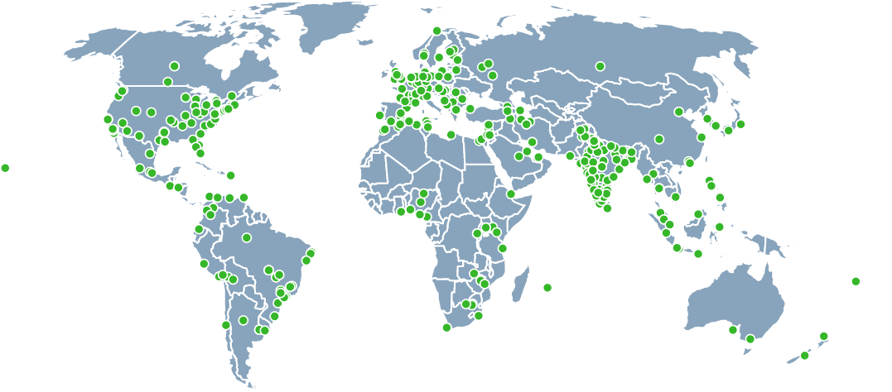
SCHOOL OF AI CITIES

Slide 7
Our Core Values
Embrace the Weird (We celebrate radically new ways of thinking. The unusual excites us.)
Inspire and Educate (When we influence others, we make sure it inspires & educates them in someway).
Data Driven Optimism (We’re optimistic people that use data to verify our beliefs.)
Rapid Experimentation (We try to fail fast so we can improve the next iteration)
Be Frugal (We find clever ways to support ourselves and grow our community, grassroots style)
Choose Love, not Fear (We try our best to make all of our decisions based on love for ourselves and others)
Draw the Owl (We’re not always given instructions. So we take ownership and figure them out ourselves)

Slide 8
What we host ?
Class - A School of AI class involves up to 3 speakers educating an audience on a particular AI topic(library, algorithm, concept, ethics, etc.)
Study Group - A School of AI Study Group involves having an engaging group conversation on a particular AI research paper.These are open-ended sessions that involve asking any questions you have about the paper and discussing the merits of different algorithmic approaches.
Hands-on Workshops - A hands-on workshop involves coding. Students are asked to bring their laptops as they will be following along as the presenter guides them through a particular application of AI.
Hackathon - Hackathons are events that are up to 24 hours in length that involve students creating an AI application that relates to a specific topic. These topics can be as open-ended (Code an AI app!) or specific (Use PyTorch to create a price prediction app).

Slide 9

Our hosting partner :

Slide 10
How can you involve in School of AI ?
Volunteering.
Active Participation.
Learn and Teach.
Sponsorship.

Slide 11
Let's dive in...

