Slide 1
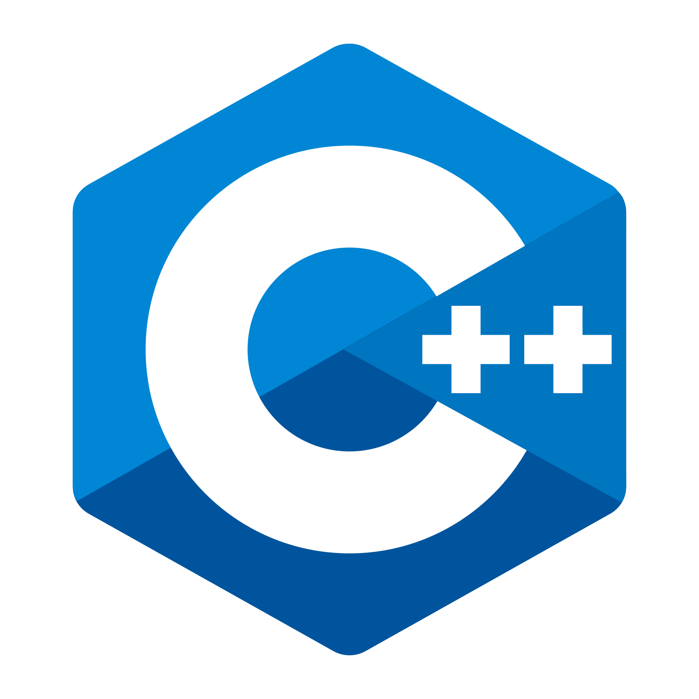
`
`
C++ in detail: common idioms

Slide 2
Why learning idioms?
Idiom is a way to solve some recurring problem in a programming language.
Thus, learning idioms helps better understand the language.

Slide 3
Curriculum
This course is about common (not all of them) C++ idioms that are related:
- types system
- polymorphism
- dependencies
- templates
- resource management
- optimization

Slide 4
Prerequisites
- At least basic knowledge of C++ (this course is not for complete beginners)
- Compiler supporting at least C++11

Slide 5
See you in the course!

