Slide 1
Dependency Inversion Principle
Basic idea
As expressed by Robert C. Martin:
- High-level modules should not depend on low-level modules. Both should depend on abstractions.
- Abstractions should not depend upon details. Details should depend upon abstractions.
Simply put, this means that we depend on and program to abstractions instead of concrete implementations.

Slide 2
Dependency Inversion Principle
Some terminology
Usually, we refer to a client class, which uses some other service class or interface, as a policy / high level class.
While service class is of low level, it contains some mechanism / implementation details needed for the client class.
In OOP, abstraction is something that shows only the most essential attributes, the truths that do not vary when its details change, and hides unnecessarily implementation details.
Good abstractions change rarely while implementation details change frequently. Thus, it’s better to depend on abstractions.

Slide 3
Dependency Inversion Principle
Layered design
In procedural programming, policies (high level modules) depend on implementation details (low level modules).
In OOP, however, we invert that dependency such that both details and policies depend on abstractions; then abstractions (service interfaces) are usually owned by their clients or kept in their own packages.
This implies that our application has clearly defined layers where changes to lower layers (implementation details) do not impact higher levels.

Slide 4
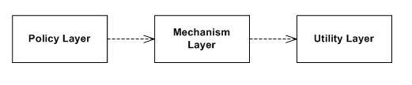
Dependency Inversion Principle
By Klodr - Own work, CC BY-SA 4.0, https://commons.wikimedia.org/w/index.php?curid=37915253

Slide 5
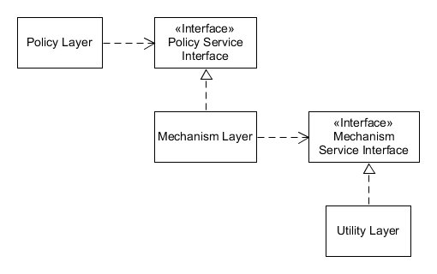
Dependency Inversion Principle
By Klodr - Own work, CC BY-SA 4.0, https://commons.wikimedia.org/w/index.php?curid=37915253

Slide 6
Dependency Inversion Principle
Violating the principle
When high level modules/classes depend on low level modules/classes
High level modules/classes are coupled to implementation details and are impacted by changes to implementation details
High level models/classes are recompiled, and maybe also changed, when implementation details change
High level modules/classes are harder to maintain, reuse and test (hard to isolate from dependencies)

Slide 7
Dependency Inversion Principle
Complying with the principle
When modules/classes depend on abstractions instead of implementation details
They are easier to maintain, reuse and test (mocks, stubs, etc.)
They are loosely coupled
Clients are changed, rebuilt, retested and redeployed less often
It allows to make good frameworks (e.g., Qt)

Slide 8
Dependency Inversion Principle
How to follow (part 1)
Think in terms of layers: policy layer, mechanism layer, utilities layer
Determine abstractions, something that remains true regardless of how we implement it (e.g., storage – local file, DB, remote using AWS, etc.)
Depend on abstractions instead of implementation details / concrete classes (use references to abstract base classes, don’t inherit from concrete class, don’t override implemented methods) if such classes are volatile, that is, they are going to change often.
For abstractions use dynamic polymorphism with inheritance and/or static polymorphism with templates.*
* Some interesting answers https://stackoverflow.com/questions/43576556/dependency-inversion-from-s-o-l-i-d-principles-in-c

Slide 9
Dependency Inversion Principle
How to follow (part 2)
Interfaces (abstractions) are usually distributed with clients who own and depend on them, and not with the classes that implement them (i.e., interface file is in the same library/package as is the client). If many clients depend on the same interface, it goes not with a client but stands alone in some separate library/package, which allows greater re-usability of such interfaces.
Use dependency injection (separates the creation of a client's dependencies from the client's behavior) and factories (see more in creational patterns).
According to dependency injection, client depends on services but does not create them – some other non-client code passes services to the client (we call this “injector”), the client only has to know the interfaces. Basically, the same as parameter passing but with clear intent to decouple.
Dependency injection frameworks, such as https://github.com/google/fruit or https://github.com/boost-ext/di, are rather for large complex projects.

Slide 10
Dependency Inversion Principle
Nota bene
There is no free lunch – abstractions increase code complexity.
Excessive abstractions (premature abstractization) can do more harm then good.
Replace concrete classes by abstractions only where such classes are volatile, that is, they change often (usually our application code and not standard or third party libraries).
Do not apply DIP to classes that do not or are not likely to change often.
Mocks are often implemented via inheritance. It may happen that the only other implementations of our interfaces are mocks. Try not to add abstractions only because it will allow to use mocks and test classes easier.
In real-life projects good abstractions / interfaces are rather hard to define.

