Slide 1
The Economics of Privacy: Classical and Behavioral Insights
An incomplete overview in silly examples

Slide 2
Right to Privacy
European Convention on Human Rights (Art. 8)
US: derived from 4th amendment

Slide 3
Your opinion
“Right to privacy (and its enforcement by state authorities) is...
  ...good and important
  ...less important
  ...bad.”

Slide 4
Privacy: An economist's vague definition
For today:
Privacy = Only you know what...
    ...you want or
    ...you did or
    ...happened to you.

Slide 5




Privacy is inefficient
Job interview for air traffic controller:
  Extensive on the job training needed
  2 Applicants:
  What do you want to ask our applicants but cannot?
Privacy = asymmetric information = inefficient
Posner AER P&P 1981

Slide 6


Privacy and Reputation
Alcoholic has to decide whether to seek counselling
  Decision private vs public
Donations for local school
  Private vs public
Lesson:
  With reputation effects privacy is sometimes good.
Daughety and Reinganum AEJ: Micro 2010

Slide 7


Repeat purchases and Data Privacy
Should you buy an S class Mercedes?
  Customer database makes demand more elastic
  No data →less elastic demand→higher prices
Consumers are naive
  Ripoff
Lesson:
  Privacy regulation can be beneficial if consumers are naive and detrimental if they are not.
Acquisti and Varian Marketing Sci. 2005, Taylor RAND 2004

Slide 8
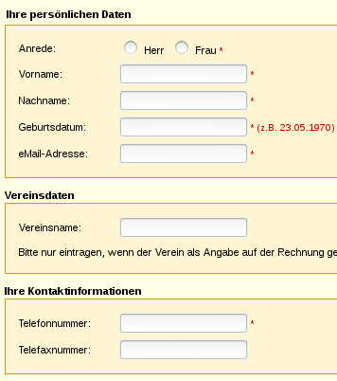
Cost-Benefit Structure and Privacy on the www
When ordering a book recently:
Time structure of benefits/risks
Acquisti and Grossklags 2007

Slide 9

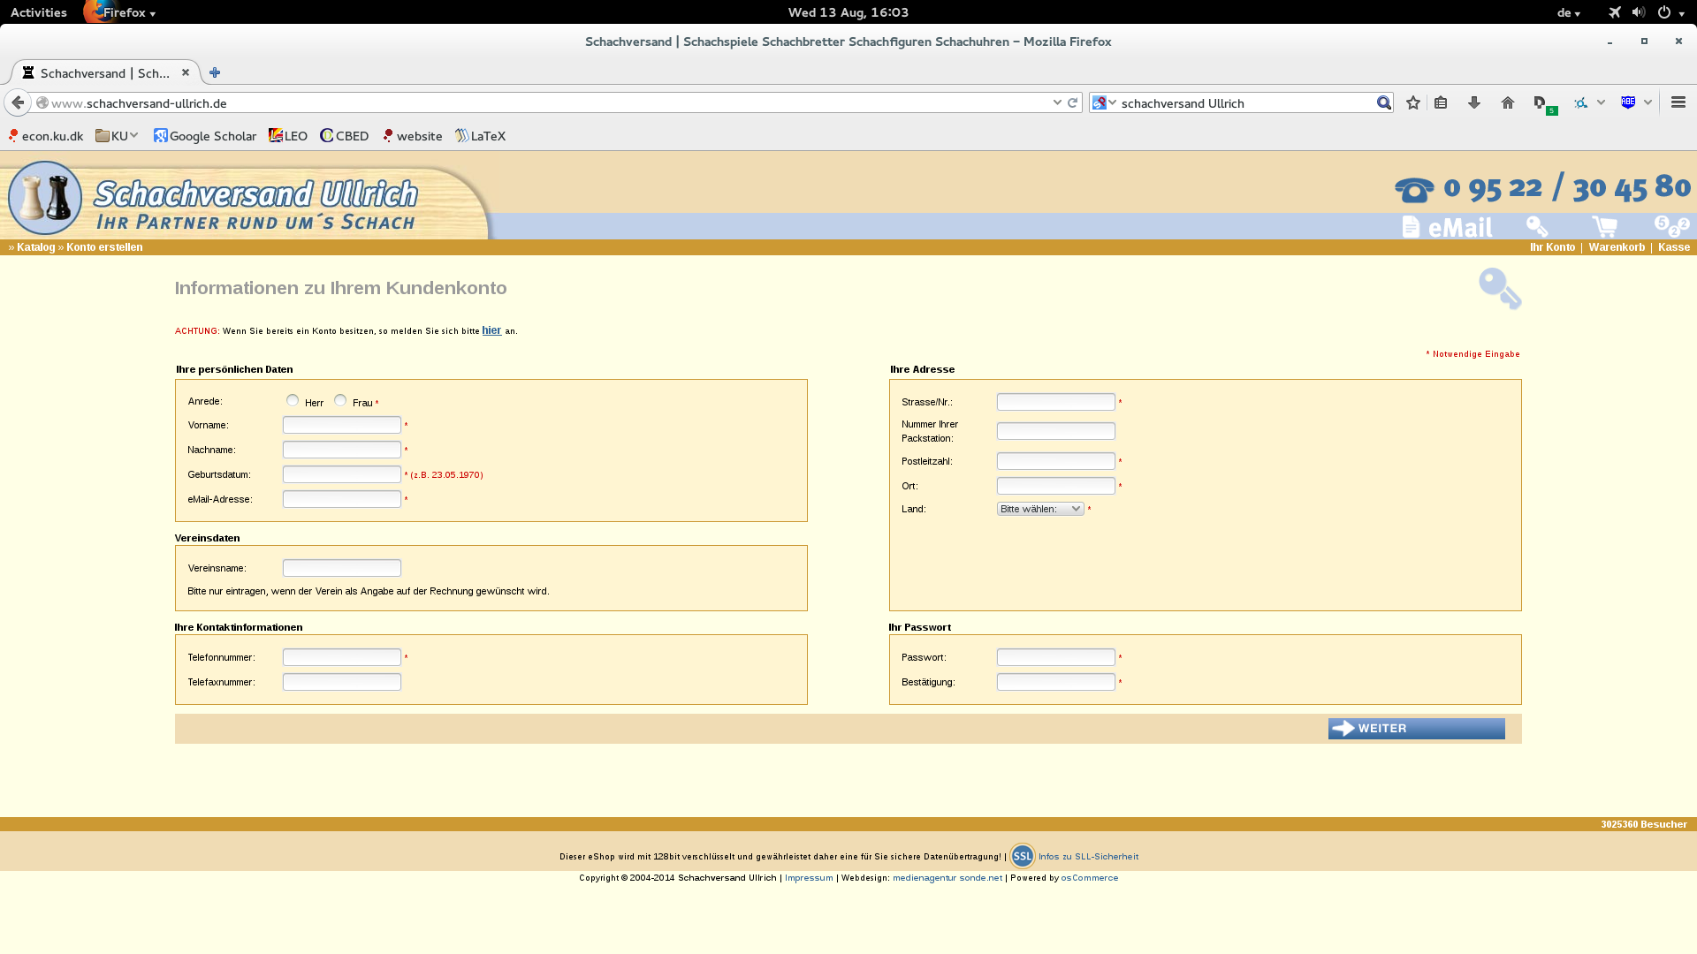
One Question for YOU
Who learned a new argument/view/idea during this talk?

Slide 10
Conclusion 0
Literature states only the obvious
Paradigm shift required if any future use

Slide 11
Back to: Your opinion
“Right to privacy (and its enforcement by state authorities) is...
  ...good and important
  ...less important
  ...bad.”
Who changed his/her opinion?

Slide 12
Conclusion 1
Economics contributes greatly to understanding privacy
More research on economics of privacy to come
  Agency problems in data holding entities
  Privacy and consumer behavior
  Privacy in networks
  Value of privacy
  Privacy regulation and innovation
  ....

Slide 13
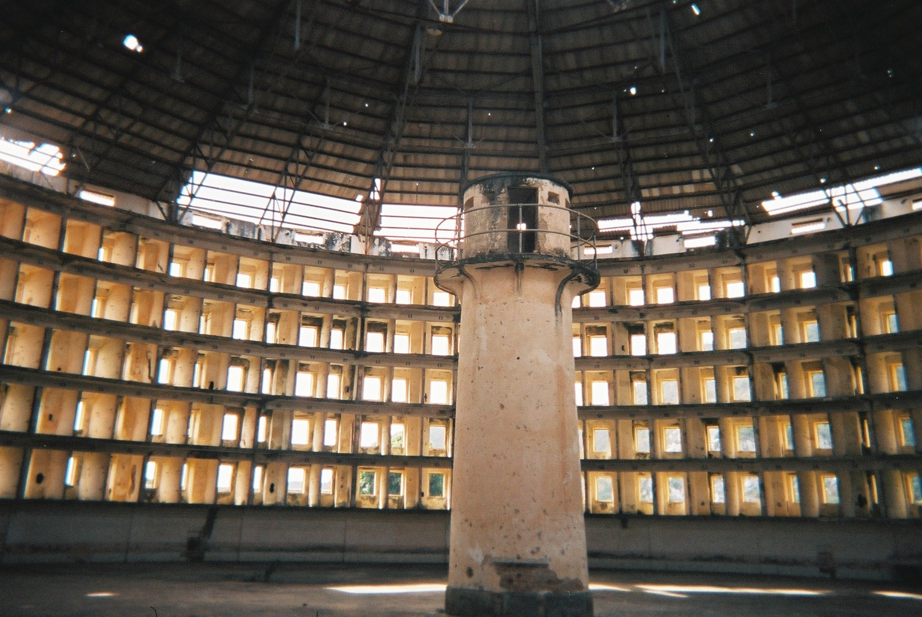
Conclusion 2
Are economists missing the point?
  Narrow focus on private information
  If you have a hammer, every problem looks like a nail.
  “Right to be left alone.”
  Power and Democracy
  Problem of Regulation vs.
  Problem of Legislation?
  Bentham's panopticon
  “a new mode of obtaining power of
  mind over mind, in a quantity hitherto
  without example.”

Slide 14

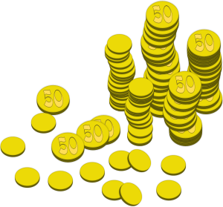


Privacy and Price
Discrimination
Airfare is lower if you stay over weekend
  business travellers
  Leisure travellers
Lesson:
  Privacy is inefficient
  Privacy can even harm (some) consumers
Compare: Taylor and Wagman IJIO 2014

