Slide 1
NTU SC6113 · GROUP PROJECT DEMO
Supply Chain Finance DApp
Receivables on-chain · splittable & transferable tokens · duplicate financing blocked by design
Stack: Solidity (ERC-1155 / ERC-20) · Python Flask · Ethers.js / MetaMask
Deployment: Ethereum Sepolia testnet · Render cloud
SC6113 Group Project · Oct 2026 · Demo storyline: invoice upload -> confirmation -> financing -> funding -> repayment -> redemption

Slide 2
01 · BACKGROUND & PROBLEM
SMEs wait months to get paid, and core-enterprise credit never reaches them
01
Slow payments lock up cash flow
Product Goals (PRD 1.2)
After delivering goods to a core enterprise, SMEs wait months for payment and lack short-term liquidity.
Fast funding — suppliers receive bank funding within minutes of on-chain invoice confirmation
Duplicate-proof financing — each invoice can be registered and financed exactly once; duplicates are rejected
Splittable, transferable credit — receivable tokens split into shares and flow downstream
Full audit trail — every key action is recorded on-chain; auditors trace and freeze suspicious tokens anytime
02
Invoices cannot be verified across institutions
The same invoice can be financed at multiple banks, and institutions do not share their data.
03
Core-enterprise credit stops downstream
Tier-2 and tier-3 suppliers have no direct contract with the core enterprise and cannot borrow its credit.
SC6113 · Supply Chain Finance DApp
02

Slide 3
02 · SOLUTION OVERVIEW
Confirmed receivables become splittable, financeable digital tokens
Demo storyline (PRD Sec.3) — every step is an on-chain transaction; PDFs and hashes stay off-chain
Upload Invoice
CE Confirms
Token Minted
Split / Finance
Quote · Fund
Repay
Redeem
Five roles, one chain
Supplier uploads invoices, splits & transfers, requests financing Core Enterprise confirms invoices, repays at maturity
Financier quotes & funds, marks overdue Auditor traces provenance, freezes tokens Admin reviews onboarding, emergency pause
5
role permissions
20
on-chain tx types
26
features
5
smart contracts
19
frontend pages
7
database tables
SC6113 · Supply Chain Finance DApp
03

Slide 4
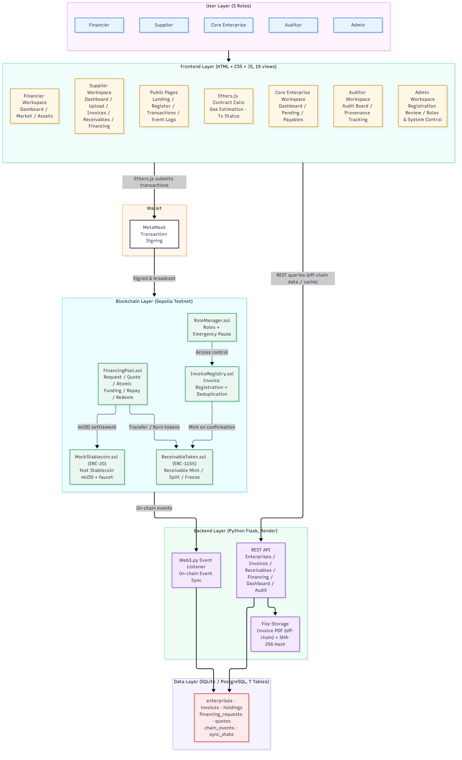
03 · SYSTEM ARCHITECTURE
On-chain holds money & tokens; off-chain holds files & queries
The frontend never routes transactions through the backend — users sign directly against Sepolia contracts via MetaMask; the backend never touches private keys.
Invoice PDFs off-chain, hashes on-chain — anyone can verify the file is untampered before confirming, balancing evidence with gas cost.
A Web3.py event listener syncs continuously — TransferSingle and other events land in 7 business tables powering dashboards and audit queries.
Five interconnected contracts meet the course requirement; Flask is hosted on Render.
Source: docs/design-EN/diagrams/01-system-architecture.mmd
SC6113 · Supply Chain Finance DApp
04

Slide 5
04 · SMART CONTRACT DESIGN
Five contracts with clear duties; RoleManager owns access and the pause switch
RoleManager.sol | Grants & revokes the five roles (Supplier / Core Enterprise / Financier / Auditor / Admin); global emergency pause
InvoiceRegistry.sol | Invoice registration with dedup keys; on confirmation it mints the equal-value receivable; rejection releases the dedup key
ReceivableToken.sol | ERC-1155 receivable tokens - splittable transfers, auditor freeze/unfreeze; mintable only by Registry, burnable only by the Pool
FinancingPool.sol | Financing requests (token escrow), quote locking, atomic settlement, repayment pool, redemption and overdue marking
MockStablecoin.sol | ERC-20 test stablecoin mUSD with a faucet for demos
Security baseline | nonReentrant on all value movers + checks-effects-interactions; Slither reports zero high/medium issues
While paused: admin role operations and auditor freeze/unfreeze still work (emergency response); all other writes are rejected; reads are unaffected.
Contract interactions on the next page; ABIs and query functions in contracts/abi and contracts/docs/interface.md.
SC6113 · Supply Chain Finance DApp
05

Slide 6
05 · CORE MECHANISM
Duplicate financing blocked by three gates: dedup, escrow, transfer lock
Gate 1
Registration dedup · InvoiceRegistry
Gate 2
Escrow lock · FinancingPool
Gate 3
Transfer lock · ReceivableToken
The contract derives a dedup key from "invoice no. + buyer + seller + amount". Resubmitting the same combo reverts with InvoiceAlreadyExists — the tx never lands.
Requesting financing escrows the token into the pool, so the same shares cannot back two open requests — double pledging is physically impossible.
Tokens acquired by financiers can no longer be transferred — only held to redemption, ruling out multi-layer resale of one token.
Precision matters: a rejected invoice releases its dedup key so the supplier can fix and resubmit; overdue items can still be repaid, moving Overdue back to Repaid.
SC6113 · Supply Chain Finance DApp
06

Slide 7
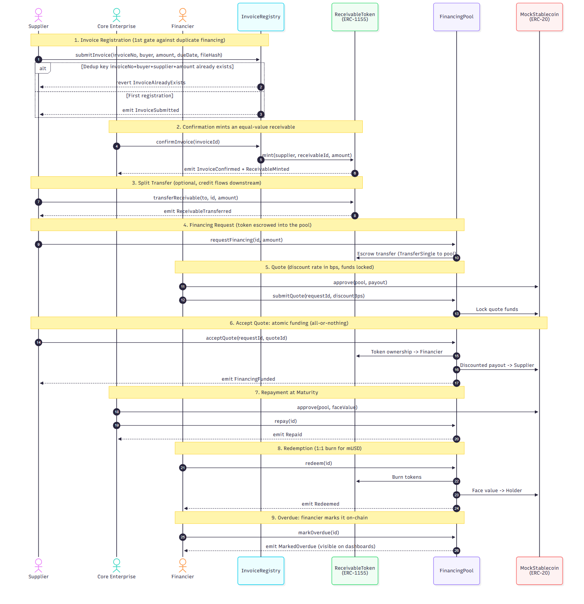
06 · CONTRACT INTERACTION
The full on-chain sequence, from registration to redemption
Confirmation is settlement — confirmInvoice emits InvoiceConfirmed and ReceivableMinted in one tx; the token lands in the supplier's wallet.
Funding is atomic — acceptQuote moves "token to financier + mUSD to supplier" in a single transaction; any failure rolls back everything.
Quotes lock funds first — submitQuote requires the financier to approve and lock mUSD, so acceptance never fails on insufficient balance.
SC6113 · Supply Chain Finance DApp
07

Slide 8
07 · BUSINESS FLOW
One main line, four recoverable branches
STEP 1 · SUPPLIER
Upload invoice
PDF off-chain, hash on-chain; dedup blocks duplicates
STEP 2 · CORE ENTERPRISE
Confirm invoice
Verify PDF & hash; confirm mints the token
STEP 3 · SUPPLIER
Split / finance
Split shares to transfer; financing escrows the token
STEP 4 · FINANCIER
Quote & fund
Discount quotes lock funds; acceptance funds atomically
STEP 5 · CORE ENTERPRISE
Repay into pool
Full face value paid into FinancingPool
STEP 6 · HOLDER
Redeem & close
Burn token, receive mUSD 1:1
Branches & exception paths (on-chain)
Reject invoice — reason required; dedup key released for resubmission
Cancel request — possible before acceptance; token returned
Overdue — financier marks it; payment still accepted afterwards
Auditor freeze — anytime; frozen blocks transfer, financing, redemption
The demo video follows Steps 1-6; full branches in docs/design-EN/diagrams/04-business-flow.mmd (including the auditor's freeze side-path).
SC6113 · Supply Chain Finance DApp
08

Slide 9
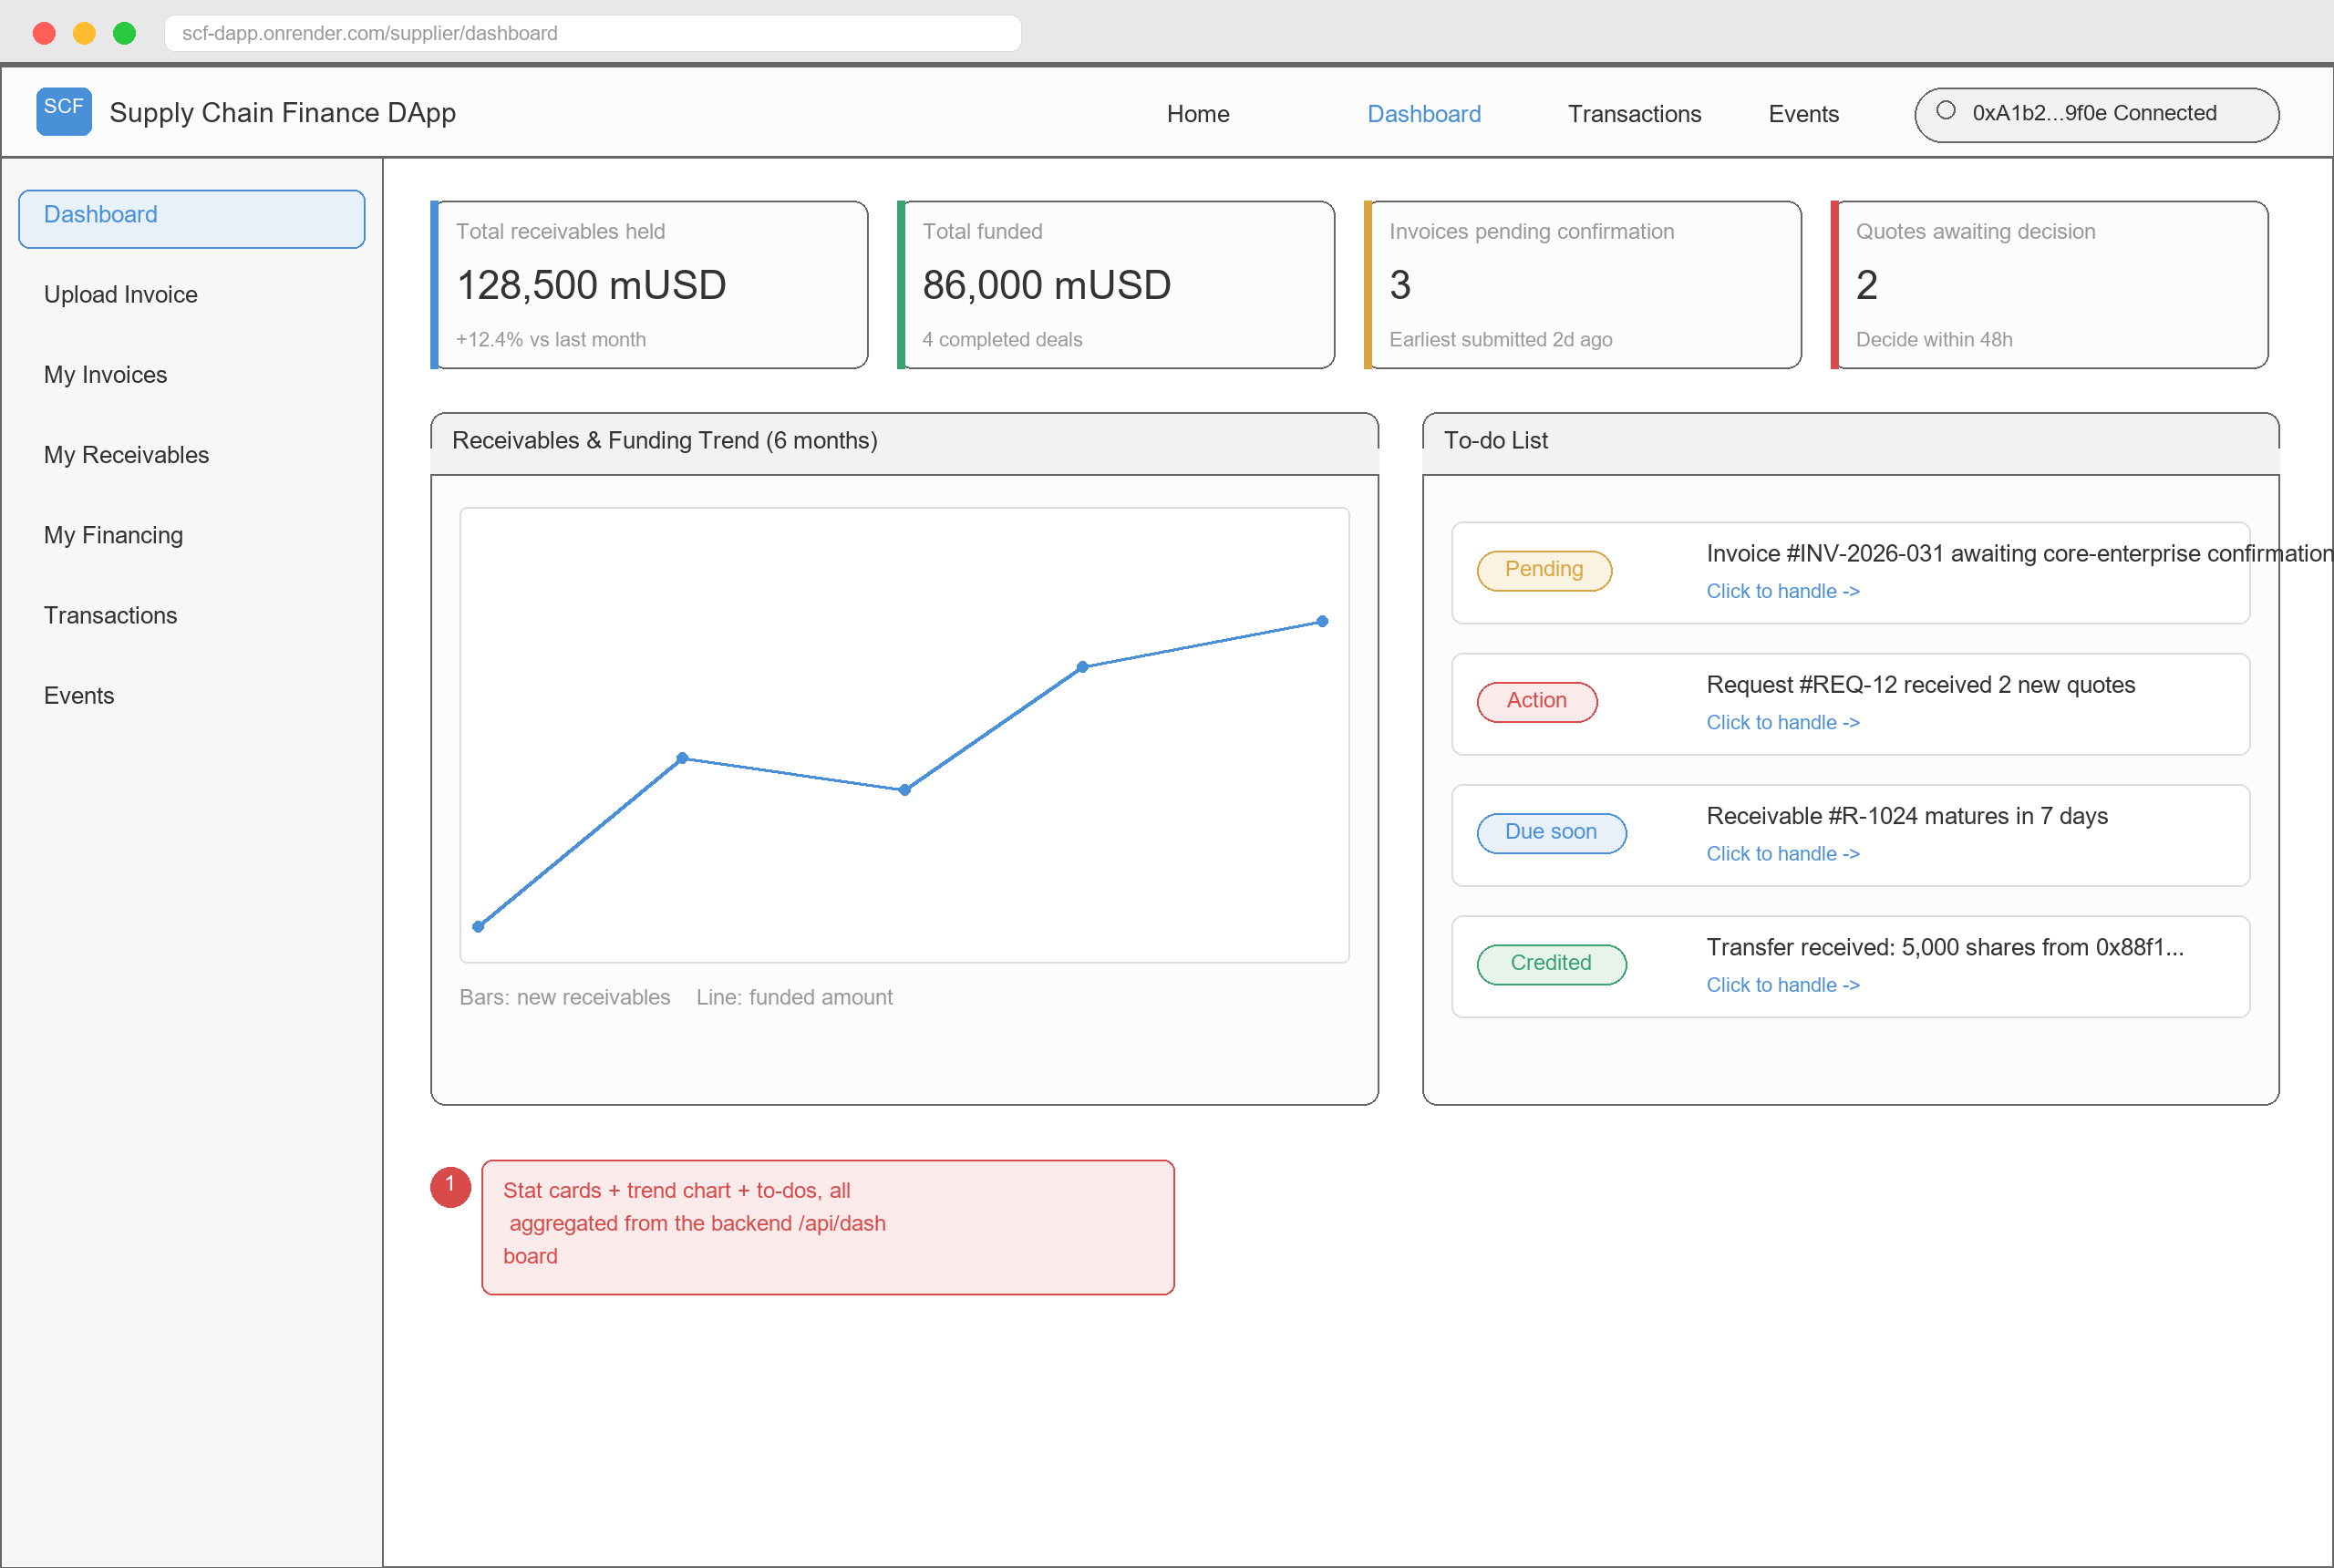
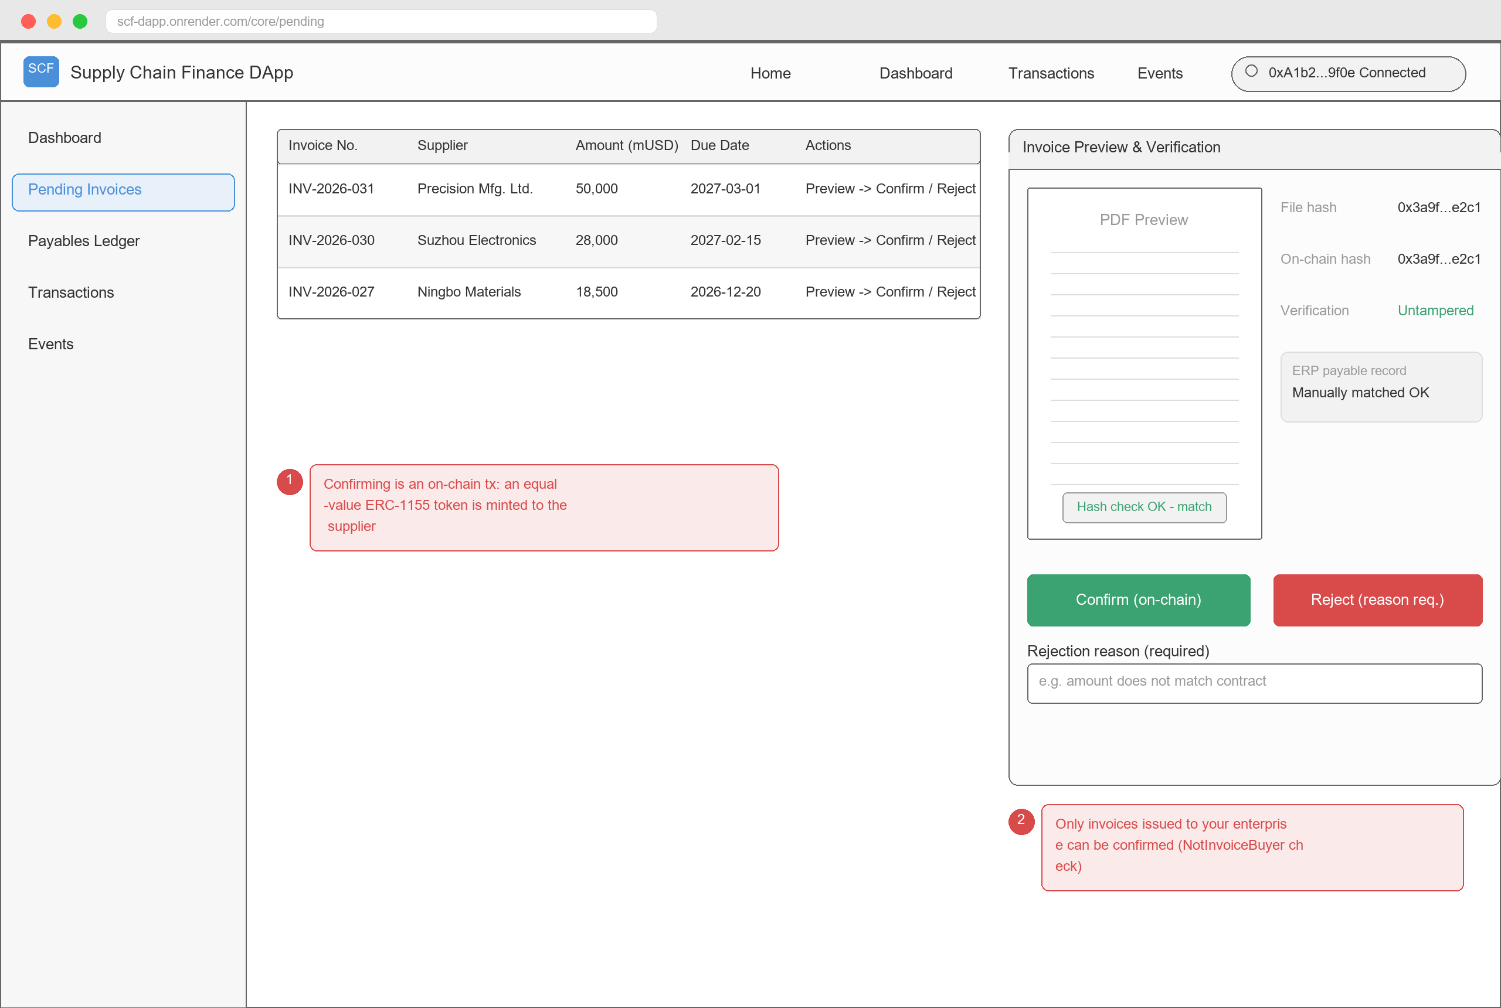
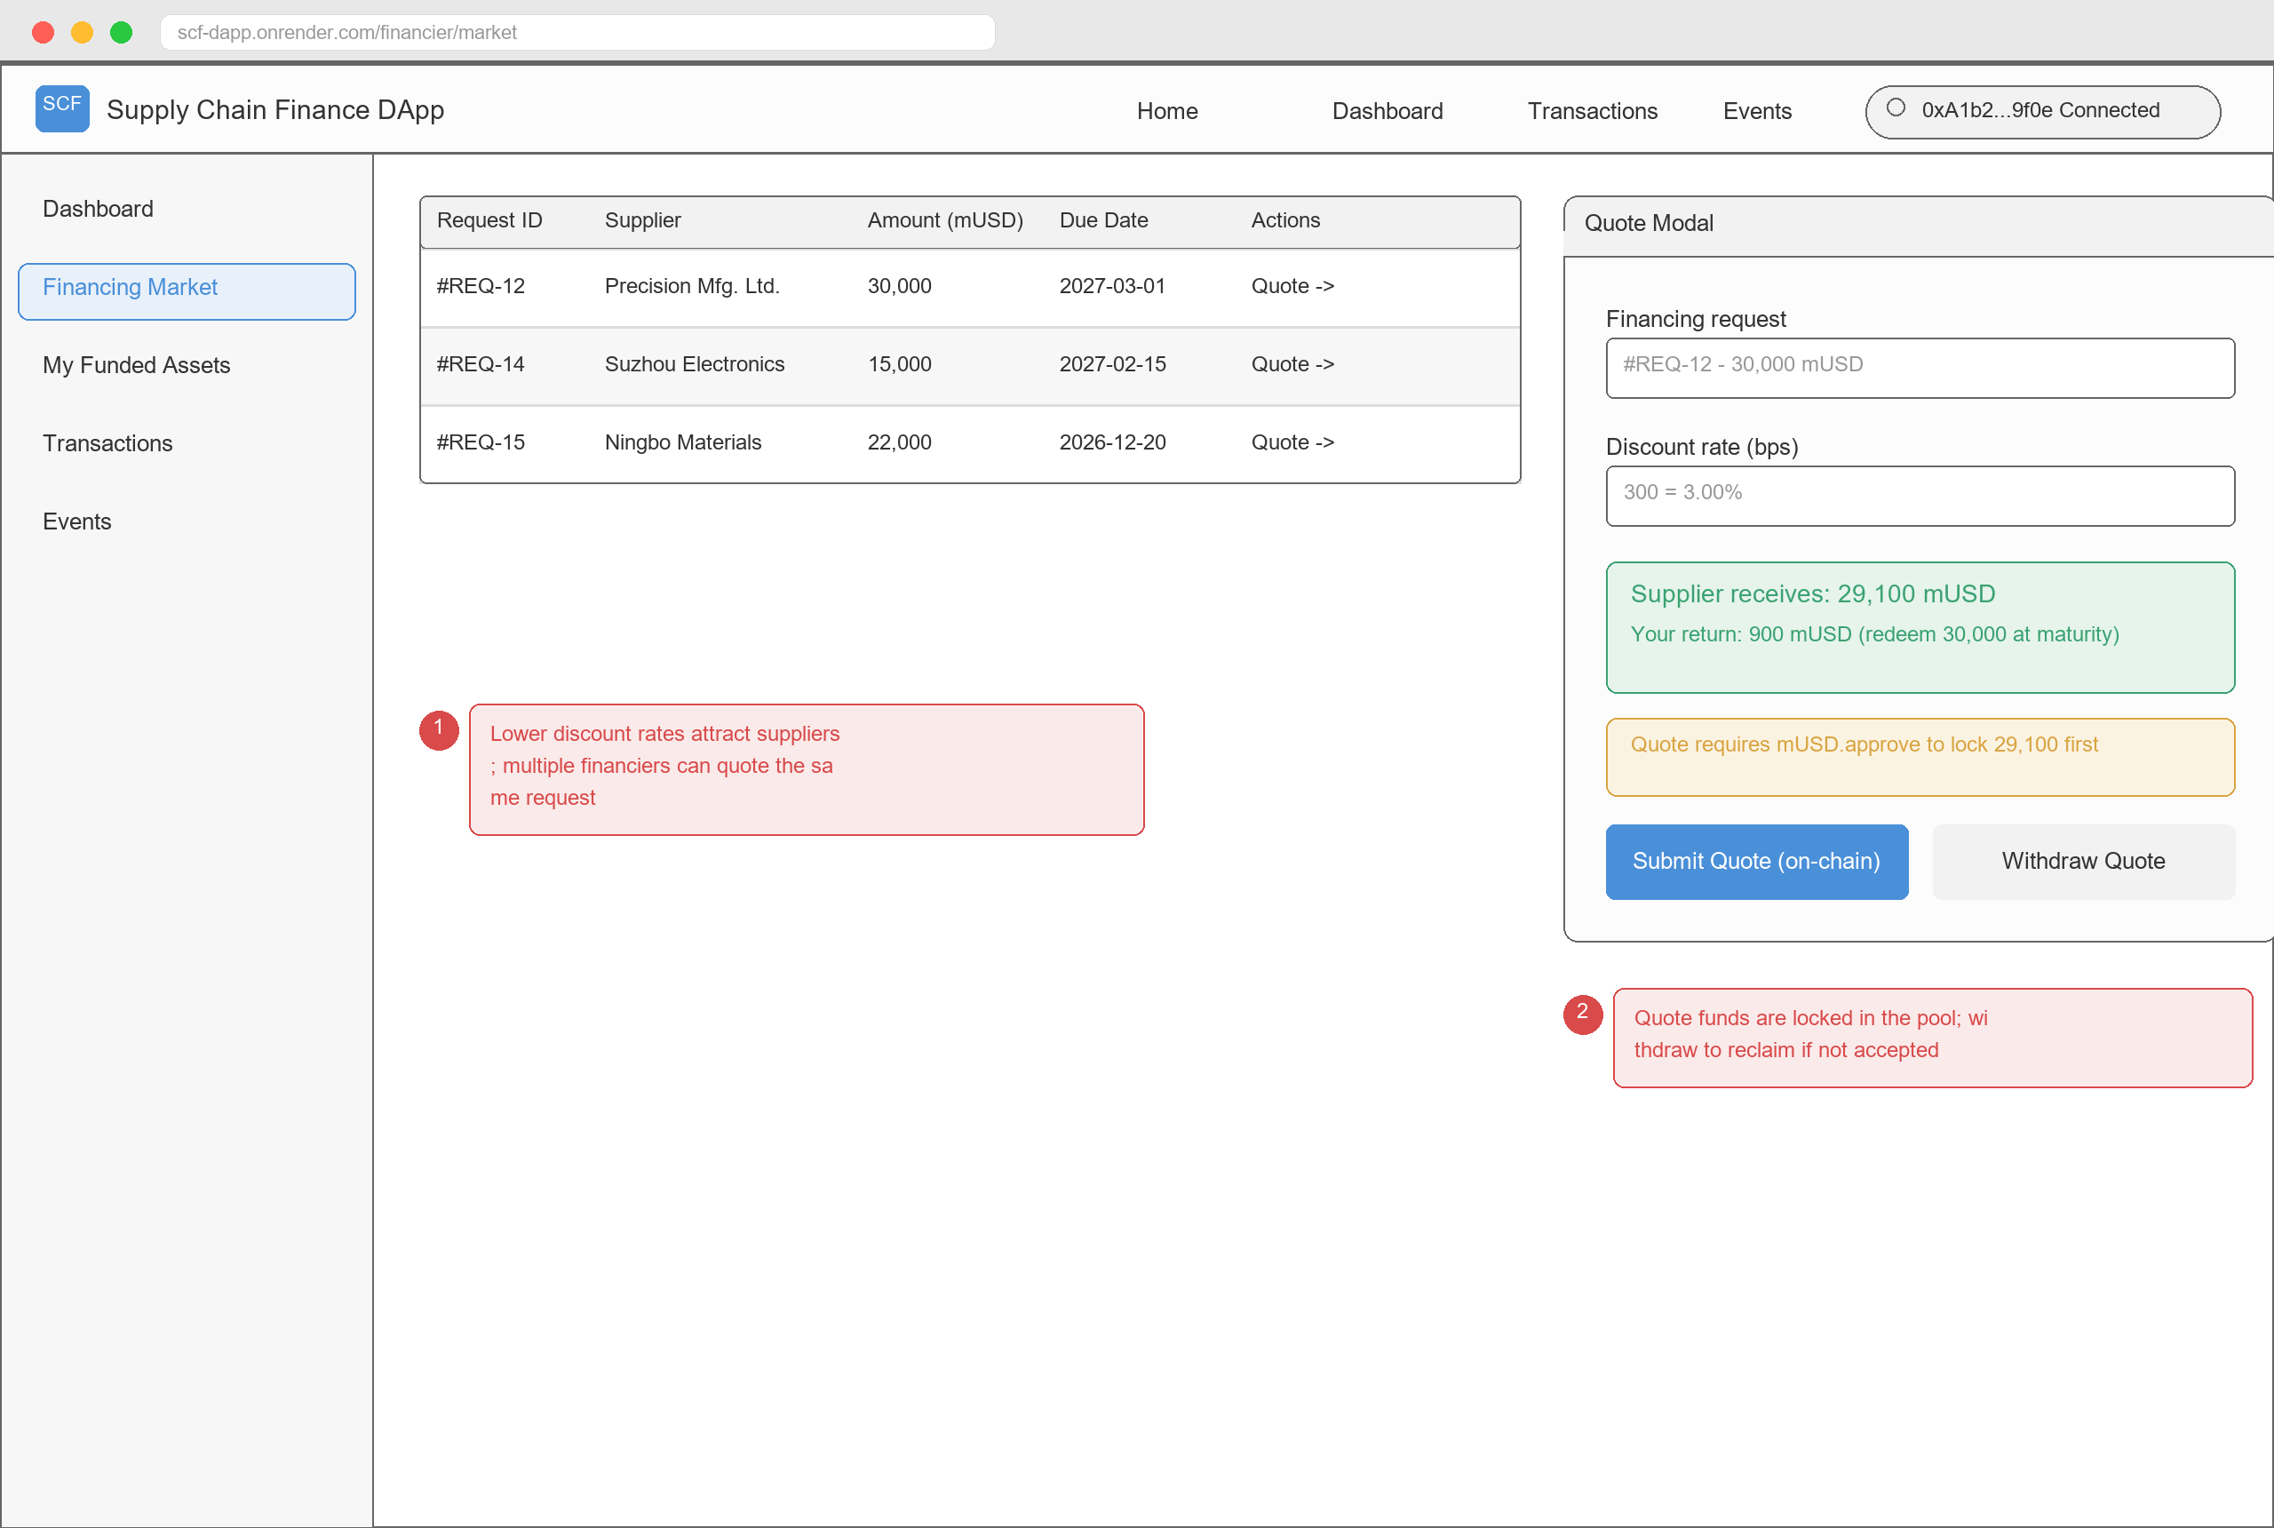
08 · UI DESIGN
19 pages for five roles - gas first, failure reasons always
Supplier dashboard · tokens / funding / to-dos
Core enterprise · verify, then confirm / reject
Financier · live discount quote preview
Interaction rules — gas estimate before every on-chain action; four-stage feedback (sign -> broadcast -> confirm -> result); failures surface decoded custom errors in plain language.
Design deliverable — 19 wireframes (docs/design-EN/wireframes/) as the frontend implementation reference, each annotated with acceptance feature IDs.
SC6113 · Supply Chain Finance DApp
09

Slide 10
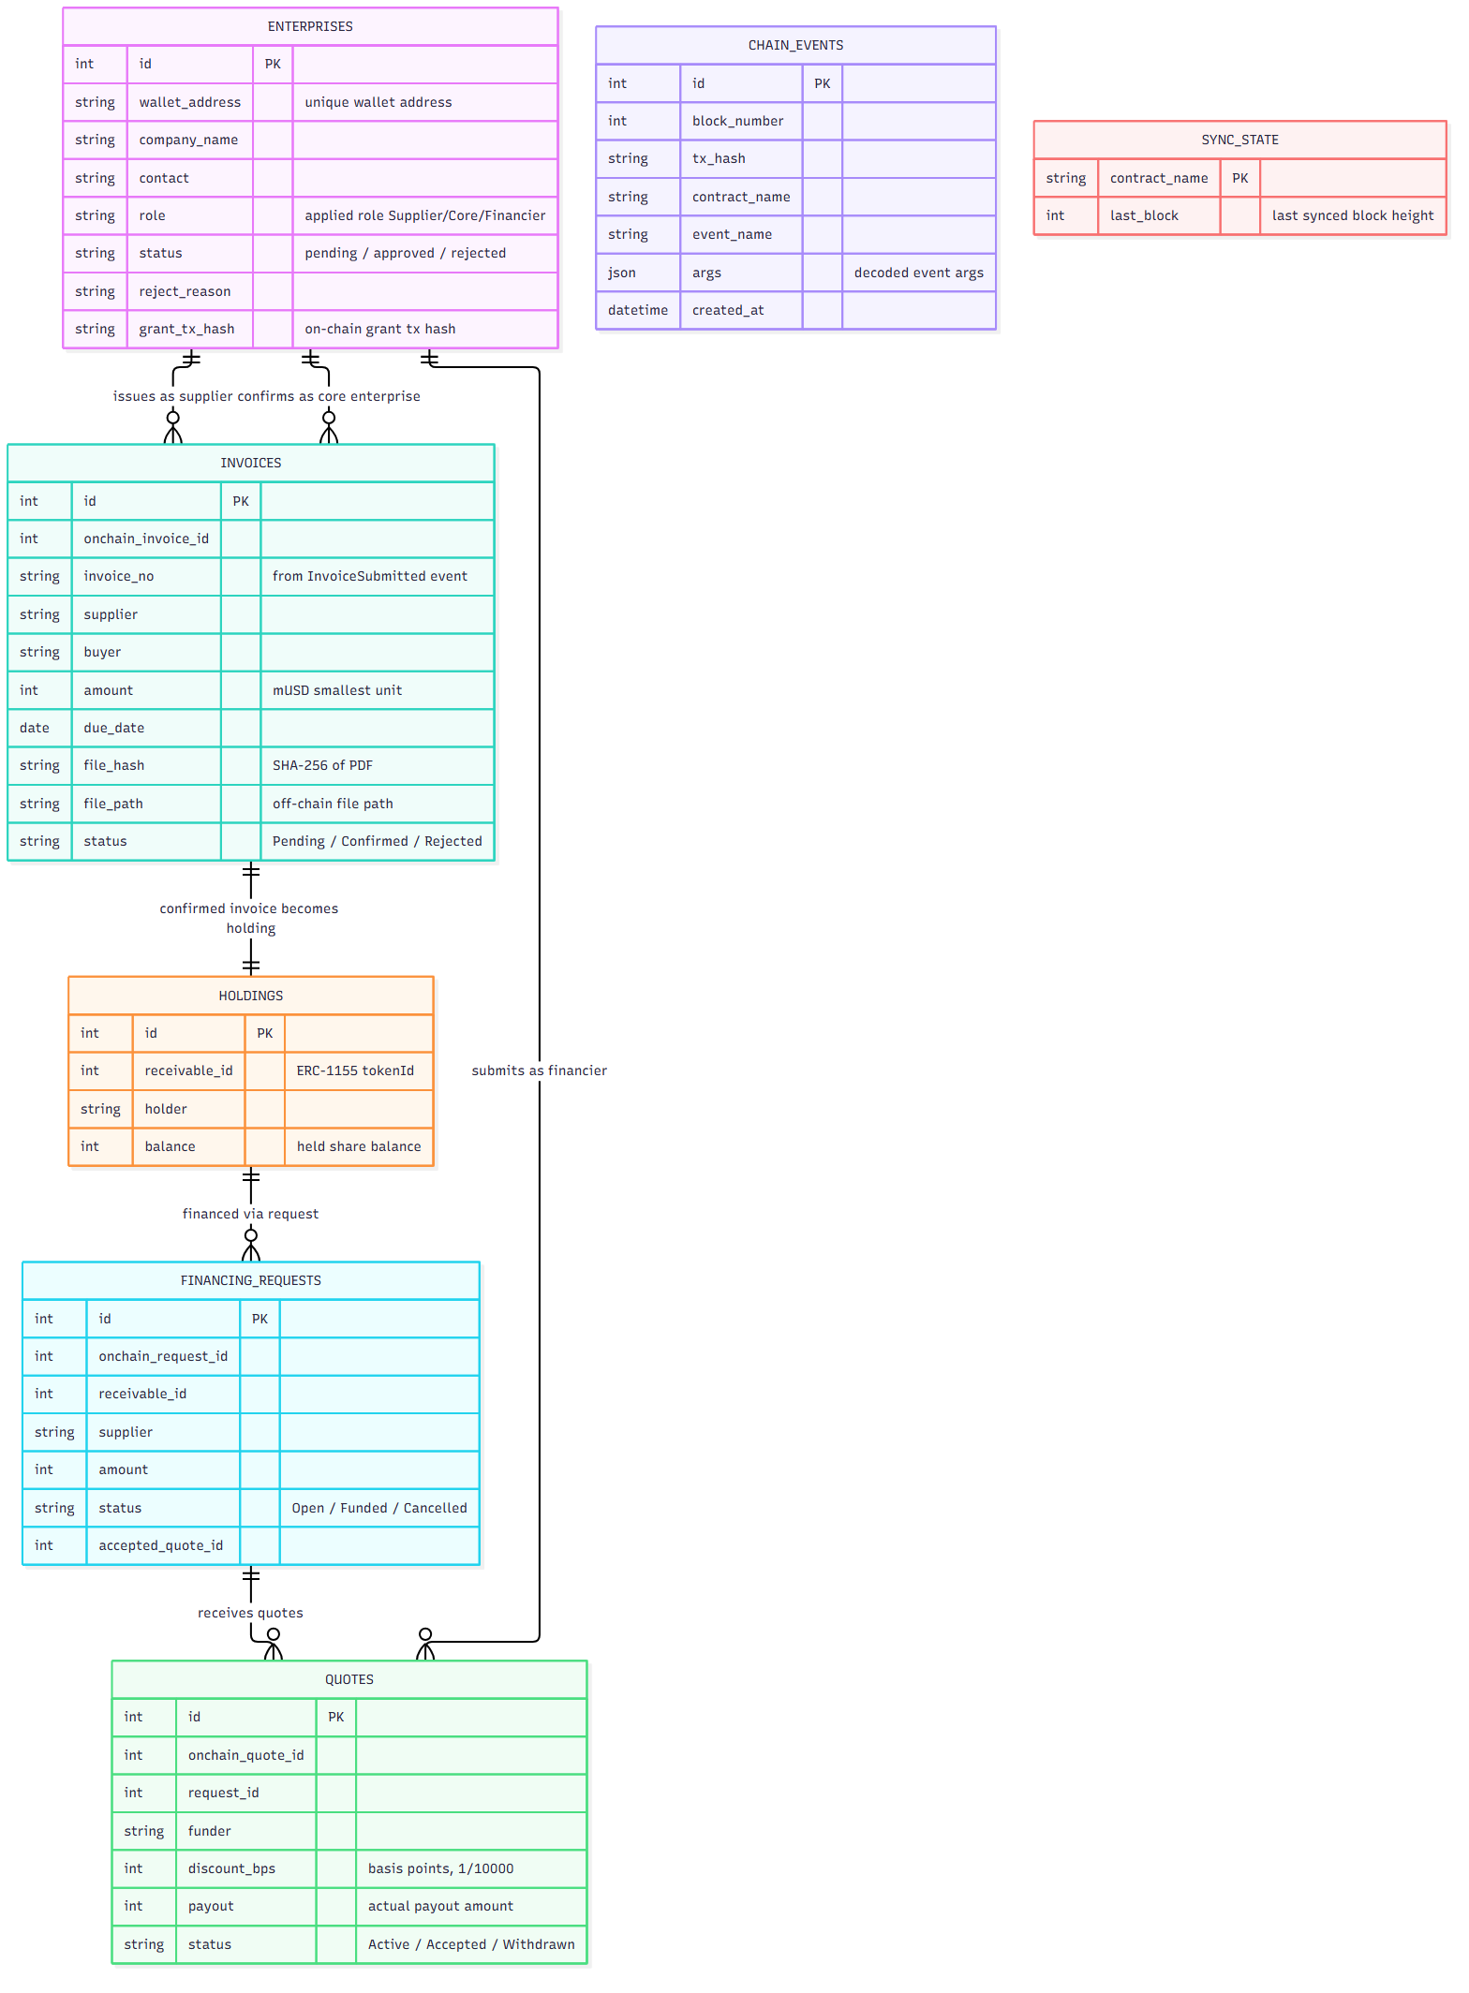
09 · DATA MODEL & BACKEND
Seven tables answer "who holds what"; event sync answers "what happened"
enterprises / invoices / financing_requests / quotes power onboarding, invoice management and the financing market; holdings is aggregated from TransferSingle events — the contracts offer no list query, an irreplaceable backend duty.
chain_events / sync_state power the audit: every event carries block number, tx hash and decoded args; the sync_state cursor guarantees resume without gaps or duplicates.
The backend never stores private keys — all writes go frontend -> MetaMask -> contracts; the backend only stores files (PDF + SHA-256), syncs events and serves aggregation queries, hosted on Render.
API list in docs/PRD.md Sec.7.2; ER source at docs/design-EN/diagrams/03-data-model.mmd.
SC6113 · Supply Chain Finance DApp
10

Slide 11
10 · GAS OPTIMIZATION
Storage packing + fewer cross-contract calls cut main-line gas by 15-21%
-10.2%
Average gas across 18 functions (92,801 -> 83,326)
How: storage slot packing (uint96 / uint64), receivable metadata stored directly on the token to skip cross-contract reads, leaner dedup mapping.
Source: contracts/docs/gas/, Foundry benchmarks, re-measured on Sepolia.
Optimized contracts redeployed; addresses and ABIs synced to the frontend (commits 9d11af2 / d56bdc4).
SC6113 · Supply Chain Finance DApp
11

Slide 12
11 · DEPLOYMENT & VERIFICATION
Live on Sepolia, with functional tests and security checks passed
Sepolia Contract Addresses (chainId 11155111)
Verification Results
RoleManager | 0x82f8...B6a2E
InvoiceRegistry | 0x3960...1eD7a
ReceivableToken | 0x3c9E...0368f
FinancingPool | 0x2bb0...985c6
MockStablecoin | 0xE3C7...1E04F
Start block | 11,869,257
Functional tests — 26 test cases executed one by one on the live Render build (Member 6, report in docs/testing/)
Contract tests — Foundry unit tests cover all write functions and revert branches of the 5 contracts
Static analysis — Slither reports zero high/medium issues; custom errors across all functions, decodable by the frontend
Cloud deployment — Flask + Gunicorn on Render; the event listener syncs chain data continuously
Full addresses in contracts/deployments/11155111.json; admin at 0x0ced...834f.
SC6113 · Supply Chain Finance DApp
12

Slide 13
SUMMARY · SC6113 GROUP PROJECT
From confirmation to redemption, one on-chain loop
· 5 contracts + 20 on-chain tx types covering the full lifecycle: register, confirm, transfer, finance, repay, redeem
· Dedup, escrow and transfer-lock gates block duplicate financing by mechanism, not by policy
· 26 features x 5 roles x real Sepolia deployment, end-to-end demonstrable
Team & Division of Labor
Member | Role | Deliverables
1 · LAO CHON IN | Smart contracts | 5 Solidity contracts, Foundry tests, Sepolia deployment, ABIs
2 · WANG JINGHAN | Backend & deployment | Flask REST API, Web3.py event listener, Render hosting
3 · LIU SHAOZHENG | Frontend & Web3 | 19 responsive views, MetaMask / Ethers.js integration
4 · GE CHEN | Research & report | Industry research, 10-15 page technical report
5 · YU MENGTAO | Design & presentation | 5 architecture diagrams, demo deck, user manual
6 · YANG SHUYI | Testing & video | 26 functional test cases, test report, demo video
Q & A
github.com/schow9527/supply-chain-finance-dapp

