Slide 1

Team Alpha:
Loan Portfolio Investment Strategy
Samuel Chow, Callahan Hinckley, Jared Cohen, Varun Jain, Dennis Schimtzek, Will Robbins
Notes:
Will

Slide 2


Background
Company
Goal
Strategy
Peer2Peer lending platform
Provide data on all previous loans
Help Dr. D generate maximum returns using data driven investment strategy
$10 million to invest
Identify “diamonds in the rough”
Account for payment probability and annualized return to reclassify loans
Key Question: Are there “diamonds in the rough” in terms of loans that could have potential to generate strong returns despite being poorly rated?
Notes:
Will

Slide 3

Executive Summary
Dr. D should invest in reclassified “A” grade loans in order to capitalize on their higher returns and reasonable probability of being paid off
A
B
C
D
E
F
A
A
$$$
Reclassify
Invest
Notes:
Will

Slide 4
Assumptions
LendingClub’s methodology for assigning risk ratings does not change significantly over time
Defaults occur in the beginning, so no money is received from defaulted loans
All loans make payments monthly
Term of loan does not affect ability to reinvest proceeds

Slide 5
EDA/Data Cleaning
Build a Model
Classify Loans
Invest
Data exploration, data imputation, one hot encoding
Use Machine Learning to find the probability that a loan will be fully paid off
Use the probability that a loan will be fully paid off to classify the loans
Find loans which were poorly rated by LendingClub with high probabilities of being fully paid off to invest in

Slide 6
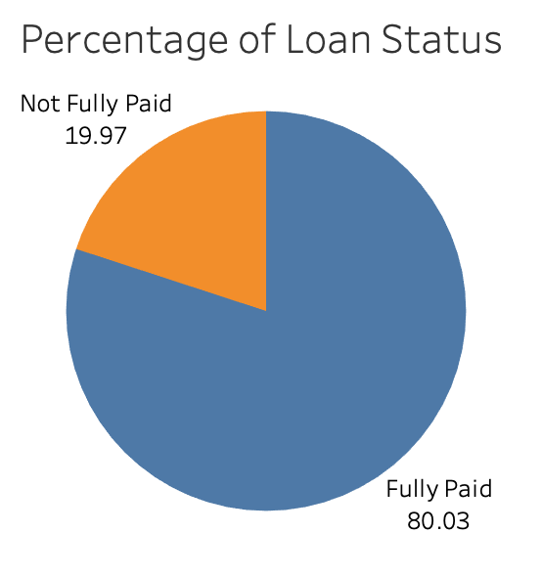
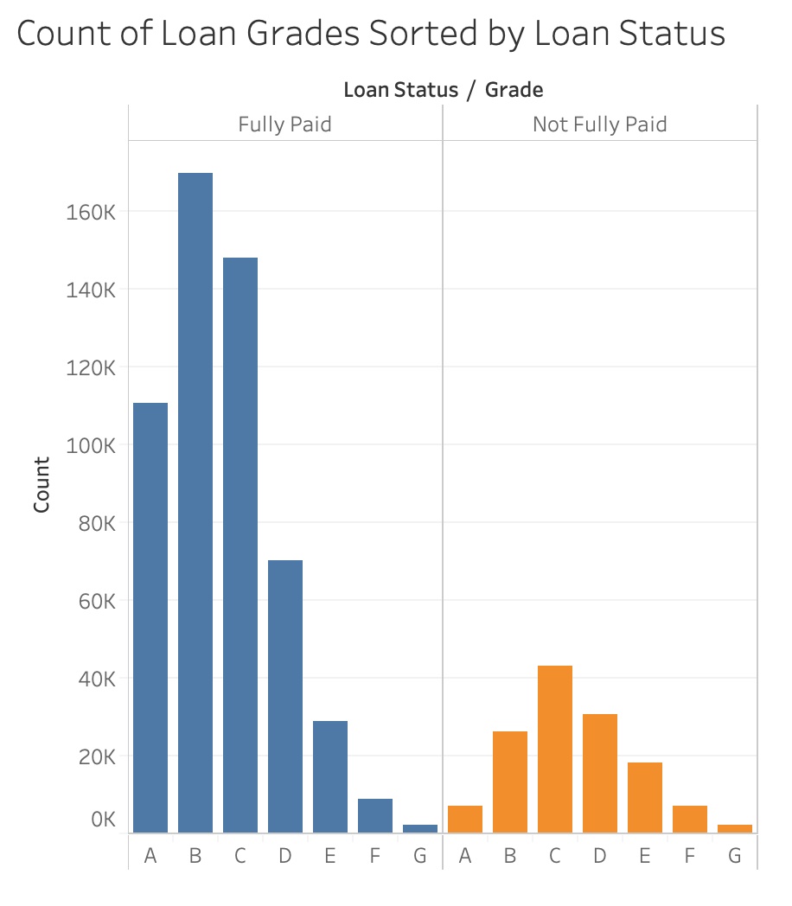
Exploratory Data Analysis

Slide 7
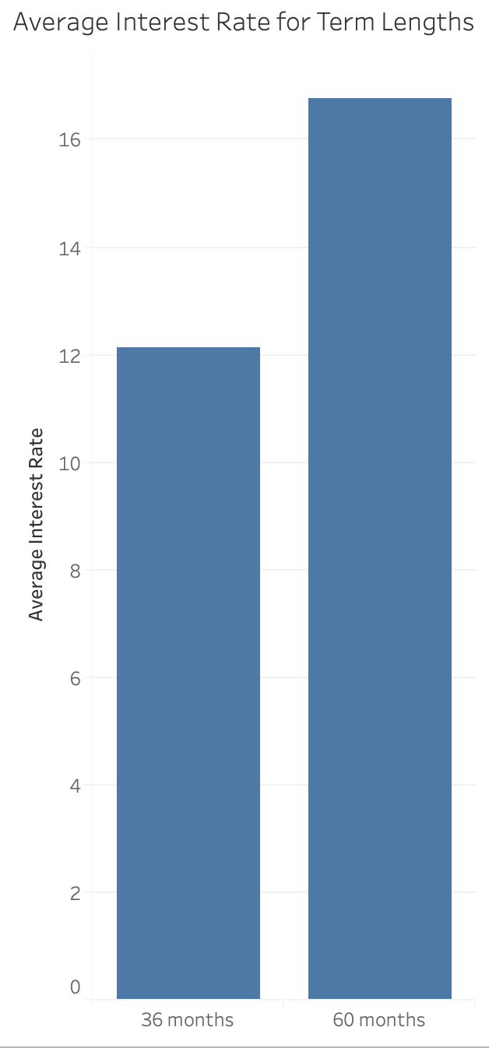
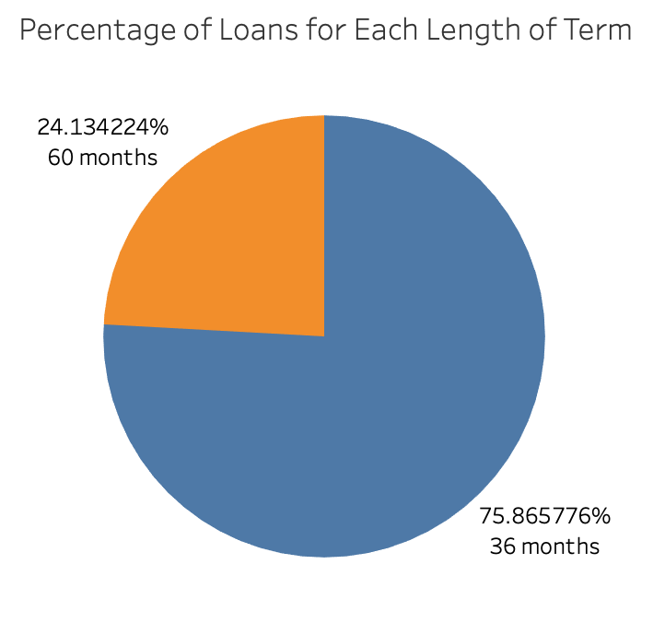
Exploratory Data Analysis

Slide 8
Cleaning the Data
Use highly correlated features with loan status
Drop leakage variables
Drop LendingClub features
Only include fully paid or charged off loans
Initial Set
1
2
3
4
Final Data
Normalized continuous data
Encode categorical data
Imputed data for missing values
Only consider loans that are either fully paid or charged off in our analysis
Only used features which are highly correlated with the status of loan
Normalized continuous data and encoded categorical data
Imputed the data for missing values
Notes:
Down to about 40 variables

Slide 9
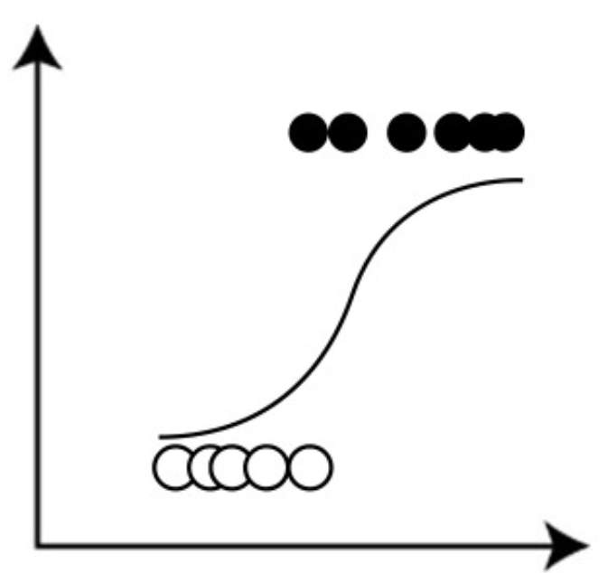

Models
Logistic Regression
XGBoost
Random Forest
Notes:
Training and testing data split

Slide 10
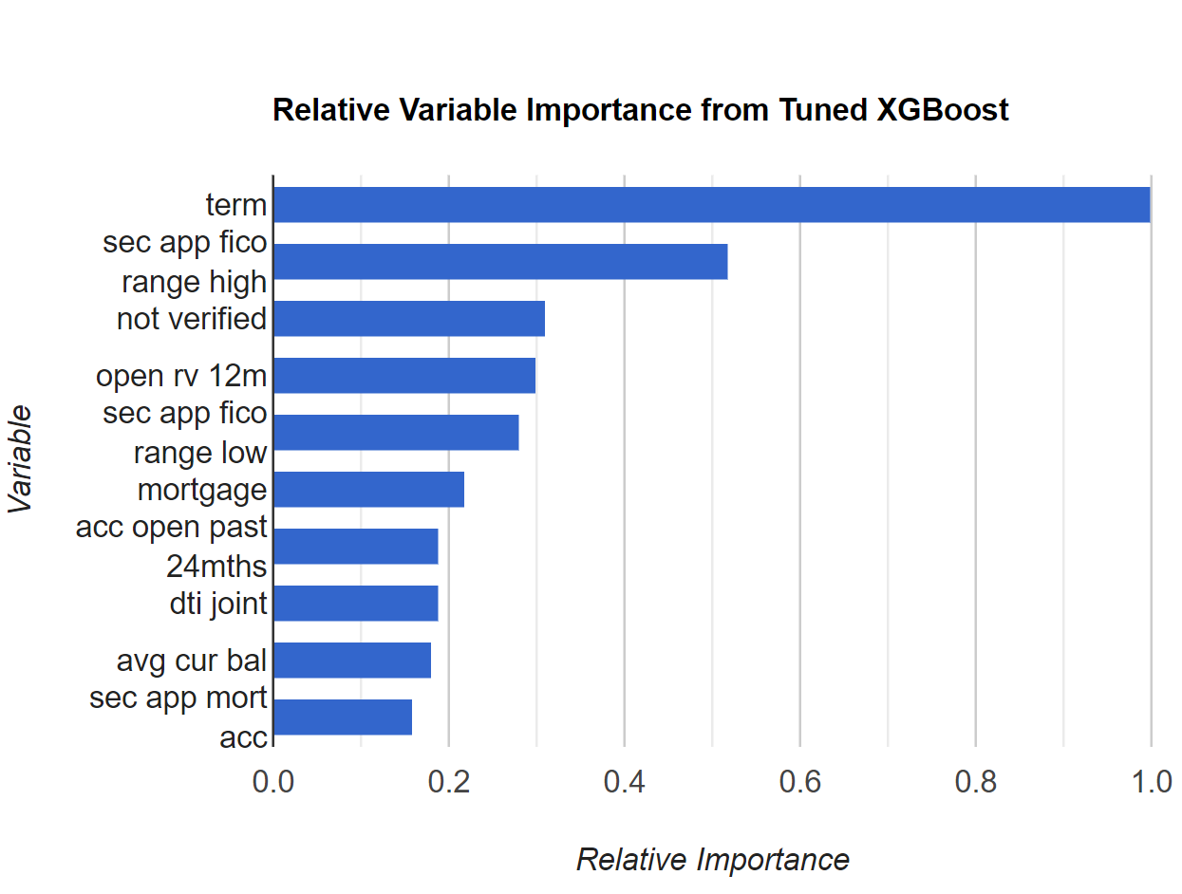
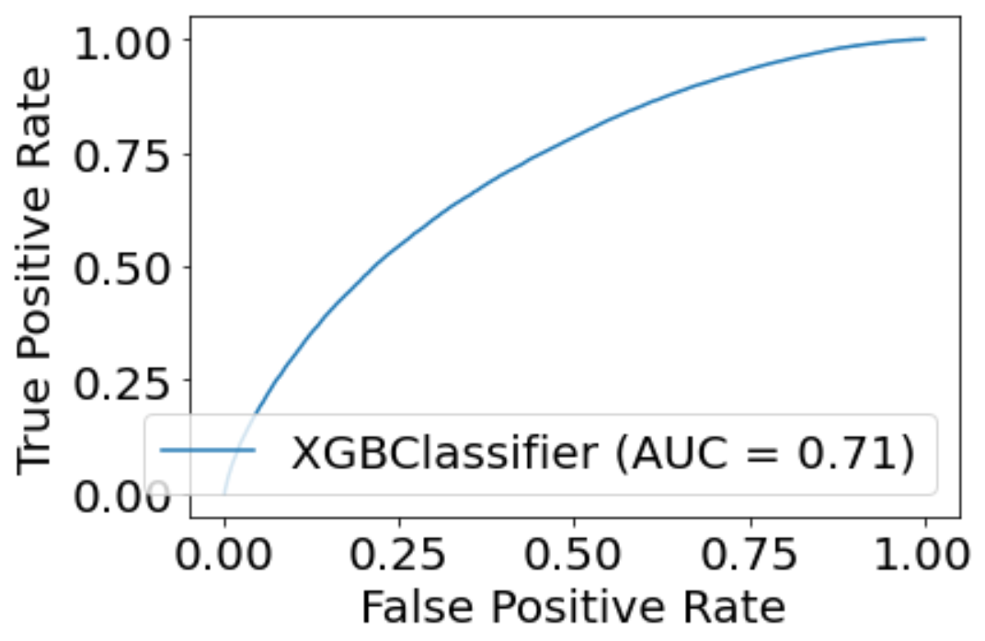
Outcomes: XGBoost

Slide 11
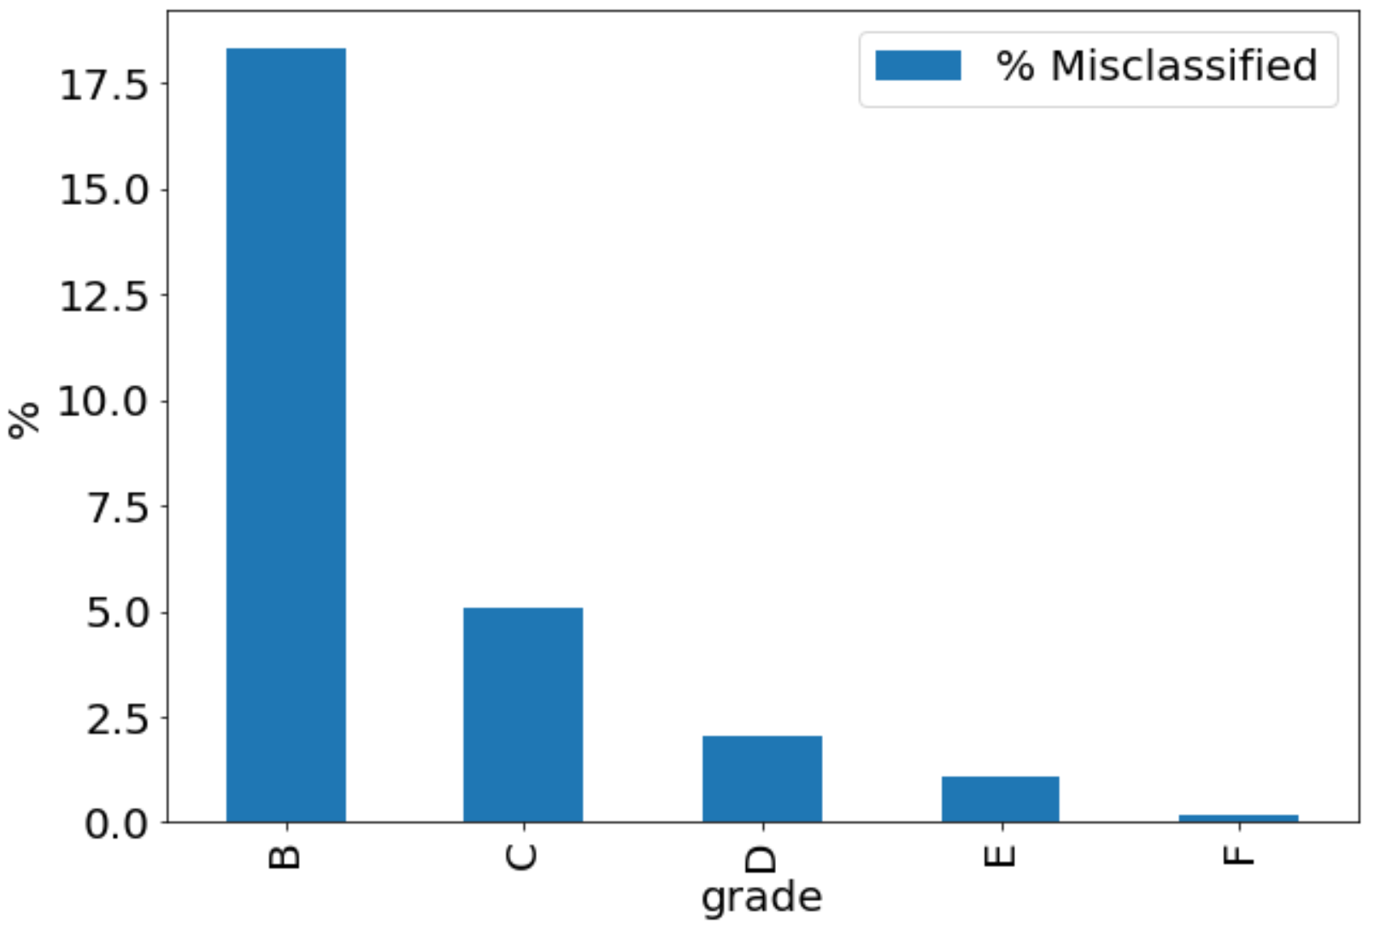
Misclassified “A” Loans as Percentage of Each Loan Grade
Notes:
Our model predicts that the average A loan has a 89% chance of being fully paid. However, there are loans that were graded B and below that our model predicted also had an 89% chance or higher of being fully paid. We figured that these loans were misclassified. In this chart you can see the percentage of loans in each grade which were misclassified. There is a very healthy amount of B loans whcih are just as safe as A loans. There are plenty of opportunities to invest into these loans.

Slide 12
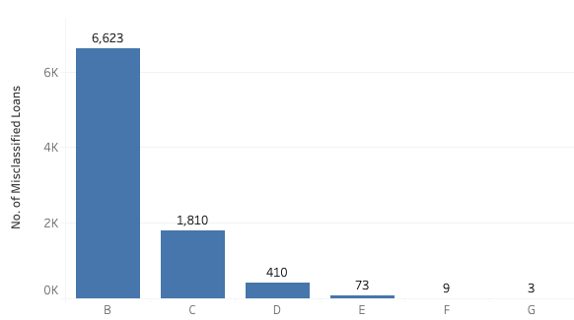
Breakdown of Misclassified “A” Loans by Grade

Slide 13
Recommendation
Prioritized Strategy of Investing in Reclassified A Loans:
Priority 1: Probability of Loan Being Paid Off
Priority 2: Interest Rate
To take both priorities into account, we invest in Reclassified “A” loans based on “Expected Return” for a Loan. This is a percentage which takes in Priority 1 and 2 as variables.
LendingClub Grade | Number of Loans w/ probability of being paid off > 89% | Average Percentage Expected Return | Sum of Value of Selected Loans | Total Expected Profit from Selected Loans
B | 6623 | 9% | $86,380,175 | $8,183,214
C | 1810 | 13% | $22,305,450 | $2,799,690
D | 410 | 16% | $4,326,00 | $686,789
E | 73 | 20% | $627,000 | $126,615
F | 9 | 22% | $62,925 | $13,928
G | 3 | 26% | $15,200 | $3,870
Investment Priority

Slide 14
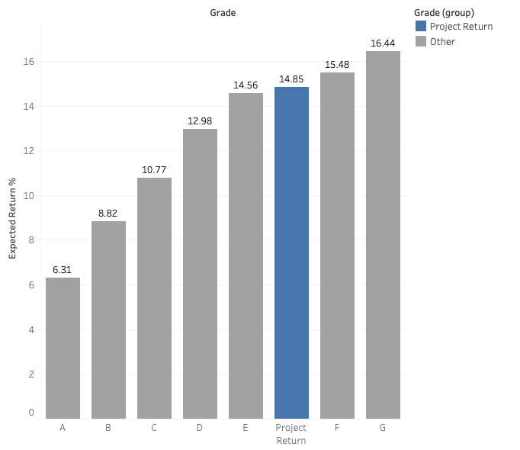
How do we do?
Given $10M, we return 14.85% of principal, more than doubling traditional “A” grade loan return rate.

Slide 15
Future Improvements
Account for reinvestment based on loan term
Look at loans that were paid off early
Look at earning some money from defaulted loans
Consider misclassified B loans that might give a better return for slightly more risk

