Slide 1
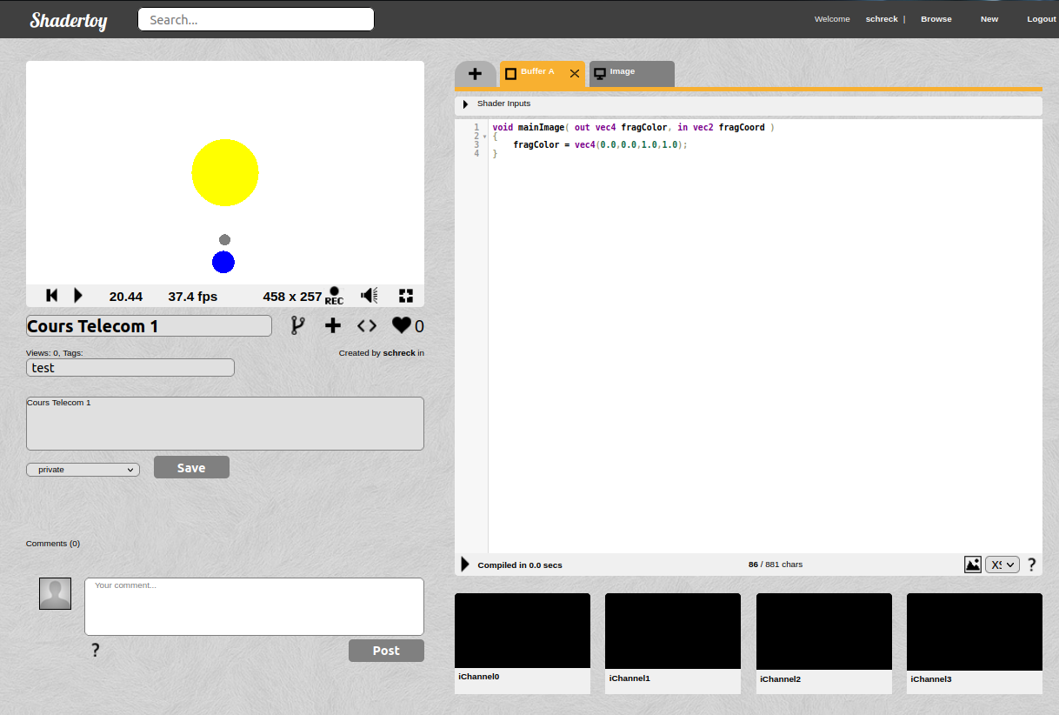
Intro Shadertoy
Fragment shader: language GLSL
https://www.shadertoy.com/
https://shaderoo.org

Slide 2
GPU pipeline in a nutshell
geometry
projected
fragments
pixels
Application
Vertex
processor
Fragment
processor
Rasterizer
screen

Slide 3
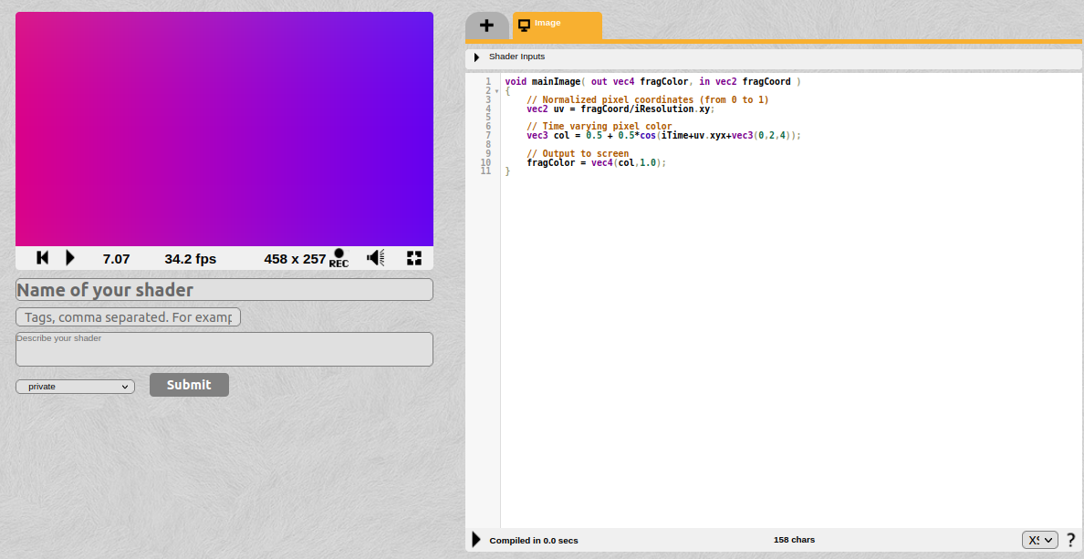
Shadertoy: fragment shader

Slide 4

Shadertoy: fragment shader

Slide 5

Shadertoy: fragment shader

Slide 6
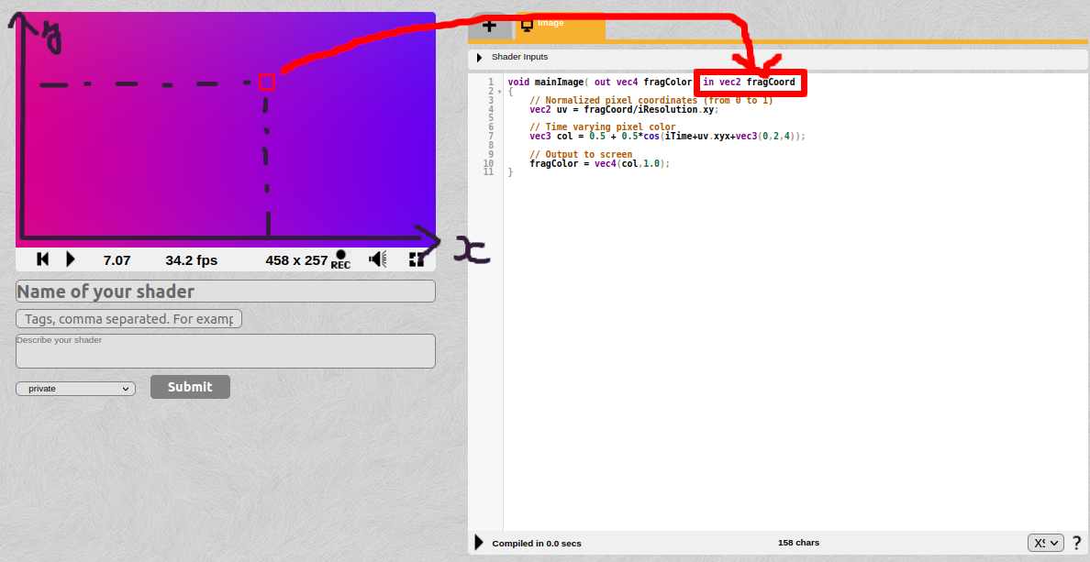
Shadertoy: fragment shader

Slide 7
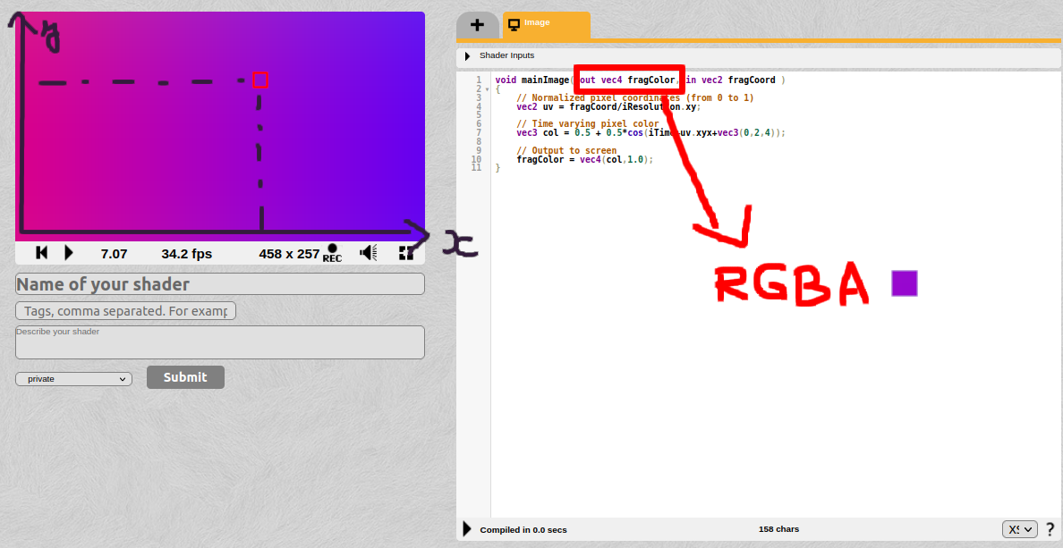
Shadertoy: fragment shader

Slide 8


Shadertoy: fragment shader
https://www.youtube.com/watch?v=8--5LwHRhjk
https://www.shadertoy.com/view/WsSBzh

