Slide 1
Transforms
Where are my objects?

Slide 2
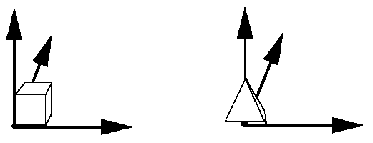
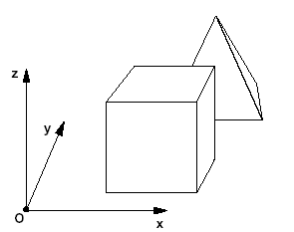
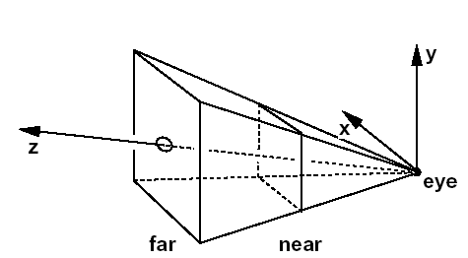
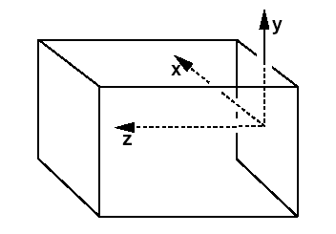
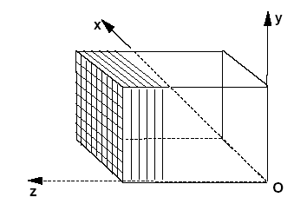
Coordinate system
Object space
World space
Camera space
Normalized Device Coordinates
[-1,-1,-1] → [1,1,1]
Screen space (viewport)
Durand/Cutler MIT

Slide 3
Transforms?
x' = ax + by + c
y' = dx + ey + f

Slide 4
Transforms?
x' = ax + by + c
y' = dx + ey + f
x'
y'
a b
d e
x
y
c
f
=
+

Slide 5
Transforms?
x' = ax + by + c
y' = dx + ey + f
x'
y'
a b
d e
x
y
c
f
=
+
p' = M p + t

Slide 6
Homogeneous Coordinates
Add an extra dimension
  2D -> 3 x 3 matrices
  3D -> 4 x 4 matrices

Slide 7
Homogeneous Coordinates
Add an extra dimension
  2D -> 3 x 3 matrices
  3D -> 4 x 4 matrices
Each point has an extra value, w
  Projective space

Slide 8
Homogeneous Coordinates
Add an extra dimension
  2D -> 3 x 3 matrices
  3D -> 4 x 4 matrices
Each point has an extra value, w
  Projective space
x'
y'
z'
w'
a
e
i
m
b
f
j
n
c
g
k
o
d
h
l
p
x
y
z
w
=
p' = M p

Slide 9
Homogeneous Coordinates
x' = ax + by + c
y' = dx + ey + f
Affine formulation
x'
y'
a b
d e
x
y
c
f
=
+
p' = M p + t

Slide 10
Homogeneous Coordinates
x' = ax + by + c
y' = dx + ey + f
Affine formulation
Homogeneous formulation
x'
y‘
1
a b
d e
0 0
c
f
1
x
y
1
x'
y'
a b
d e
x
y
c
f
=
=
+
p' = M p + t
p' = M p

Slide 11
Homogeneous Coordinates
Most of the time w = 1
Multiply by an affine matrix , w unchanged
x'
y'
z'
1
a
e
i
0
b
f
j
0
c
g
k
0
d
h
l
1
x
y
z
1
=

Slide 12
Homogeneous Coordinates
Most of the time w = 1
x / w
y / w
z /w
1
x
y
z
w
=

Slide 13
Scale (sx, sy, sz)
Scale(s,s,s)
y
p'
Uniform scaling: sx = sy = sz
p
q'
q
x
x'
y'
z'
1
sx
0
0
0
0
sy
0
0
0
0
sz
0
0
0
0
1
x
y
z
1
=

Slide 14
Rotation
ZRotate(θ)
y
p'
About z axis
p
θ
x
z
x'
y'
z'
1
cos θ
sin θ
0
0
-sin θ
cos θ
0
0
0
0
1
0
0
0
0
1
x
y
z
1
=

Slide 15
Rotation
ZRotate(θ)
y
p'
About x axis
p
θ
x
z
x'
y'
z'
1
1
0
0
0
0
cos θ
sin θ
0
0
-sin θ
cos θ
0
0
0
0
1
x
y
z
1
=

Slide 16
Translate (tx, ty, tz)
Translate(c,0,0)
y
Translations in the matrix
p
p'
x
x'
y'
z‘
1
1
0
0
0
0
1
0
0
0
0
1
0
tx
ty
tz
1
x
y
z
1
c
=

Slide 17
Direction != point
Directions have w = 0 (point at infinity)
  They do not translate
  Only impacted by rotations and scale
x
y
z
0
1
0
0
0
0
1
0
0
0
0
1
0
tx
ty
tz
1
x
y
z
0
=

Slide 18
Combining
Scale then Translate
(5,3)
Scale(2,2)
(2,2)
Translate(3,1)
(1,1)
(3,1)
(0,0)
(0,0)

Slide 19
Combining
Scale then Translate
(5,3)
Scale(2,2)
(2,2)
Translate(3,1)
(1,1)
(3,1)
(0,0)
(0,0)
Use matrix multiplication: p' = T ( S p ) = TS p

Slide 20
Combining
Scale then Translate
(5,3)
Scale(2,2)
(2,2)
Translate(3,1)
(1,1)
(3,1)
(0,0)
(0,0)
Use matrix multiplication: p' = T ( S p ) = TS p
1
0
0
1
3
1
2
0
0
2
0
0
2
0
0
2
3
1
0
0
1
0
0
1
0
0
1
TS =
=

Slide 21
Combining
Scale then Translate
(5,3)
Scale(2,2)
(2,2)
Translate(3,1)
(1,1)
(3,1)
(0,0)
(0,0)
Use matrix multiplication: p' = T ( S p ) = TS p
1
0
0
1
3
1
2
0
0
2
0
0
2
0
0
2
3
1
0
0
1
0
0
1
0
0
1
TS =
=
Caution: matrix multiplication is NOT commutative!

Slide 22
Non-commutative composition
Scale then Translate: p' = T ( S p ) = TS p
(5,3)
Scale(2,2)
(2,2)
Translate(3,1)
(1,1)
(3,1)
(0,0)
(0,0)
Translate then Scale: p' = S ( T p ) = ST p
(8,4)
Translate(3,1)
(4,2)
Scale(2,2)
(6,2)
(1,1)
(3,1)
(0,0)

Slide 23
Non-commutative composition
Scale then Translate: p' = T ( S p ) = TS p
1
0
0
0
1
0
3
1
1
2
0
0
0
2
0
0
0
1
2
0
0
0
2
0
3
1
1
TS =
=
Translate then Scale: p' = S ( T p ) = ST p
2
0
0
2
0
0
1
0
0
1
3
1
2
0
0
2
6
2
0
0
1
0
0
1
0
0
1
ST =
=

Slide 24
Projection
Objects are positioned in camera view
  Eye at 0,0,0
  Depth along z axis (convention)
  Still in regular 3D space
Project on screen
  Orthographic
  Perspective (most common)

Slide 25
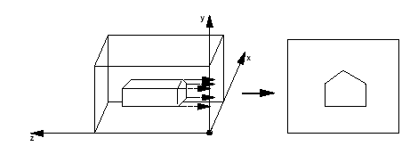
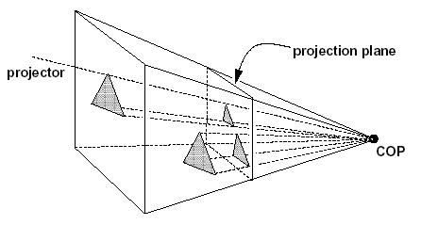
Orthographic vs Perspective
Orthographic
Perspective

Slide 26
Simple Orthographic Projection
Project all points along the z axis to the z = 0 plane
x
y
0
1
1
0
0
0
0
1
0
0
0
0
0
0
0
0
0
1
x
y
z
1
=

Slide 27
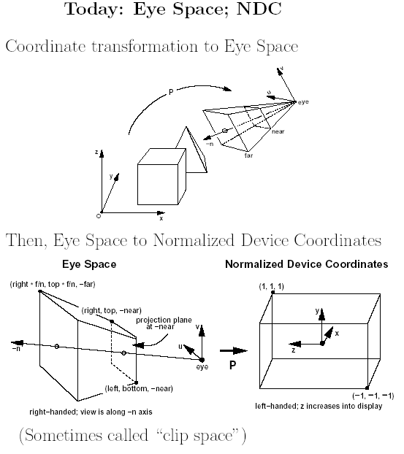
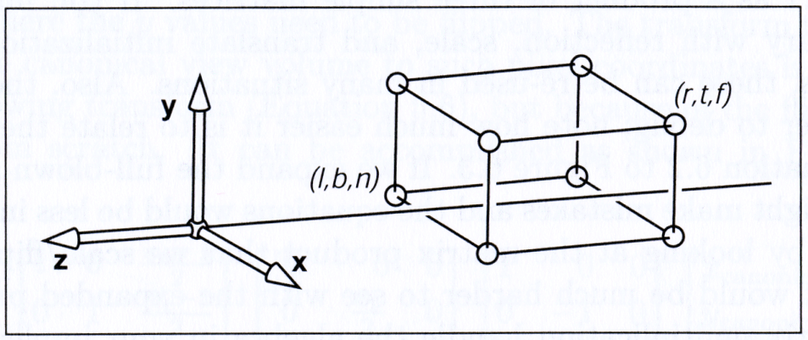
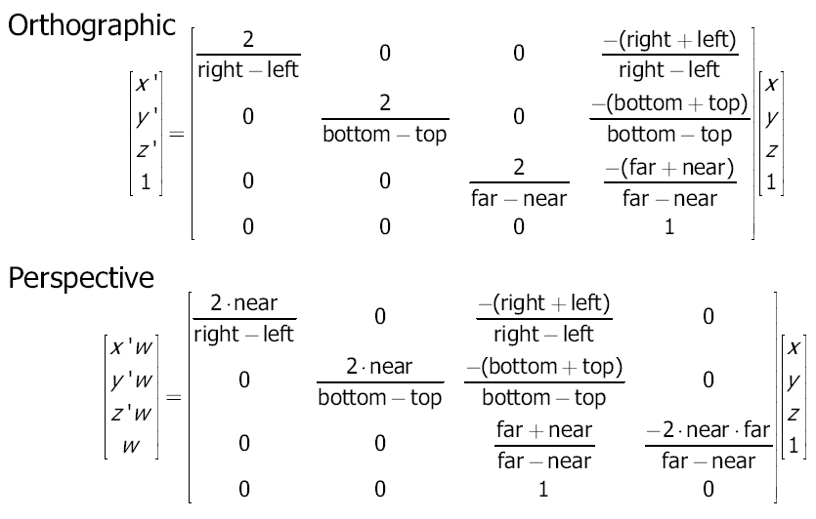
Canonical Orthographic Projection

Slide 28
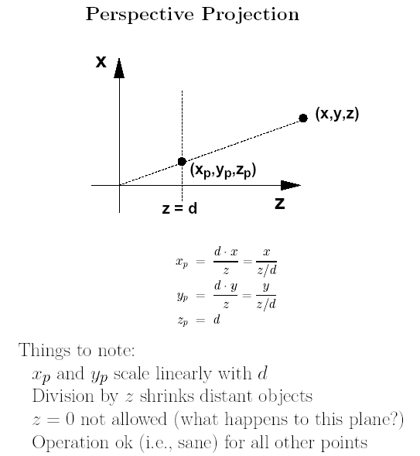
Simple Perspective Projection
Project to the z = d plane, eye = origin
homogenize
x * d / z
y * d / z
d
1
x
y
z
z / d
1
0
0
0
0
1
0
0
0
0
1
1/d
0
0
0
0
x
y
z
1
=
=

Slide 29
Canonical Perspective Projection

Slide 30
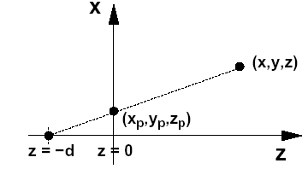
At the limit
this perspective
projection matrix...
...is simply an
orthographic projection
1
0
0
0
0
1
0
0
0
0
0
1/d
0
0
0
1
1
0
0
0
0
1
0
0
0
0
0
0
0
0
0
1
→

