Slide 1

Introduction à l’infomatique graphique
Camille Schreck
Permission to reuse for teaching in tuition-free schools is granted provided that credits are given.
All other uses are forbidden without explicit permission.

Slide 2
Introduction
Computer Graphics:
Rendu
Modélisation
Animation
Simulation
...

Slide 3
Introduction
Ce qu’on va voir pendant ce cours:

Slide 4
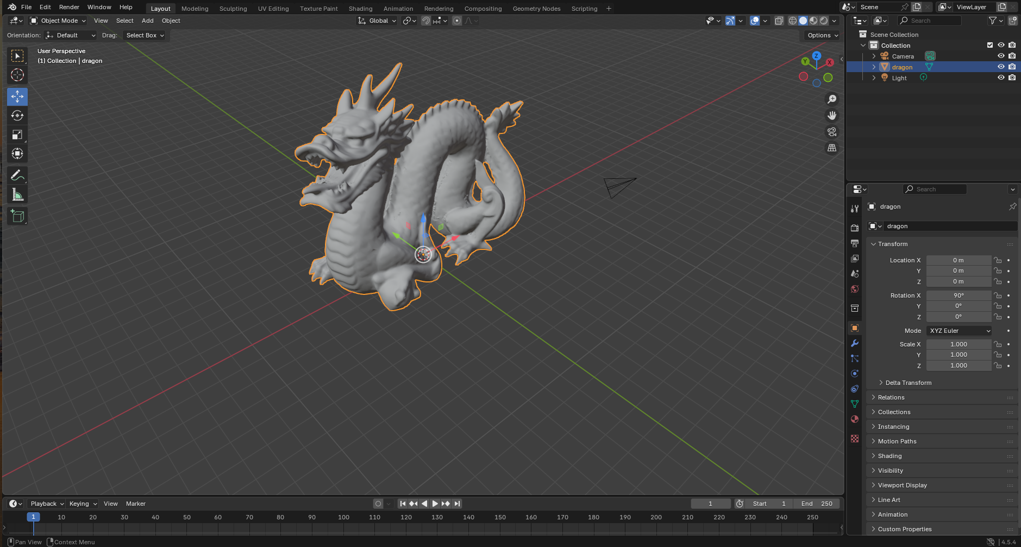
Introduction
Ce qu’on va voir pendant ce cours:

Slide 5
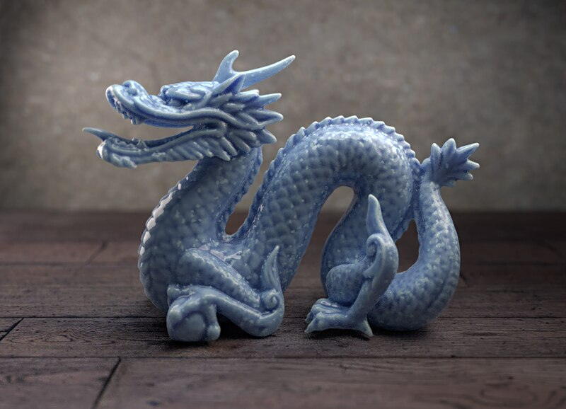
Introduction
Ce qu’on va voir pendant ce cours:

Slide 6
Introduction
Avant 1996: software

Slide 7
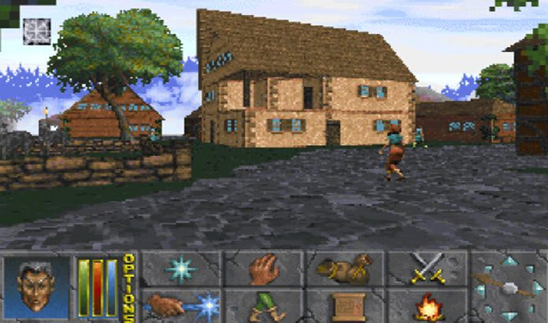
Daggerfall 1996

Slide 8
Introduction
Avant 1996: software
Après 1996: graphics accelerator (GPU)

Slide 9
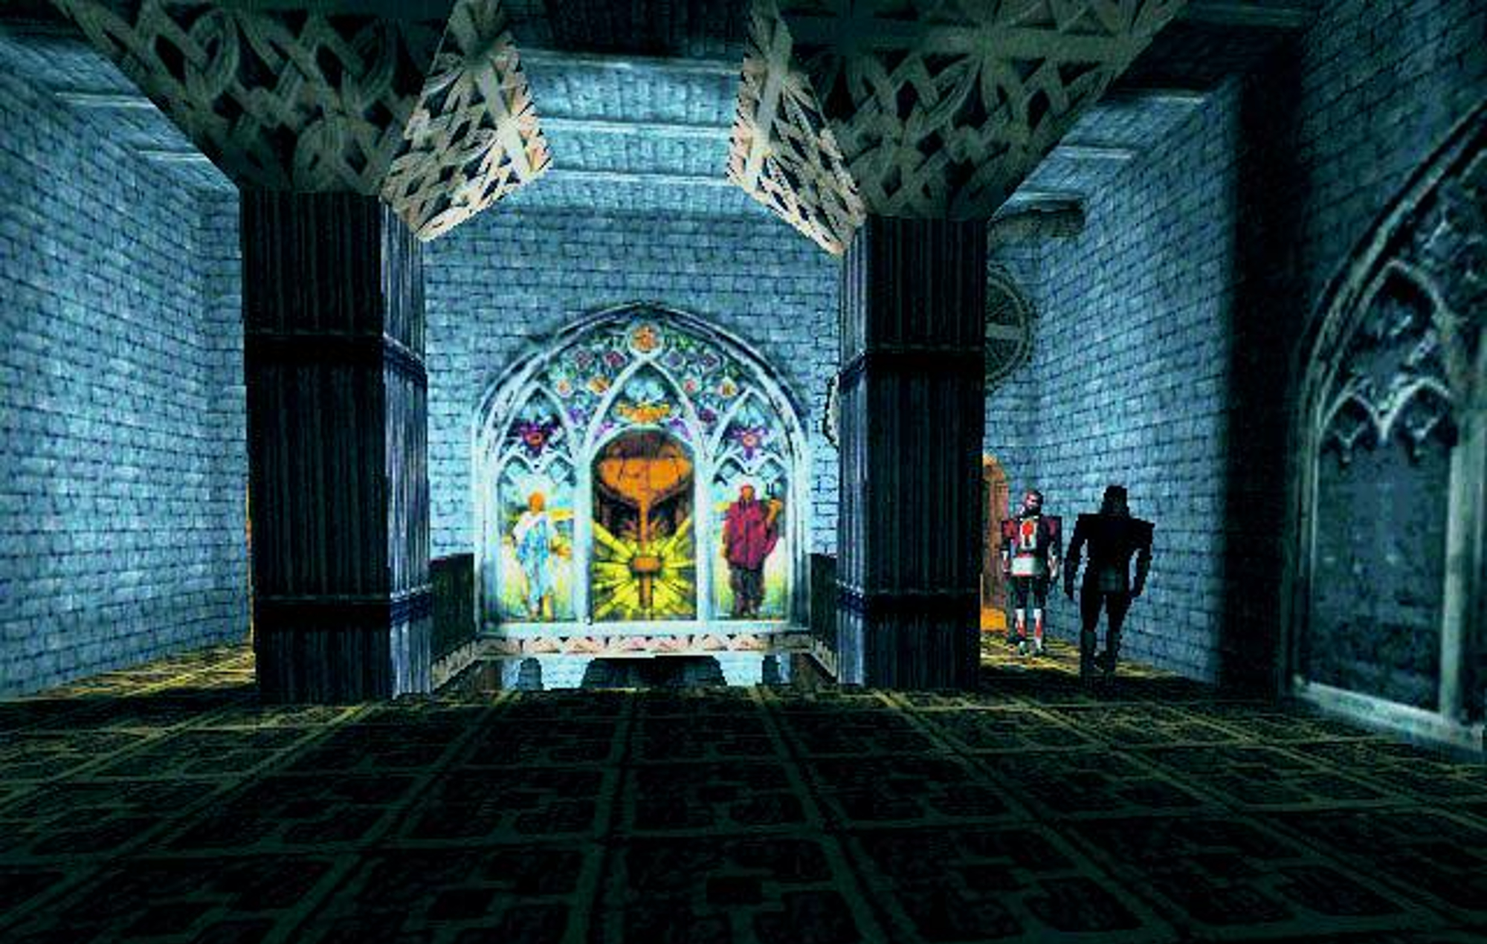
Thief 1998

Slide 10
Introduction
Avant 1996: software
Après 1996: graphics accelerator (GPU)
Maintenant...

Slide 11
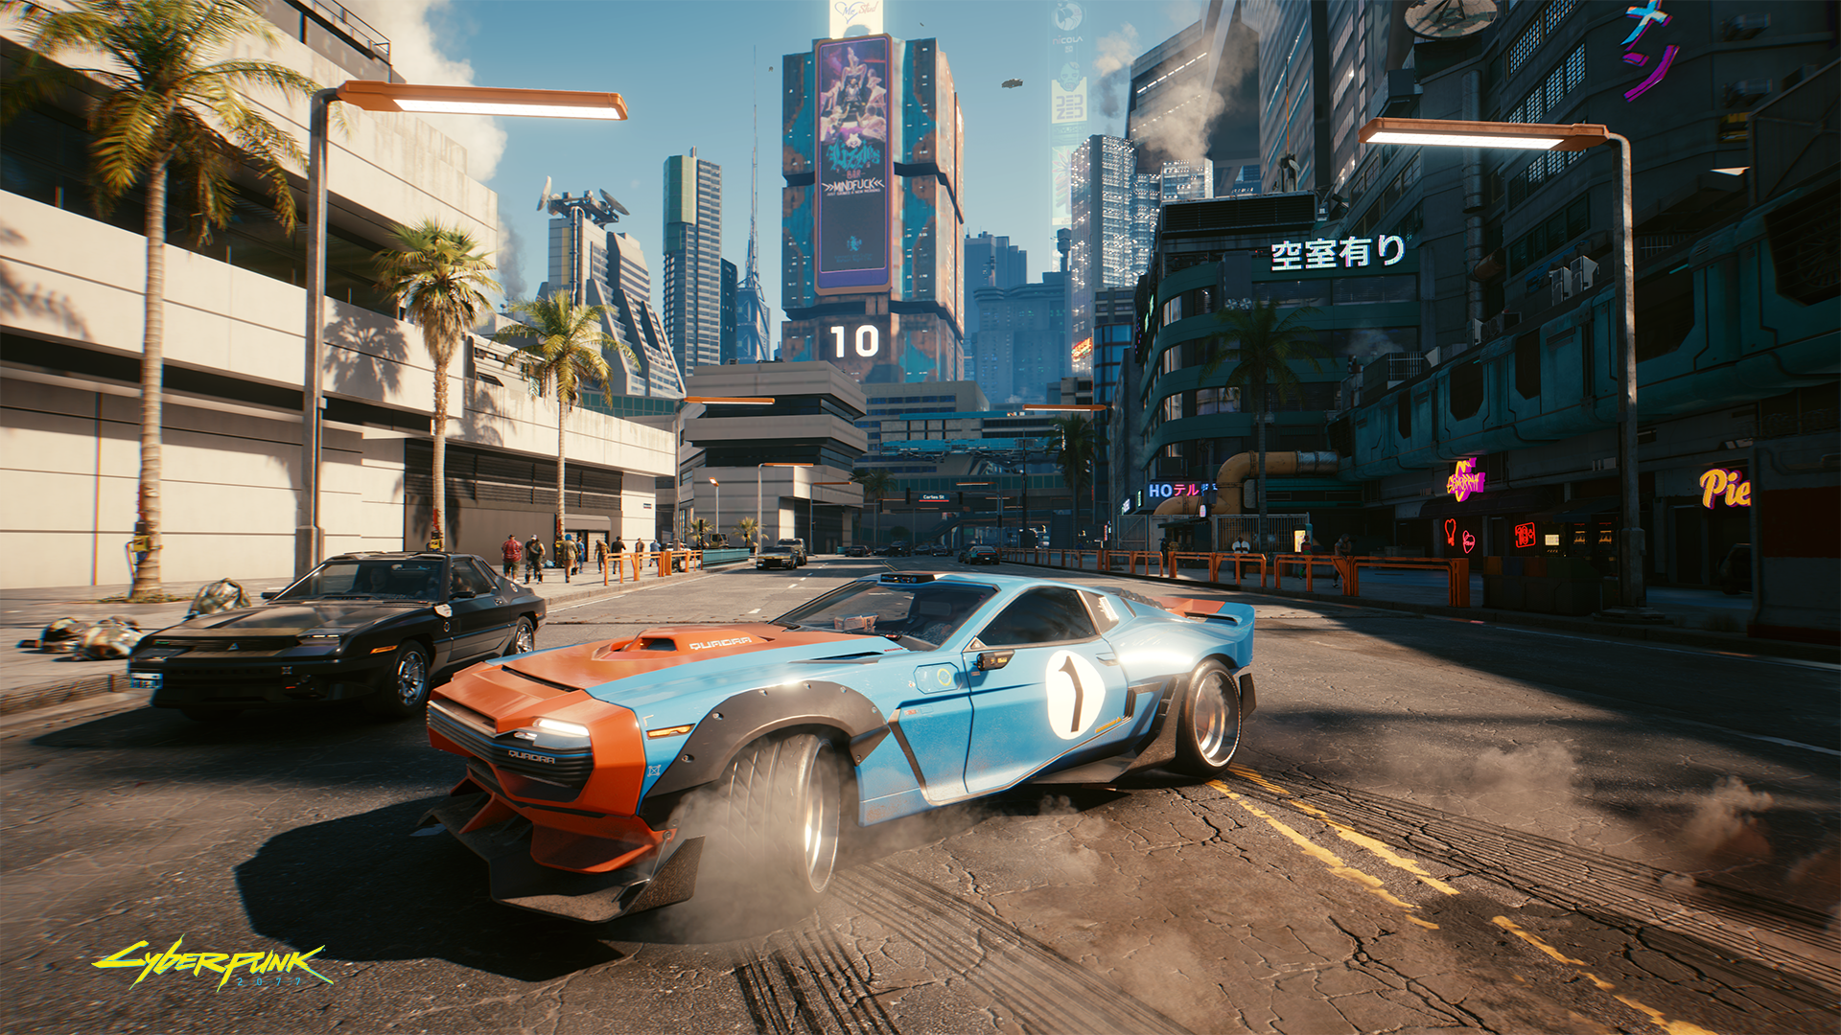
Cyberpunk 2077, 2020

Slide 12
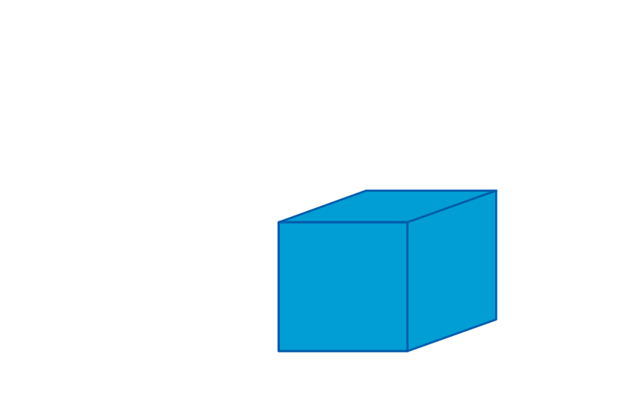
Rendu
Modèle 3D

Slide 13
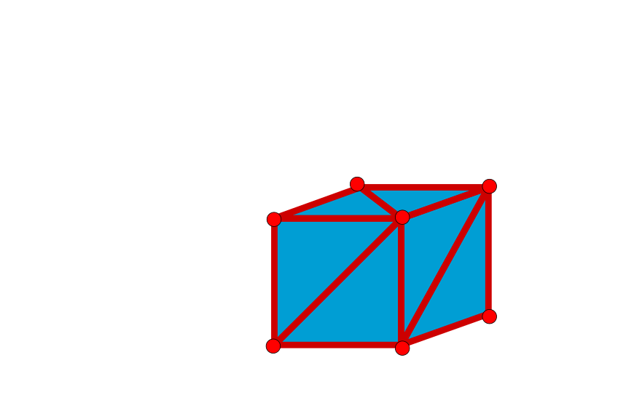
Rendu
Modèle 3D

Slide 14
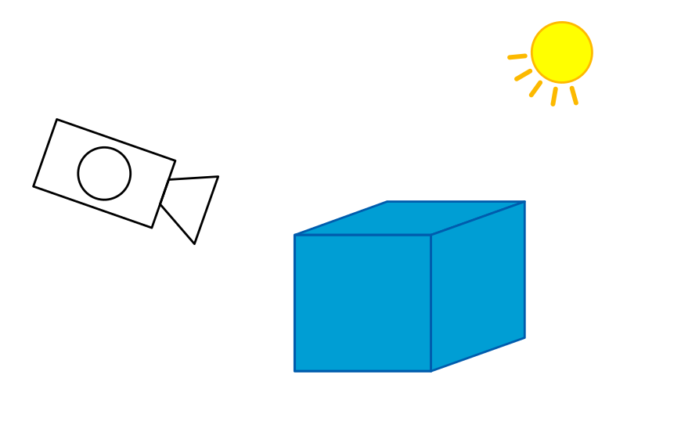
Rendu
Modèle 3D + lumières + camera

Slide 15
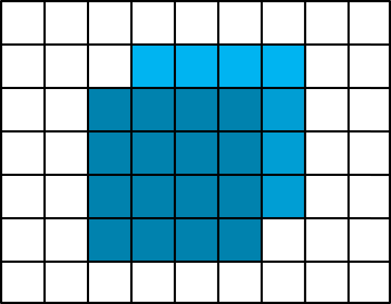
Rendu
Modèle 3D + lumières + camera Affichage à l’écran

Slide 16
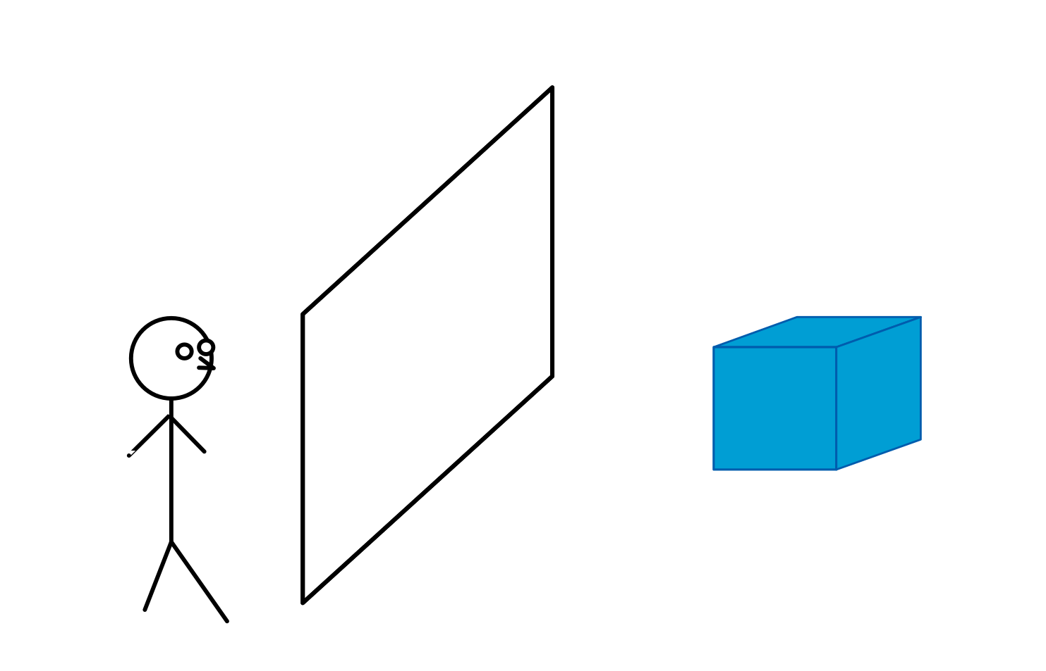
Rendu

Slide 17
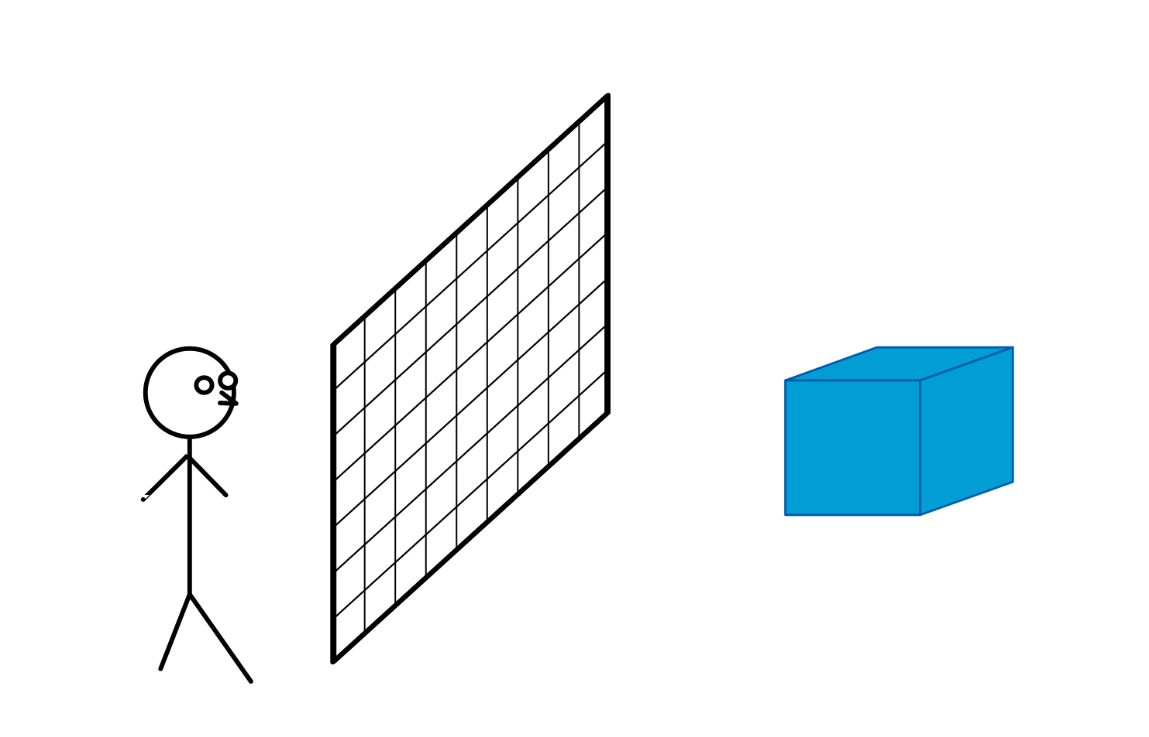
Rendu

Slide 18
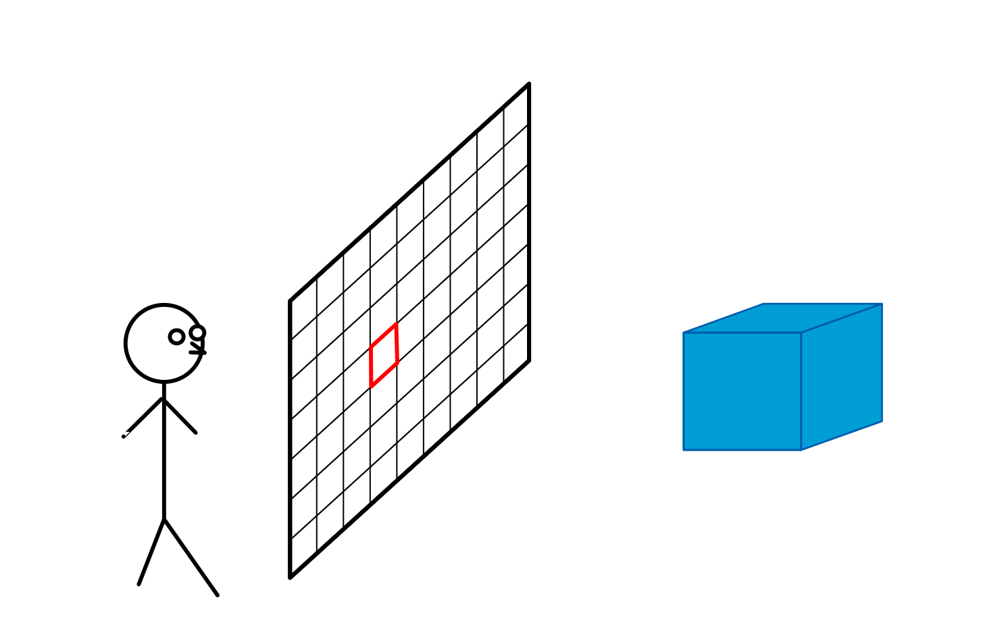
Rendu

Slide 19
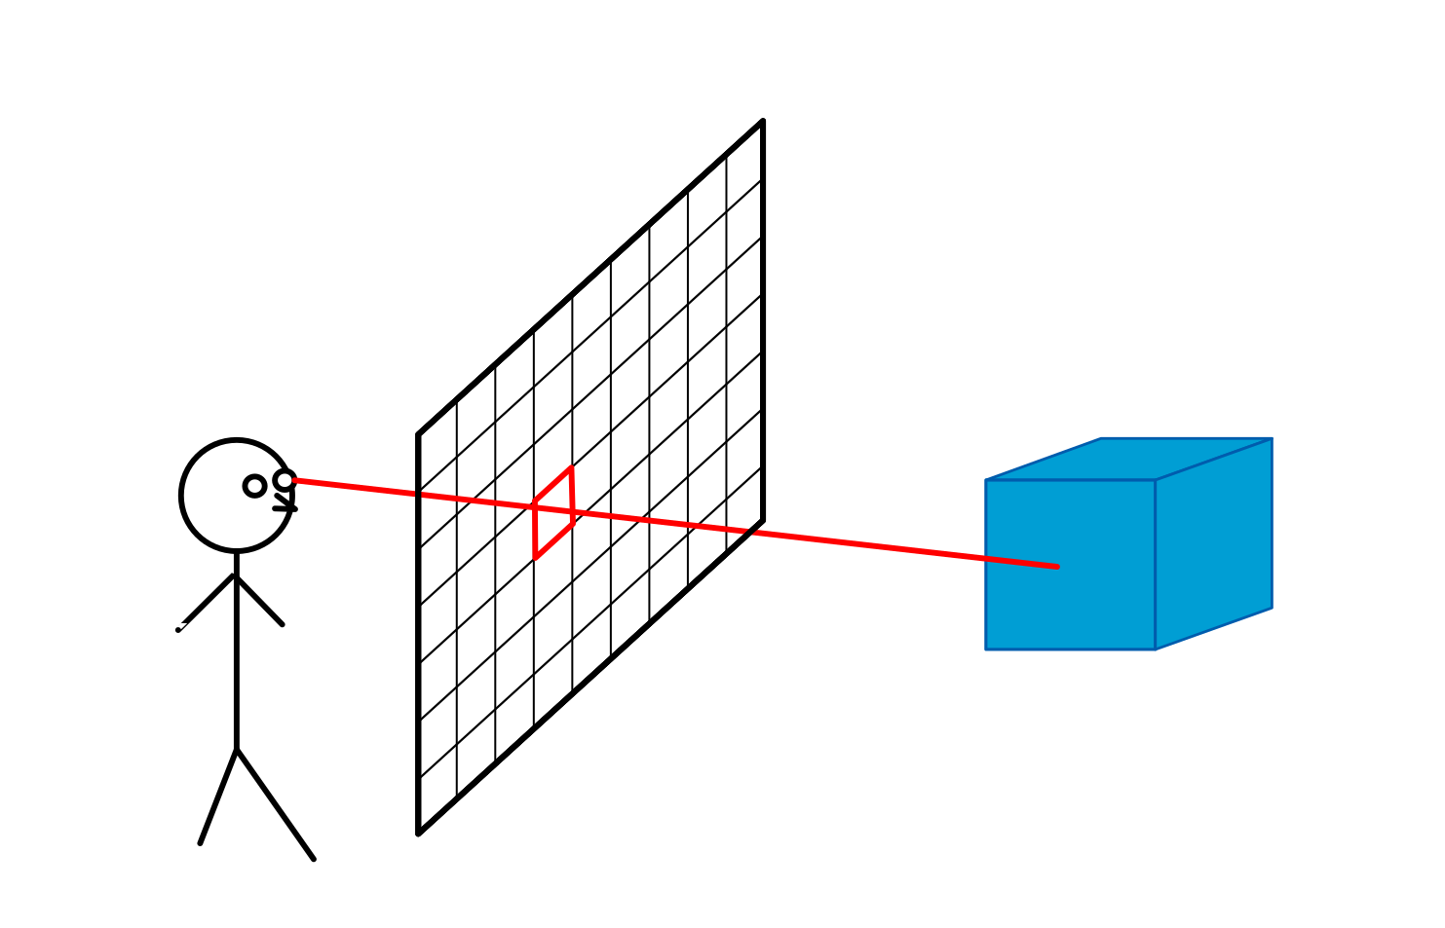
Rendu

Slide 20

Rendu

Slide 21

Rendu

Slide 22
Rendu

Slide 23
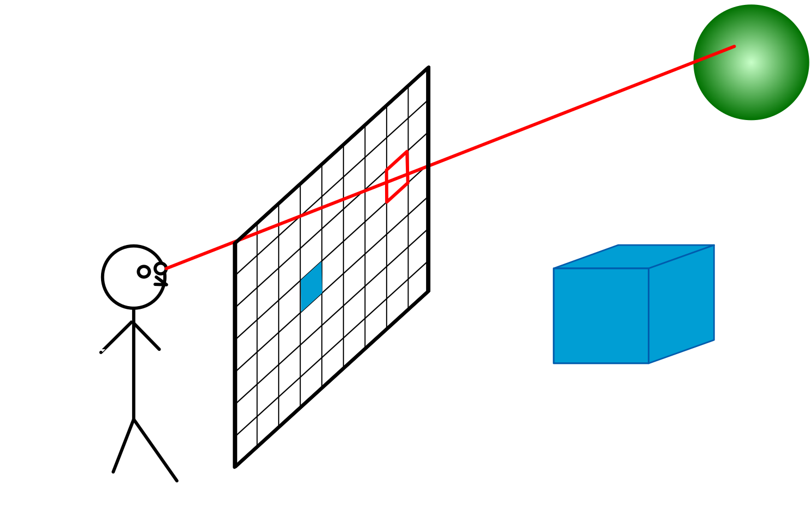
Rendu

Slide 24
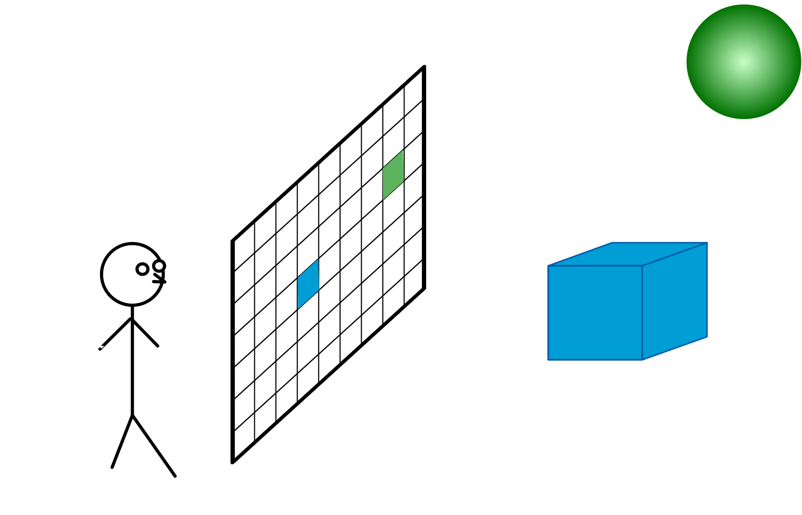
Rendu

Slide 25
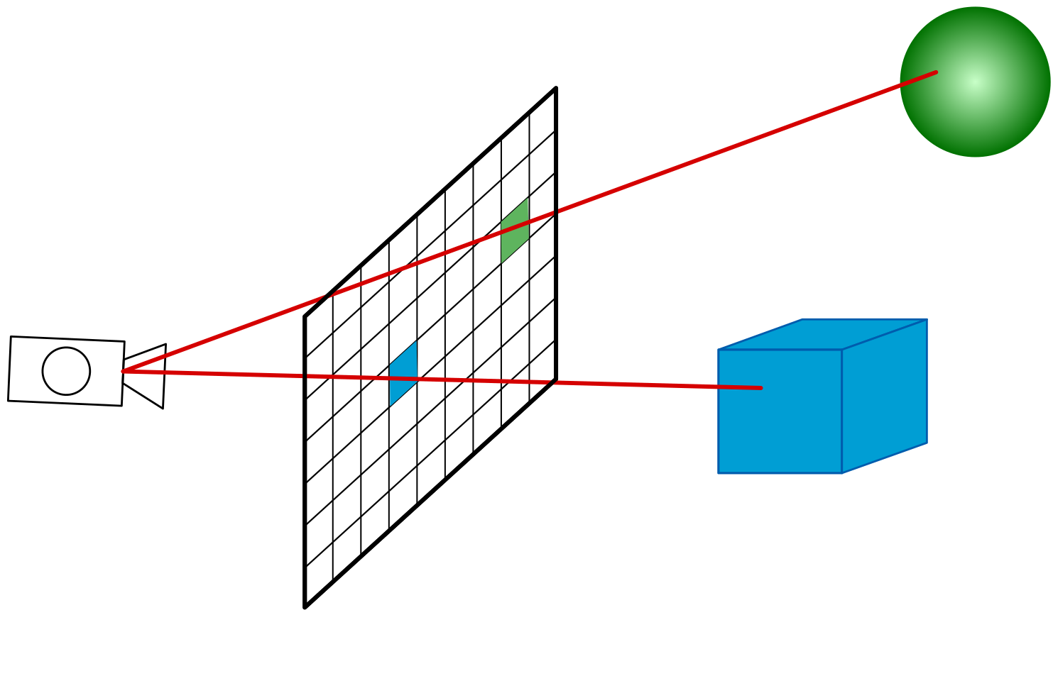
Rendu

Slide 26
Rendu
Rasterisation Lancer de rayon

Slide 27
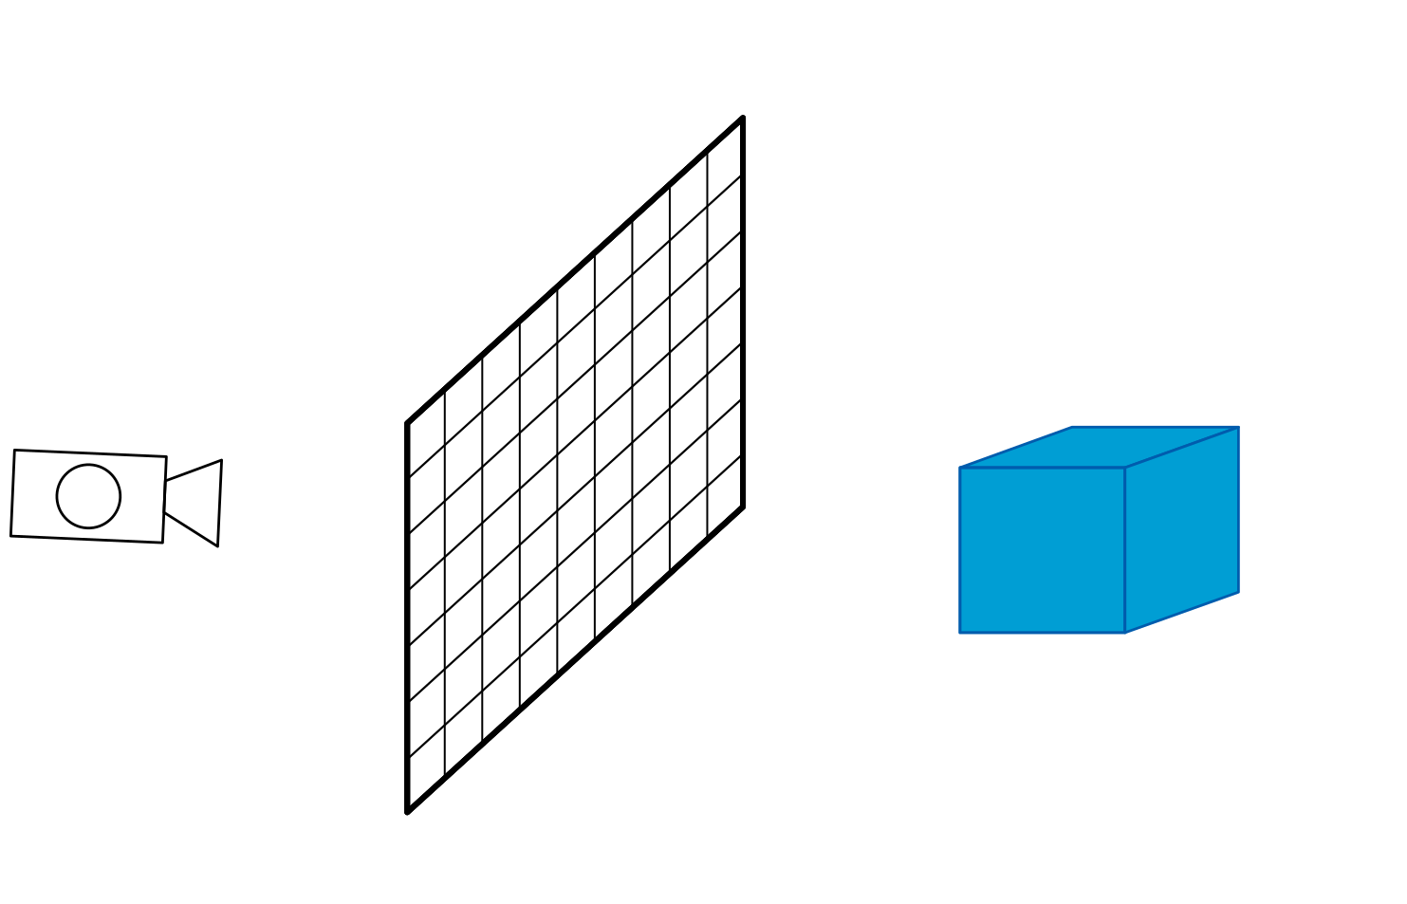
Rendu
Rasterisation Lancer de rayon

Slide 28

Rendu
Rasterisation Lancer de rayon

Slide 29
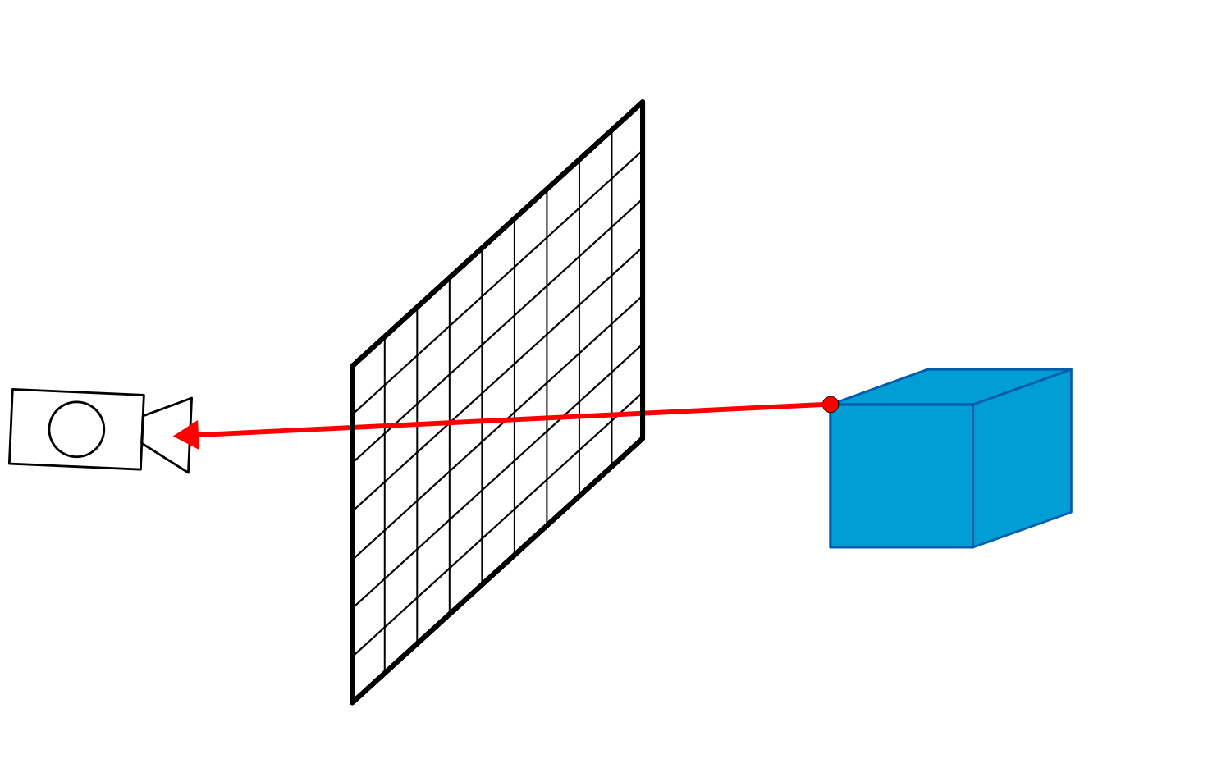
Rendu
Rasterisation Lancer de rayon

Slide 30

Rendu
Rasterisation Lancer de rayon

Slide 31
Rendu
Rasterisation Lancer de rayon

Slide 32

Rendu
Rasterisation Lancer de rayon

Slide 33
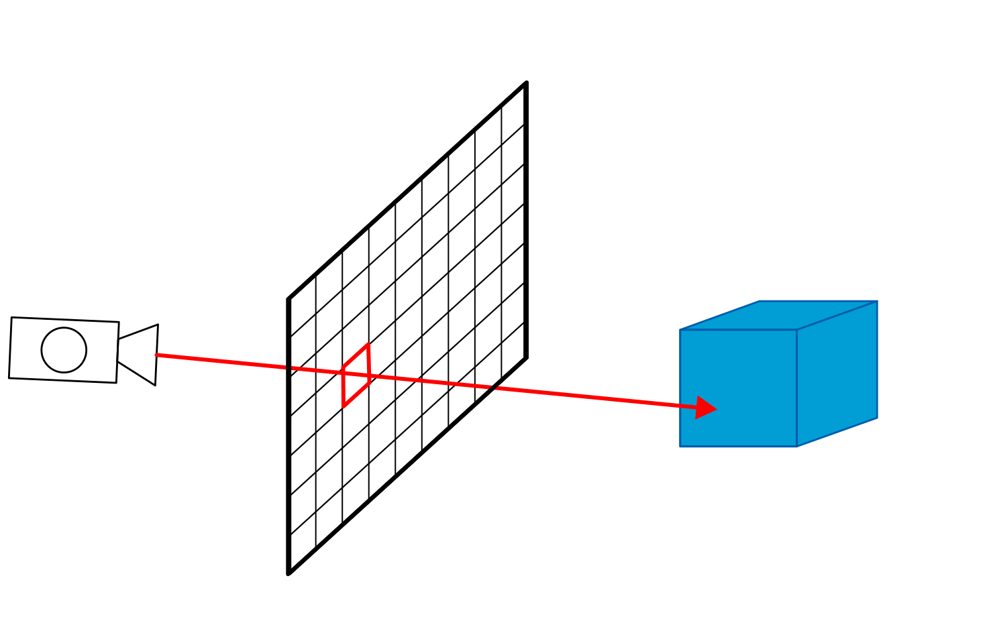
Rendu
Rasterisation Lancer de rayon

Slide 34
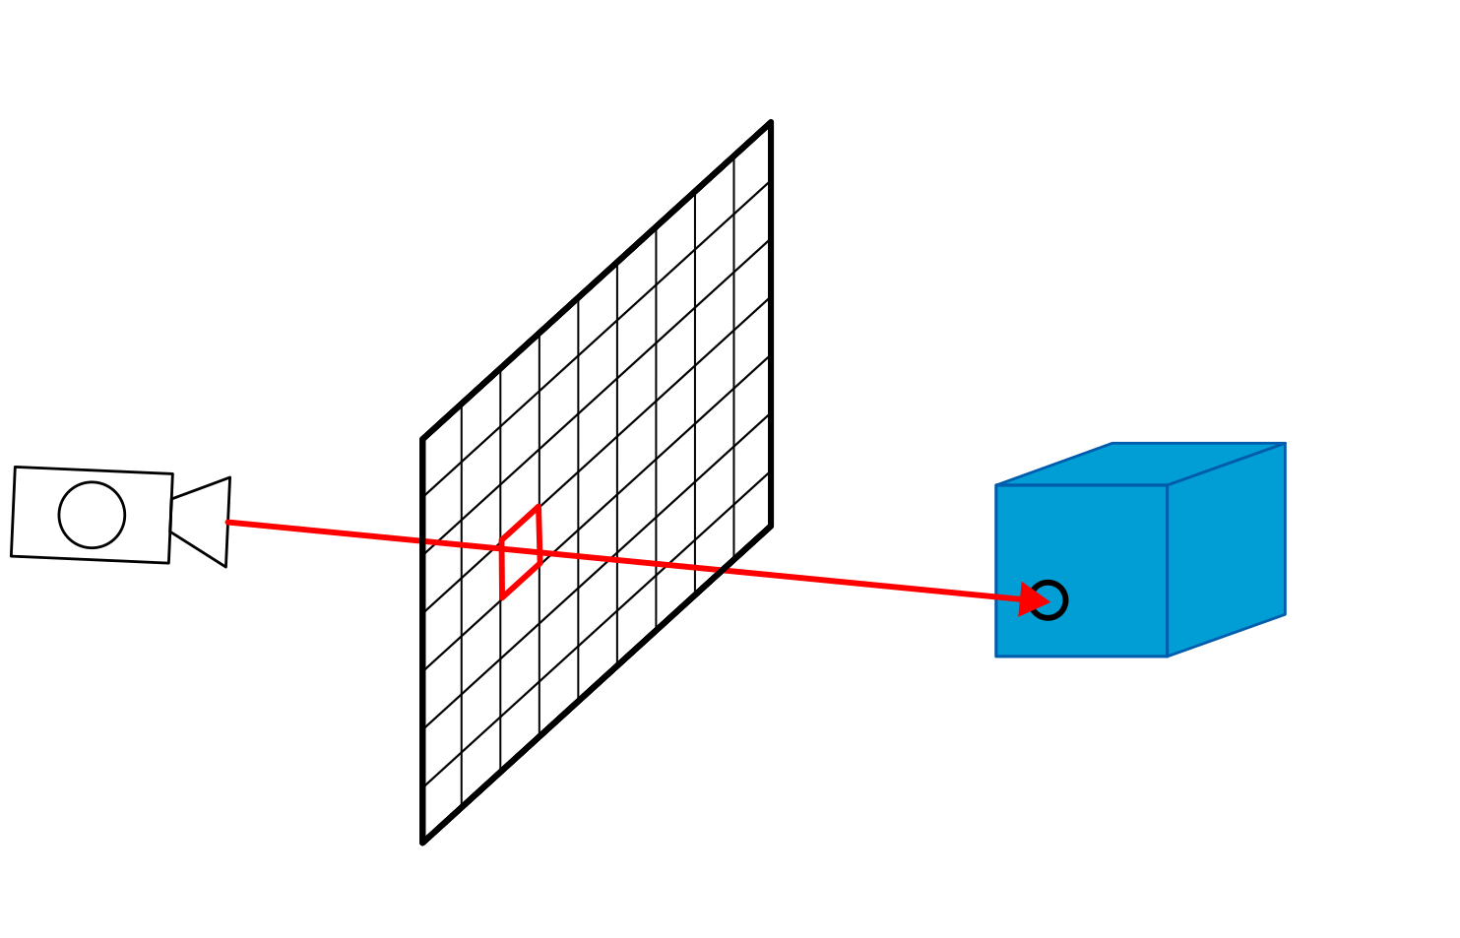
Rendu
Rasterisation Lancer de rayon

Slide 35
Rendu
Rasterisation Lancer de rayon

Slide 36
Rendu
Rasterisation Lancer de rayon
3-4 premiers cours reste des cours+projet

Slide 37
Rendu
Rasterisation Lancer de rayon
Plus rapide
Interfaces pour la 3D (OpenGL / DirectX)
Facile à implementer
Illumination globale, effect réalistes

Slide 38
Rendu: Rasterisation

Slide 39
The rendering pipeline
Transforms
3D model + lights + camera
Clipping
Projection
Rasterization
Shading
Z-test, Blending
2D image with pixel colors

Slide 40
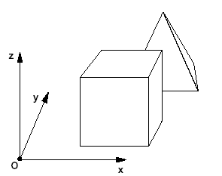
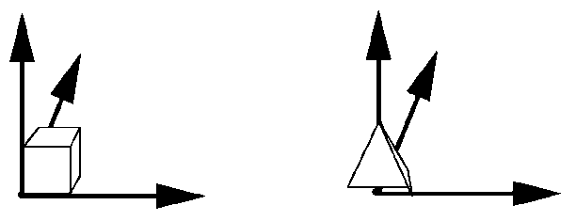
The rendering pipeline
3D models defined in object space
Transformed in common world space
Transforms
Clipping
Projection
Object space
World space
Rasterization
Shading
Z-test, Blending
Durand/Cutler MIT

Slide 41
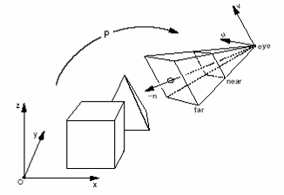
The rendering pipeline
3D models defined in object space
Transformed in common world space
And finally in Camera space
Transforms
Clipping
Projection
Object space
World space
Rasterization
Shading
Z-test, Blending
camera space
world space
Durand/Cutler MIT

Slide 42
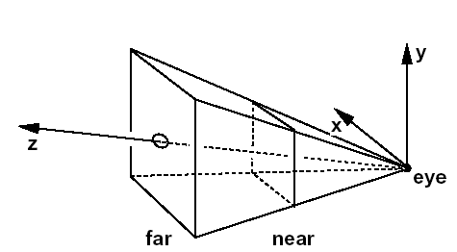
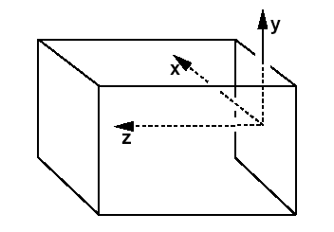
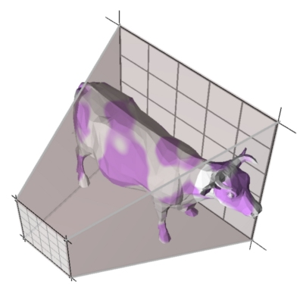
Rastérisation: the rendering pipeline
Transform to Normalized Coordinates (NDC)
Clip anything outside view frustum
Transforms
Clipping
Projection
NDC
camera space
Rasterization
Shading
Z-test, Blending
Durand/Cutler MIT

Slide 43
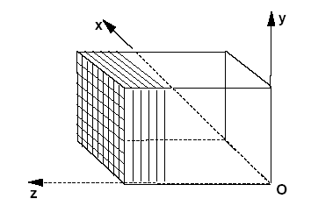
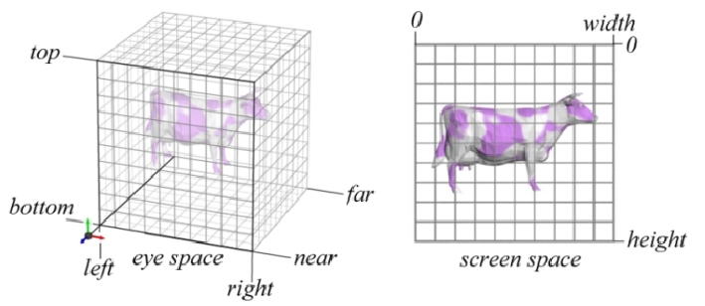
Rastérisation: the rendering pipeline
Projects on screen space
Transforms
Clipping
Projection
NDC
Screen Space
Rasterization
Shading
Z-test, Blending
Durand/Cutler MIT

Slide 44
Rastérisation: the rendering pipeline
Vector to pixels
Interpolate values (color, depth, etc.)
Transforms
Clipping
Projection
Rasterization
Shading
Z-test, Blending

Slide 45
Rasterisation
Old method: line rasterisation

Slide 46
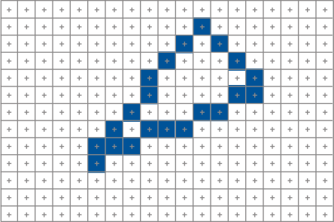
Rasterisation
Old method: line rasterisation
Compute the boundary pixels

Slide 47
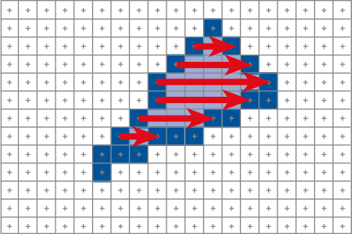
Rasterisation
Old method: line rasterisation
Compute the boundary pixels
Fill the span

Slide 48
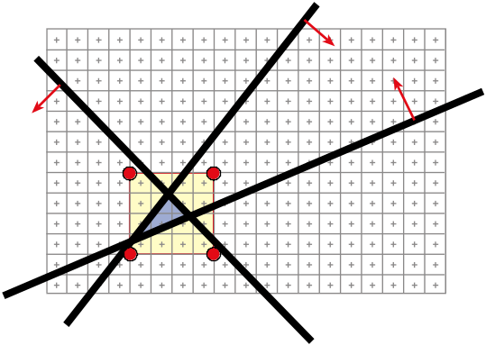
Rasterisation
Method for modern GPU

Slide 49
Rasterisation
Method for modern GPU
2
1
0

Slide 50
Rasterisation
Method for modern GPU
2
1
0

Slide 51
Rasterisation
Method for modern GPU
2
1
0

Slide 52
Rasterisation
Method for modern GPU
2
1
0

Slide 53
Rasterisation
Method for modern GPU
2
1
0

Slide 54
Rasterisation
Method for modern GPU
2
1
0

Slide 55
Rastérisation: the rendering pipeline
Transforms
Clipping
Projection
Rasterization
Shading
Z-test, Blending

Slide 56
Rastérisation: the rendering pipeline
Transforms
Z (depth) -buffer: keep the closest pixel
Clipping
Projection
Rasterization
Shading
Z-test, Blending

Slide 57
Rasterisation: the rendering pipeline
Transforms
APIs and GPUs
Most steps are controllable
    Render states
    Enable/disable operations
Some are programmable
    Vertex transform
    Pixel shading
Clipping
Projection
Rasterization
Shading
Z-test, Blending

Slide 58
Rasterisation: the rendering pipeline
geometry
projected
fragments
pixels
Application
Vertex
processor
Fragment
processor
Rasterizer
screen

Slide 59
Rasterisation: the rendering pipeline
geometry
projected
fragments
pixels
Application
Vertex
processor
Fragment
processor
Rasterizer
screen

Slide 60
Rasterisation: the rendering pipeline
geometry
projected
fragments
pixels
Application
Vertex
processor
Fragment
processor
Rasterizer
screen

Slide 61
Rasterisation: the rendering pipeline
geometry
projected
fragments
pixels
Application
Vertex
processor
Fragment
processor
Rasterizer
screen

Slide 62
Rasterisation: the rendering pipeline
geometry
projected
fragments
pixels
Application
Vertex
processor
Fragment
processor
Rasterizer
screen

Slide 63
Rasterisation: the rendering pipeline
geometry
projected
fragments
pixels
Application
Vertex
processor
Fragment
processor
Rasterizer
screen

Slide 64
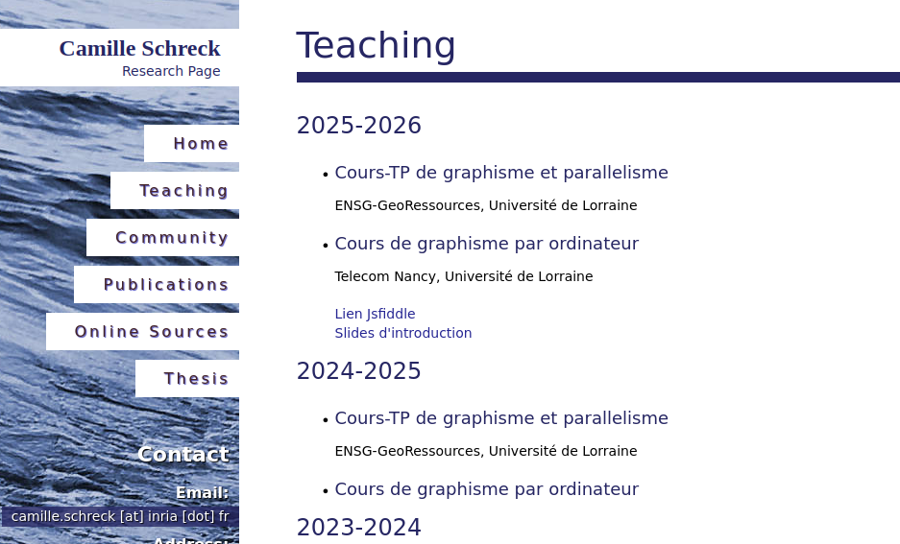
Let’s get started...
schreckc.github.io

