Slide 1

Introduction à l’infomatique graphique
Camille Schreck
Permission to reuse for teaching in tuition-free schools is granted provided that credits are given.
All other uses are forbidden without explicit permission.

Slide 2
Introduction
Informatique graphique
Rendu
Modélisation
Animation
Simulation
...

Slide 3
Introduction
Ce qu’on va voir pendant ce cours:

Slide 4
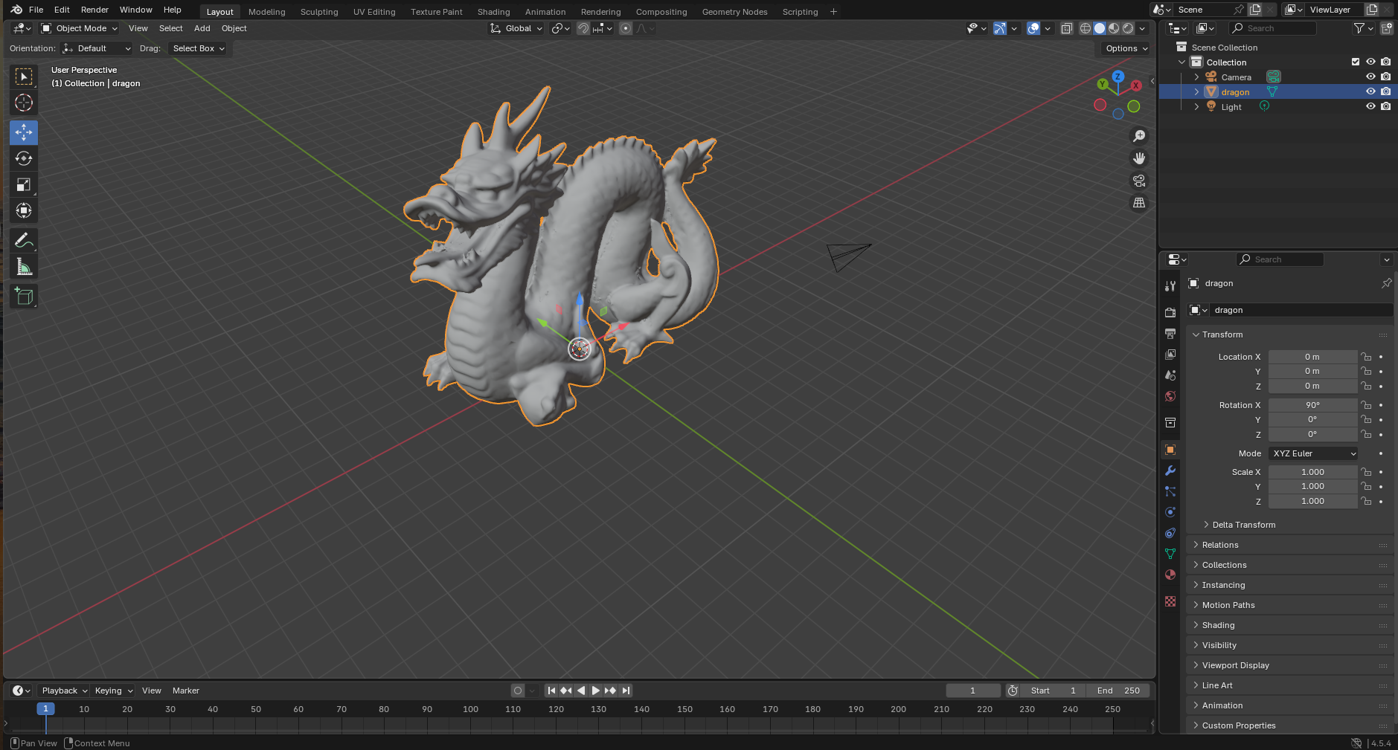
Introduction
Ce qu’on va voir pendant ce cours:

Slide 5
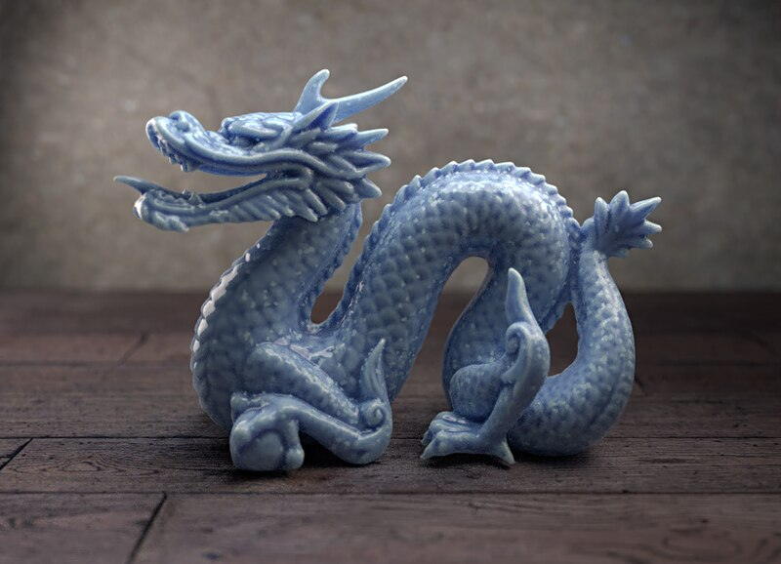
Introduction
Ce qu’on va voir pendant ce cours:

Slide 6
Introduction
Avant 1996: software

Slide 7
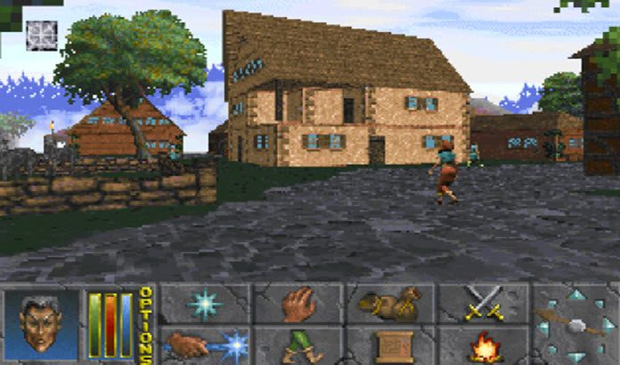
Daggerfall 1996

Slide 8
Introduction
Avant 1996: software
Après 1996: graphics accelerator (GPU)

Slide 9
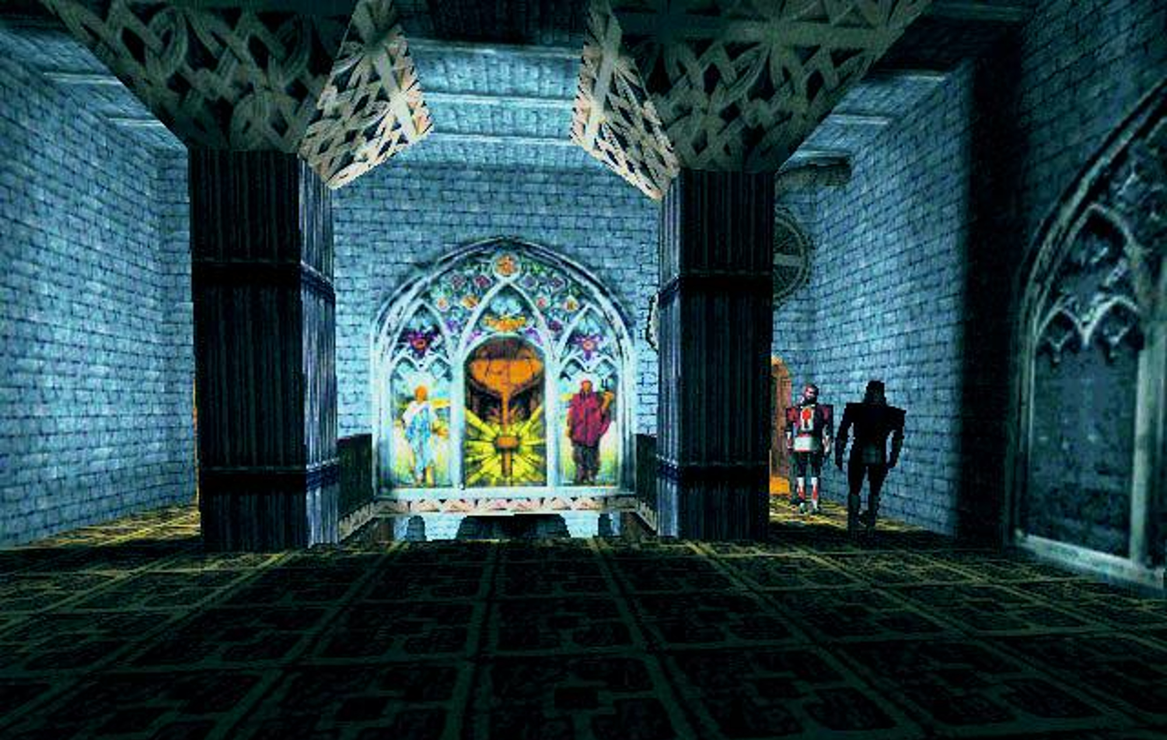
Thief 1998

Slide 10
Introduction
Avant 1996: software
Après 1996: graphics accelerator (GPU)
Maintenant...

Slide 11
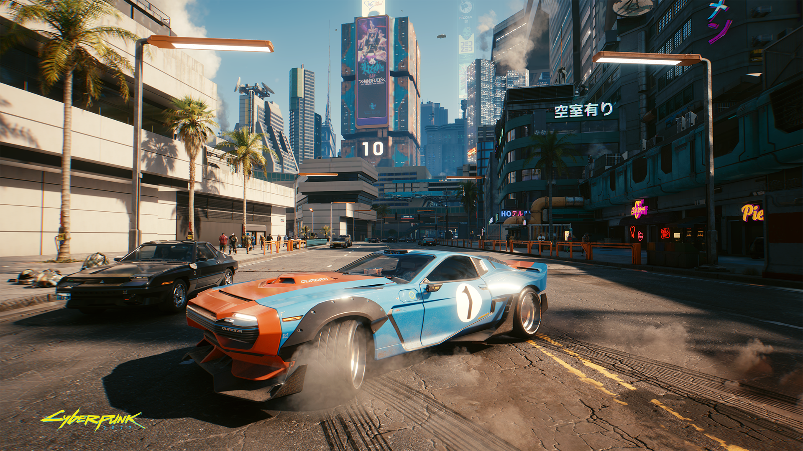
Cyberpunk 2077, 2020

Slide 12
Shader
In computer graphics, a shader is a programmable operation which is applied to data as it moves through the rendering pipeline.

Slide 13
Shader
In computer graphics, a shader is a programmable operation which is applied to data as it moves through the rendering pipeline.
Data: vertices, pixels, primitives…

Slide 14
Shader
In computer graphics, a shader is a programmable operation which is applied to data as it moves through the rendering pipeline.
Data: vertices, pixels, primitives…
Sur le GPU.

Slide 15
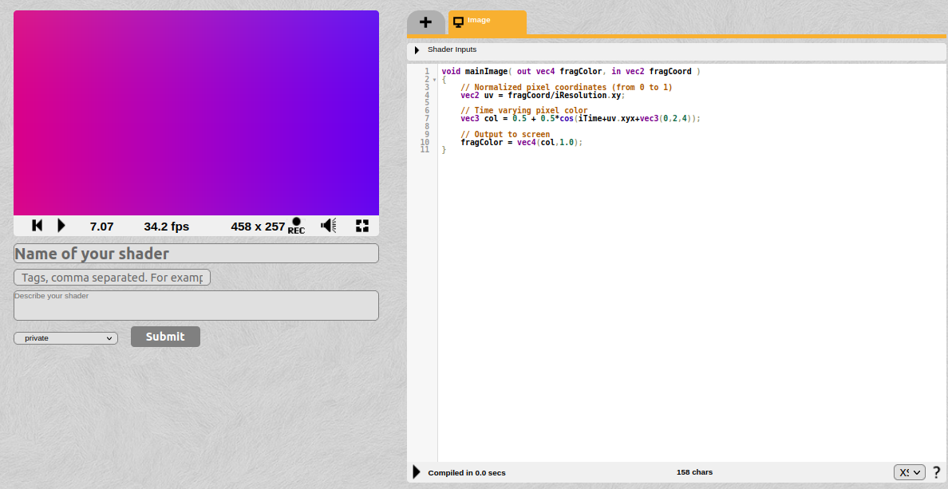
Introduction aux shaders sur Shadertoy

Slide 16

Introduction aux shaders sur Shadertoy

Slide 17

Introduction aux shaders sur Shadertoy

Slide 18
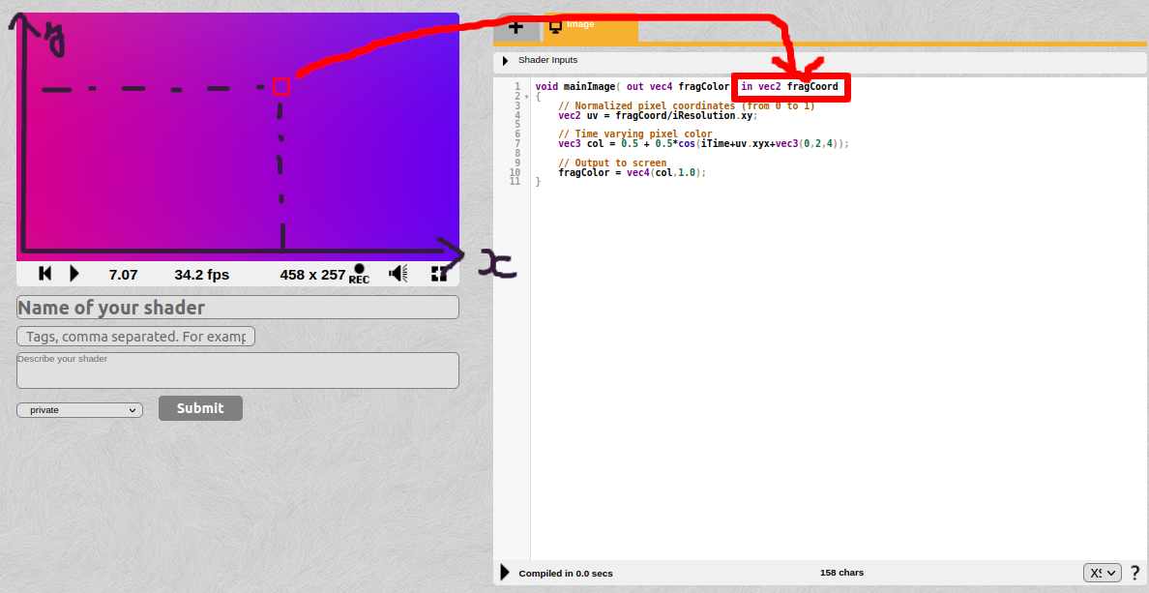
Introduction aux shaders sur Shadertoy

Slide 19
GLSL: OpenGL Shading Language
OpenGL
Proche du C
Vecteurs et matrices

Slide 20


Shadertoy
https://www.youtube.com/watch?v=8--5LwHRhjk
https://www.shadertoy.com/view/WsSBzh

Slide 21
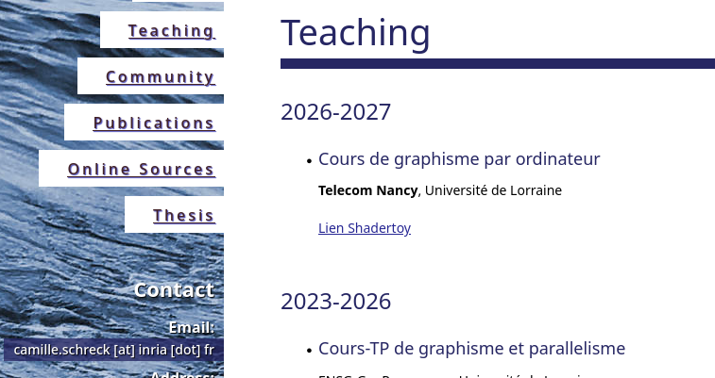
Let’s get started...
schreckc.github.io

