Slide 1
Introduction à l’informatique graphique
C.Schreck
Permission to reuse for teaching in tuition-free schools is granted provided that credits are given.
All other uses are forbidden without explicit permission.

Slide 2
3D en informatique graphique
Avant 1996: Software
Après 1996: Graphics accelerators (GPUs)
Actuellement:
– Interfaces pour la 3D (OpenGL / DirectX)
– Mais utile de connaître les algorithmes bas-niveau
(programation de shader, rendu...)

Slide 3
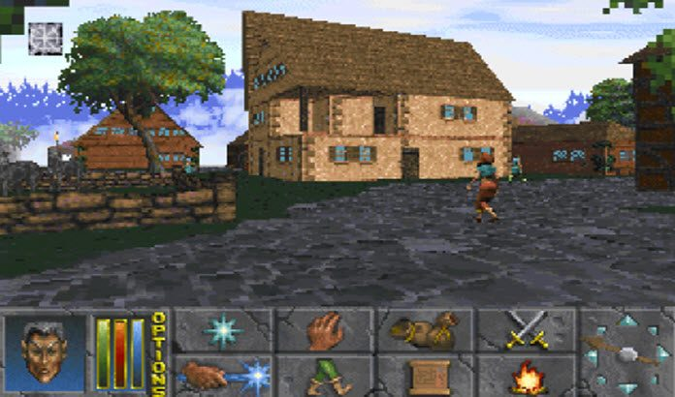
Daggerfall 1996

Slide 4
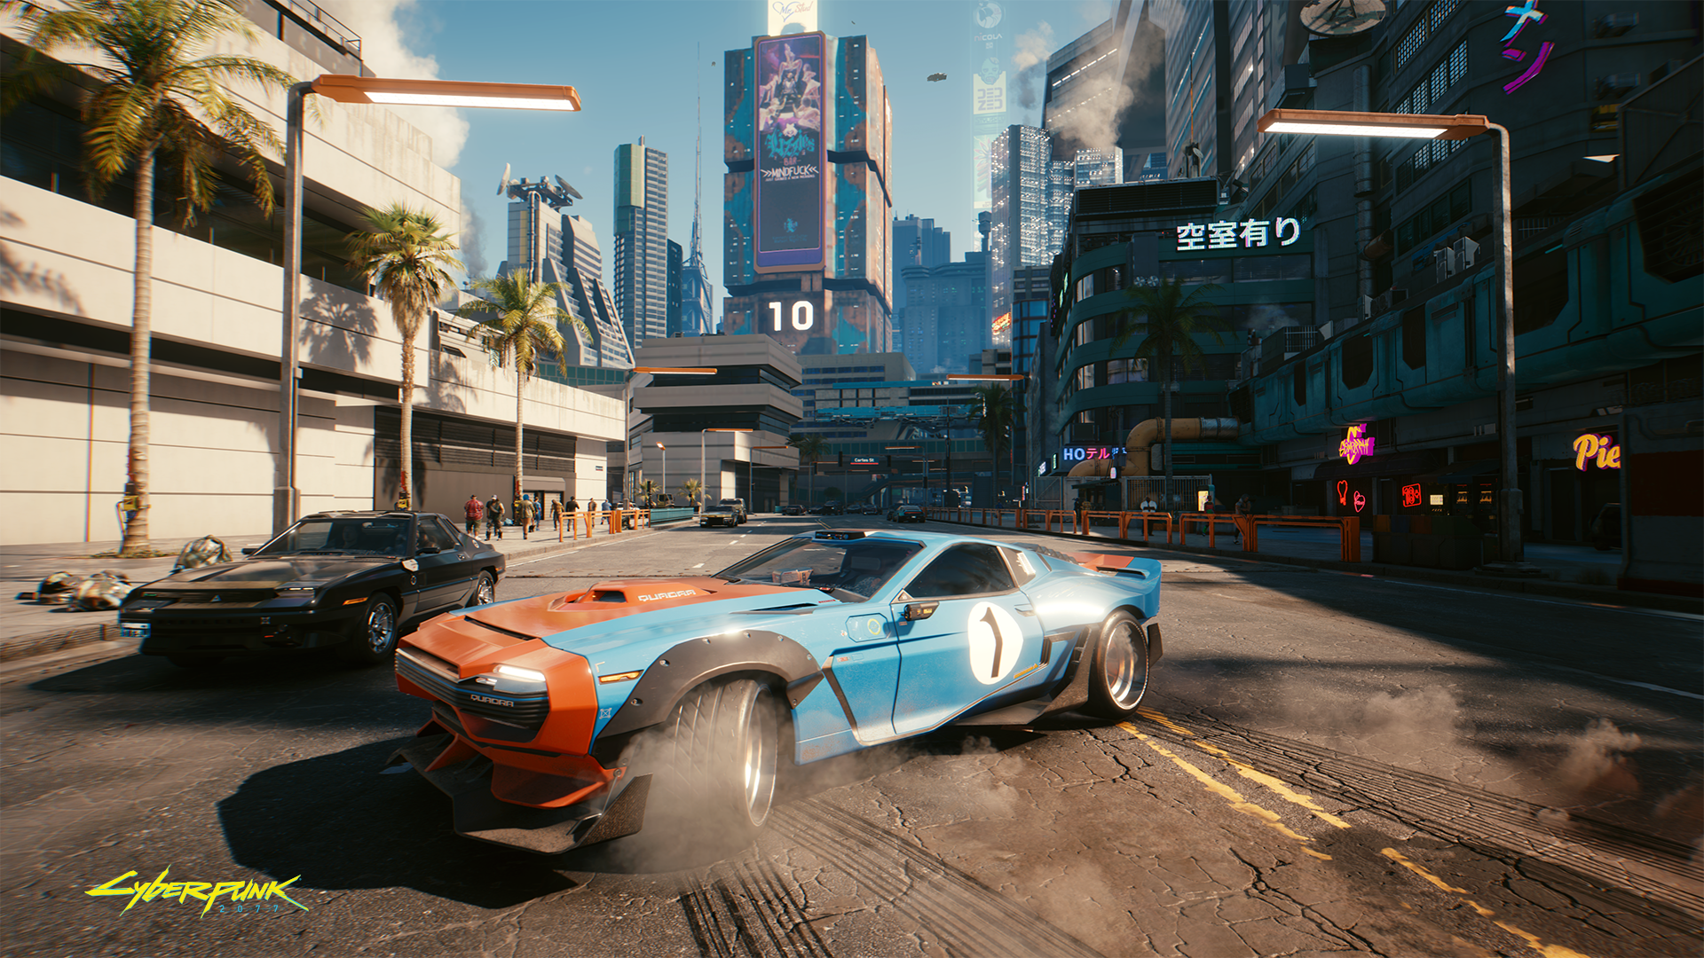

Slide 5
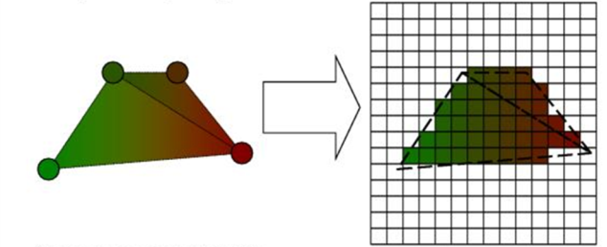
Projective rendering

Slide 6
The rendering pipeline
Transforms
3D model + lights + camera
Clipping
Projection
Rasterization
Shading
Z-test, Blending
2D image with pixel colors

Slide 7
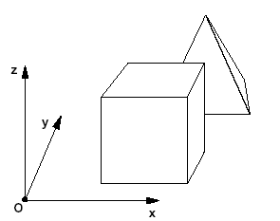
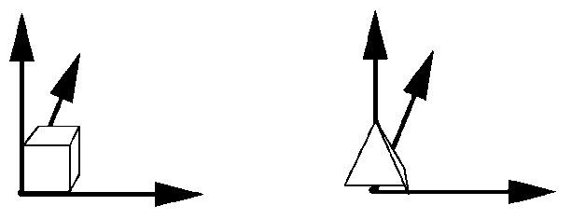
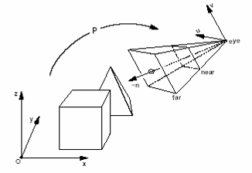
Modeling Transformations
3D models defined in object space
Transformed in common world space
And finally in
Camera space
Transforms
Clipping
Projection
Object space
World space
Rasterization
Shading
Z-test, Blending
camera space
world space
Durand/Cutler MIT

Slide 8
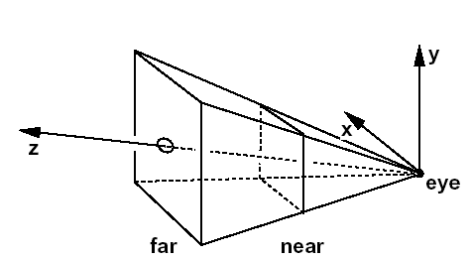
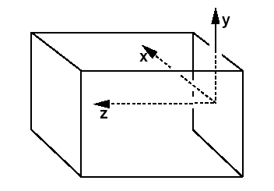
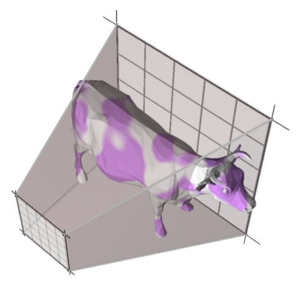
Clipping
Transform to Normalized Coordinates (NDC)
Clip anything outside view frustum
Transforms
Clipping
Projection
NDC
camera space
Rasterization
Shading
Z-test, Blending
Durand/Cutler MIT

Slide 9
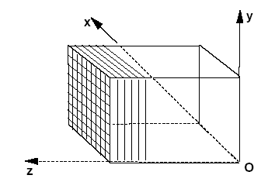
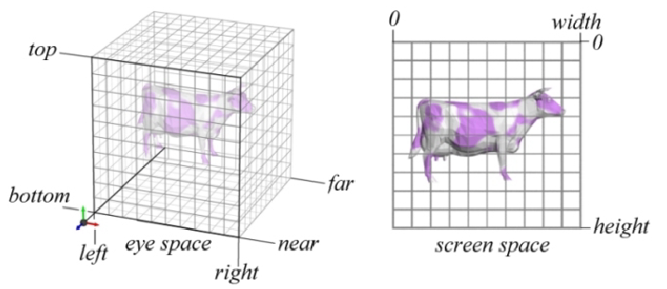
Projection
Projects on screen space
Transforms
Clipping
Projection
NDC
Screen Space
Rasterization
Shading
Z-test, Blending
Durand/Cutler MIT

Slide 10
Rasterization
Vector to pixels
Interpolate values (color, depth, etc.)
Transforms
Clipping
Projection
Rasterization
Shading
Z-test, Blending

Slide 11
Use line rasterization
Compute the boundary pixels

Slide 12
Scan-line Rasterization
Compute the boundary pixels
Fill the spans

Slide 13
For modern graphics cards

Slide 14
2
1
0

Slide 15
Shading
Transforms
Clipping
Projection
Rasterization
Shading
Z-test, Blending

Slide 16
Visibility / Display
Z (depth) -buffer: keep the closest pixel
Transforms
Clipping
Projection
Rasterization
Shading
Z-test, Blending

Slide 17
APIs and GPUs
Most steps are controllable
Render states
Enable/disable operations
Some are programmable
Vertex transform
Pixel shading
Transforms
Clipping
Projection
Rasterization
Shading
Z-test, Blending

Slide 18
GPU pipeline in a nutshell
geometry
projected
fragments
pixels
Application
Vertex
processor
Fragment
processor
Rasterizer
screen

Slide 19
GPU pipeline in a nutshell
geometry
projected
fragments
pixels
Application
Vertex
processor
Fragment
processor
Rasterizer
screen

Slide 20
GPU pipeline in a nutshell
geometry
projected
fragments
pixels
Application
Vertex
processor
Fragment
processor
Rasterizer
screen

Slide 21
GPU pipeline in a nutshell
geometry
projected
fragments
pixels
Application
Vertex
processor
Fragment
processor
Rasterizer
screen

Slide 22
GPU pipeline in a nutshell
geometry
projected
fragments
pixels
Application
Vertex
processor
Fragment
processor
Rasterizer
screen

Slide 23
GPU pipeline in a nutshell
geometry
projected
fragments
pixels
Application
Vertex
processor
Fragment
processor
Rasterizer
screen

