Slide 1
User Experience UX – Analysis
Find new ways to record and measure user experience
Simon Schrei
Supervisor
DI John Feiner

Slide 2
User Experience
”It’s everything that touches upon your experience with the product.” Donald Norman

Slide 3
User Experience
”You’ve got to start with the customer experience and work back toward the technology – not the other way around.” Steve Jobs

Slide 4
Common ways
Thinking Aloud
Eye tracking
Feedback
“We all need people
who will give us feedback.
That‘s how we improve.“
Bill Gates

Slide 5
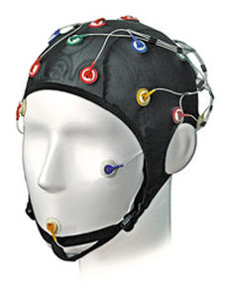
New way
Neurologic cap
http://img.medicalexpo.com/images_me/photo-m2/69285-4751701.jpg

Slide 6
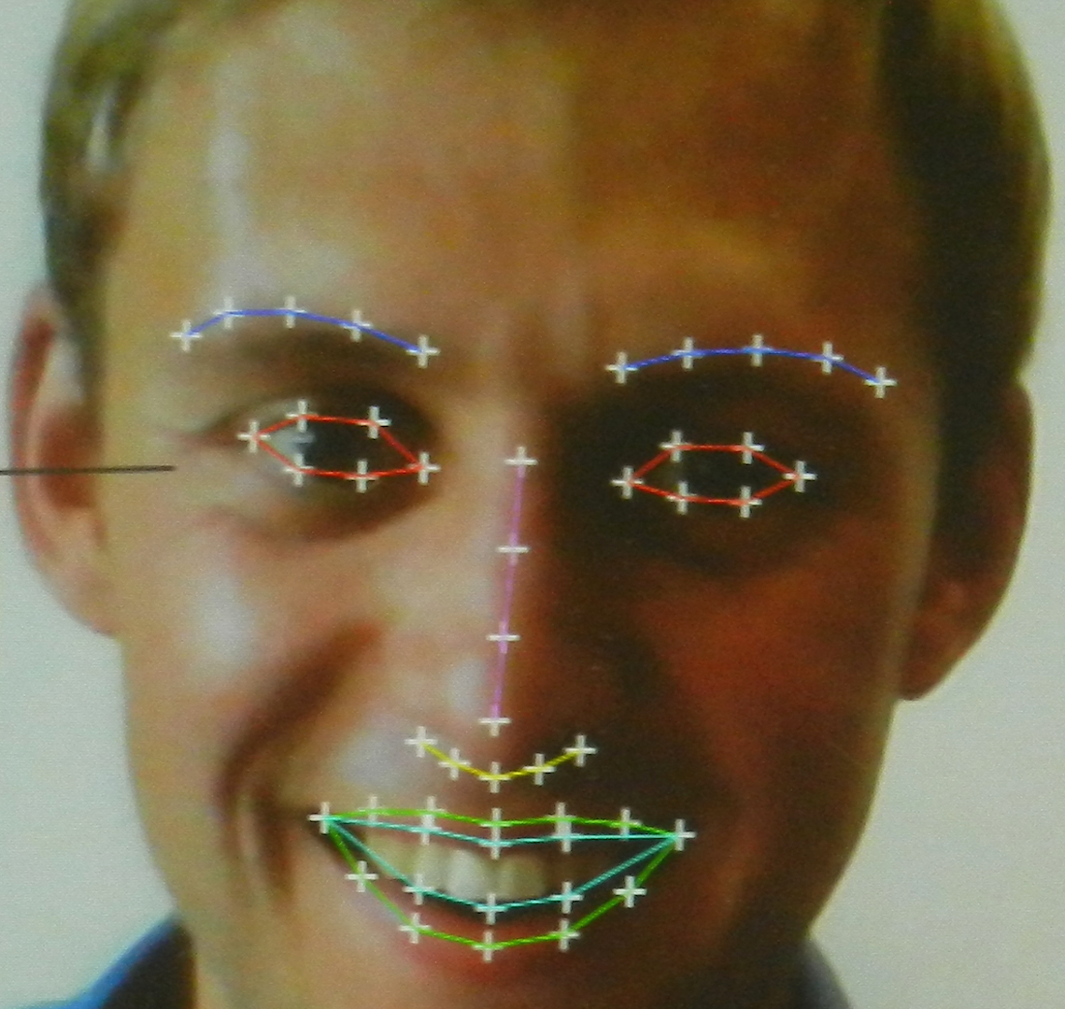
New way
Emotion tracking
http://marketingland.com/wp-content/ml-loads/2016/01/Realeyes_1920.png

Slide 7


My Project
Android App
Touch Tracker
https://pixabay.com/de/androide-schneemann-mobilfunk-1904852/
http://winxperts4all.at/images/stories/artikelbilder/Windows_Phone/java-logo.png

Slide 8
Result
News app
Touch | Spot (x|y) | Time | Difference
Touch 1 | 140, 200 | 21:00:00
Touch 2 | 140, 210 | 21:00:10 | 00:00:10
Touch 3 | 145, 190 | 21:00:20 | 00:00:10
Touch 4 | 140, 200 | 21:00:30 | 00:00:10
Touch 5 | 140, 210 | 21:00:40 | 00:00:10

Slide 9
Result
News app
Touch | Spot (x|y) | Time | Difference
Touch 1 | 140, 200 | 21:00:00
Touch 2 | 140, 210 | 21:01:00 | 00:01:00
Touch 3 | 145, 190 | 21:03:00 | 00:02:00

Slide 10
Questions?

