Slide 1
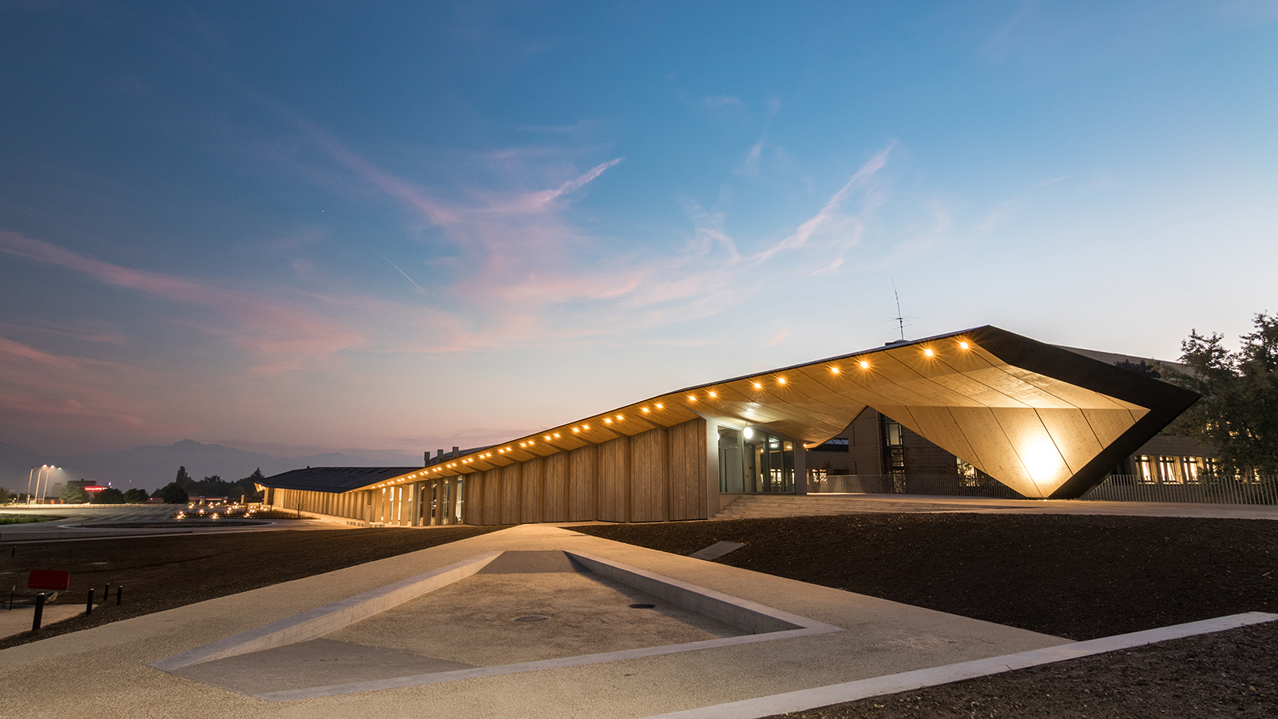

Ecole polytechnique fédérale de Lausanne
Route Planner
EPFL Presentation | 2018

Slide 2
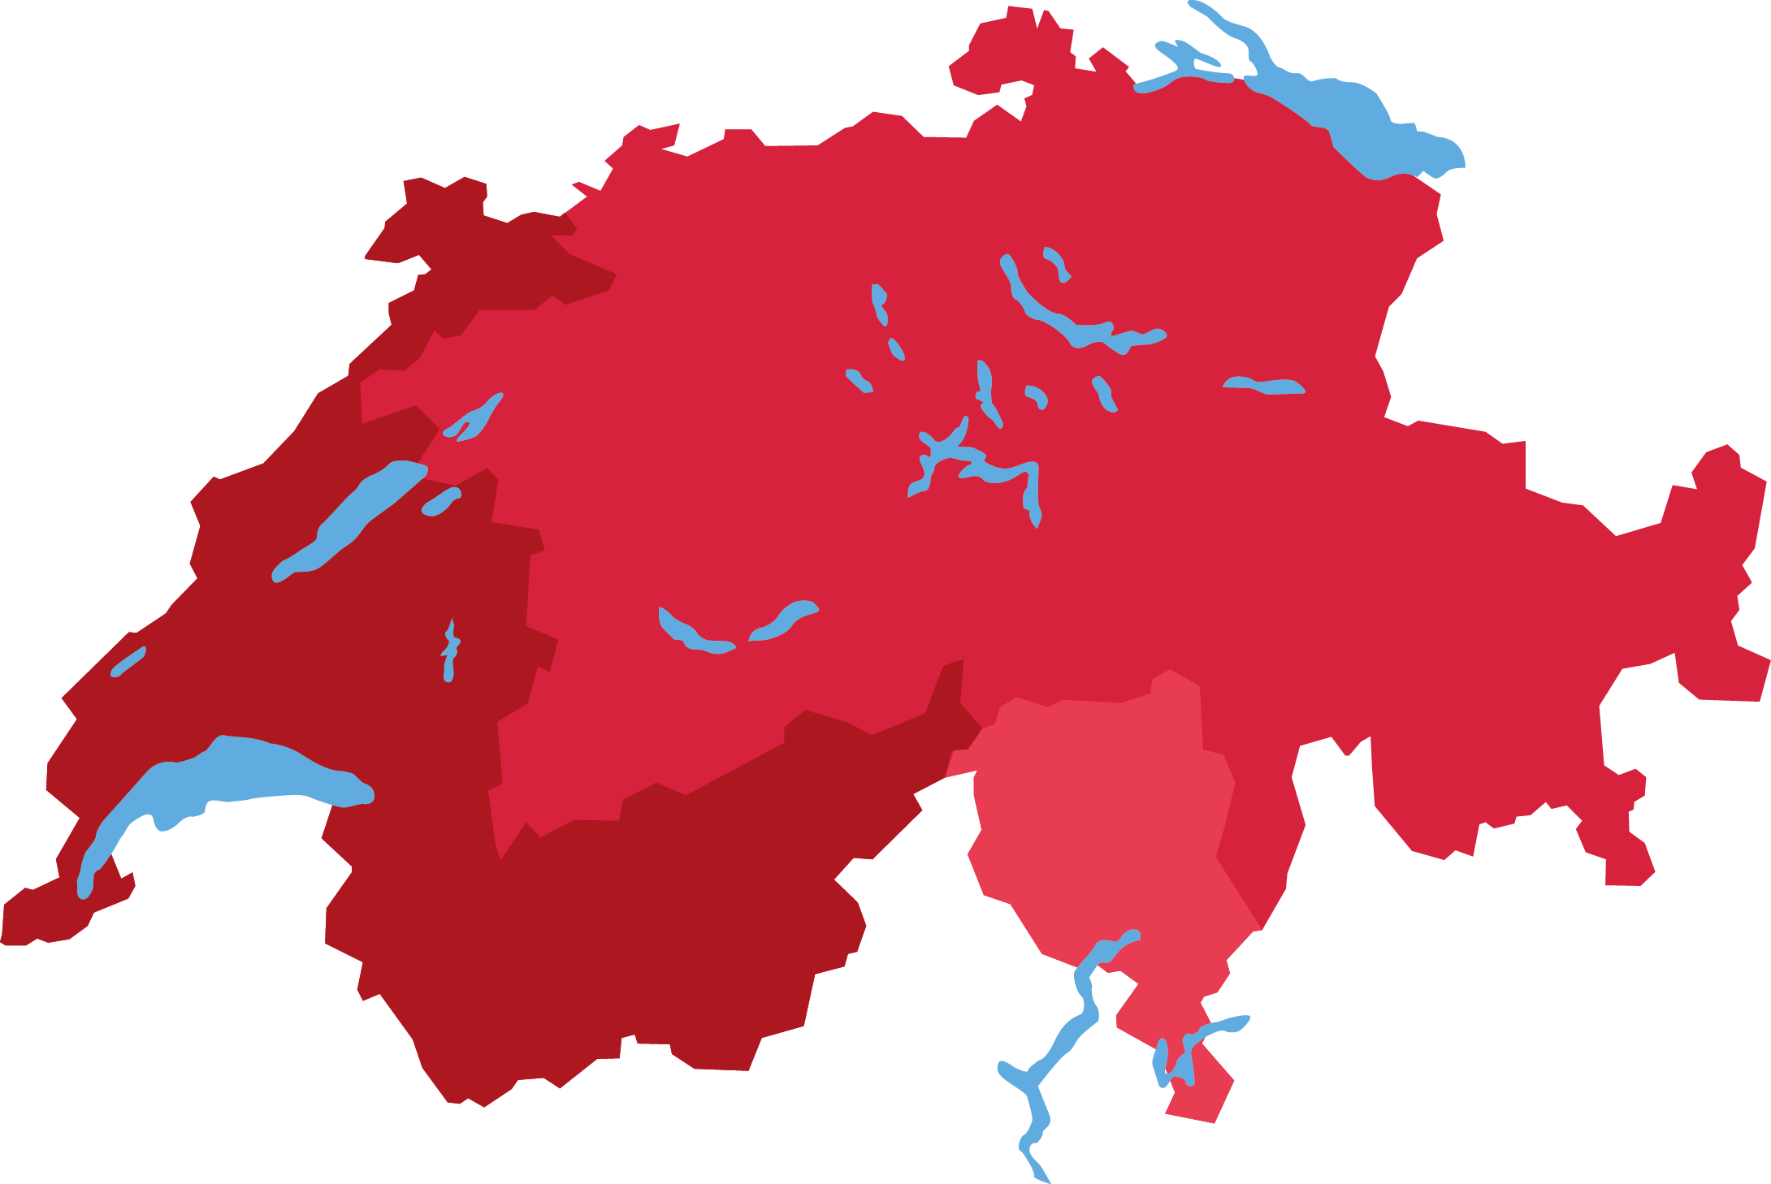
Where do you want to go ?
Bale
Zürich
St. Gallen
Bern
Lausanne
Geneva
Verbier
EPFL Presentation | 2018

Slide 3
The problem we have
Robust Journey Planner
Isochronous
Map
EPFL Presentation | 2018

Slide 4
Decompose the problem in small task
Data
Preprocessing
Delay distribution modelling
Visualization
Deterministic planner
with OTP
Robust route planning
EPFL Presentation | 2018

Slide 5
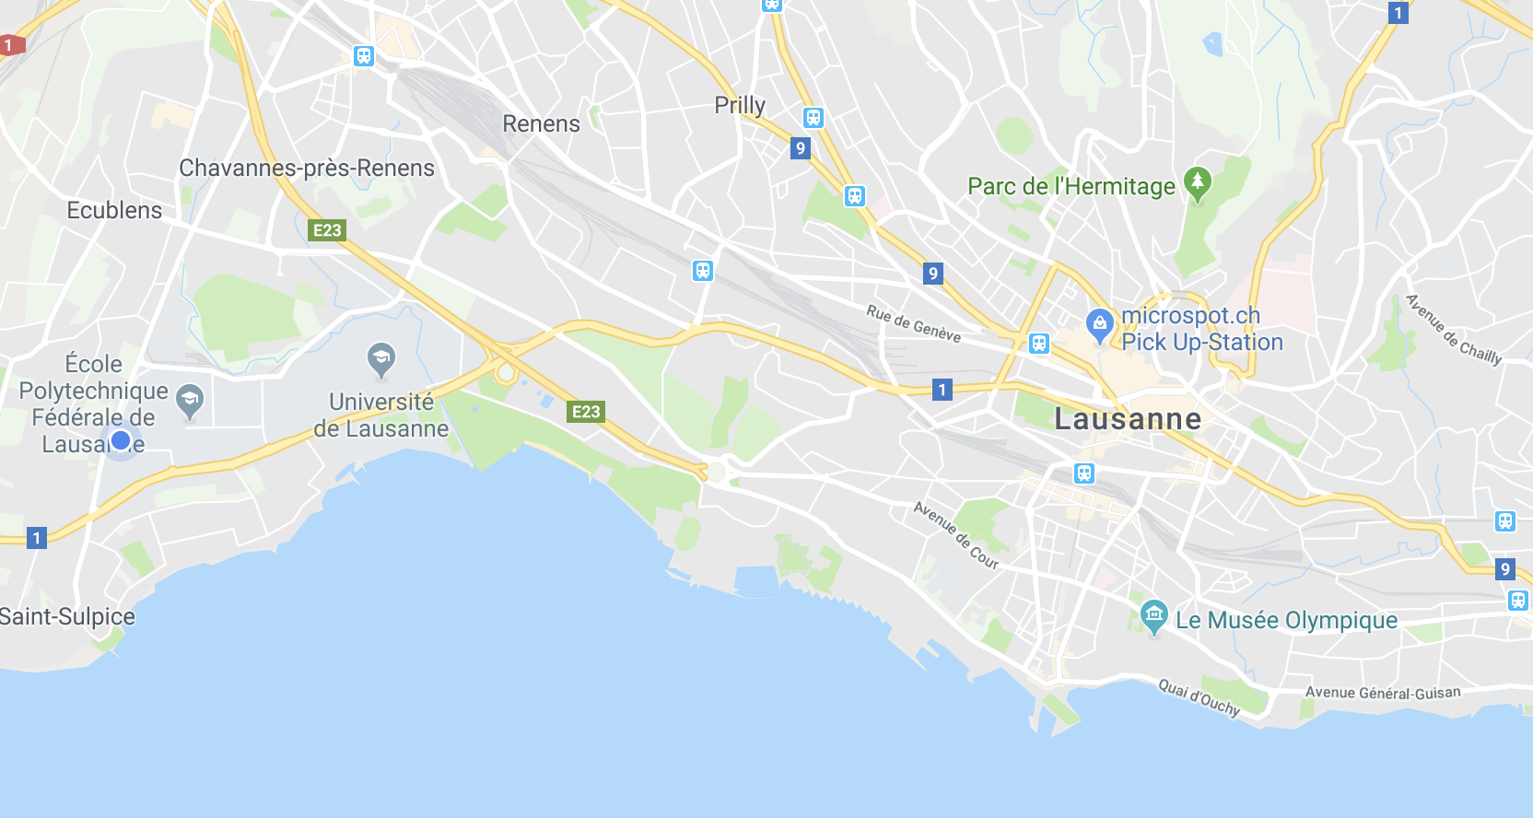
Preprocessing – Clean Metadata
Lausanne
Many redundancies
We use another dataset to recover name
38%
EPFL Presentation | 2018

Slide 6
Deterministic journey planner solution
Harnessing the power of open-source community
OpenTripPlanner – trusted by governments from:
  Finland
  Norway
  Oregon, New York, Los Angeles, Washington
  Netherlands
Using SBB timetable
EPFL Presentation | 2018

Slide 7
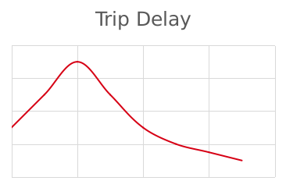
Decision tree for Feature selection
Best features
Hours
38%
StopName
2.9%
33%
Line ID
20%
EPFL Presentation | 2018

Slide 8
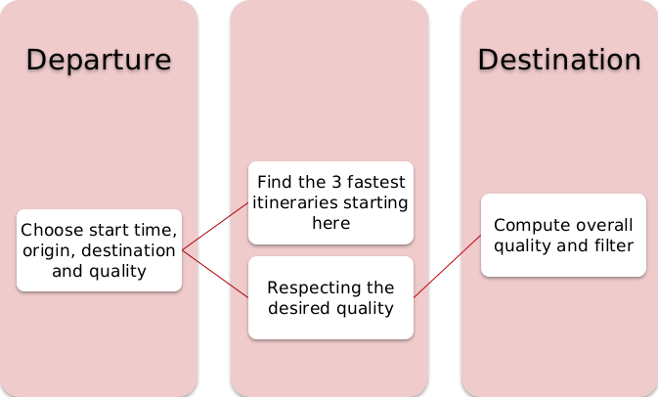
Robust route planning
For each stop in between
EPFL Presentation | 2018

Slide 9
Isochronous map
Let’s try
Zurich morning rush hours
Zurich morning rush hours with quality

Slide 10
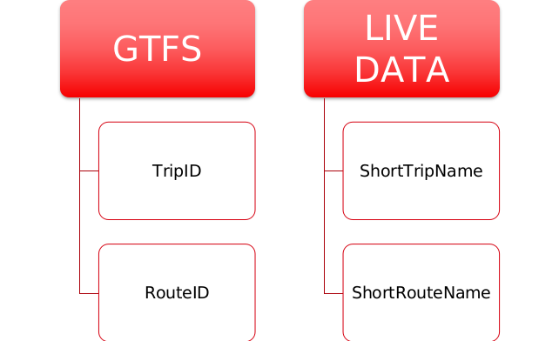
Preprocessing – Match Dataset – Get unique travel ID
EPFL Presentation | 2018

