Slide 1
Classification in Machine Learning
Suchismit Mahapatra

Slide 2
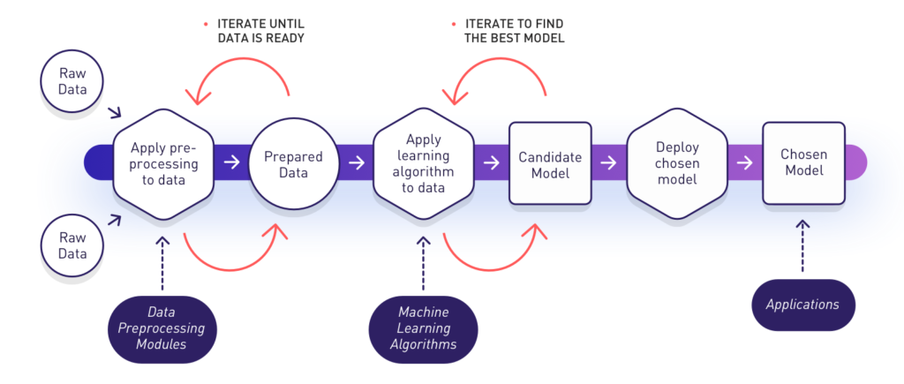
What is Machine Learning
“Machine learning studies algorithms for learning to do stuff. We might, for instance, be interested in learning to complete a task, to make accurate predictions, or to behave intelligently. The learning that is being done is always based on some sort of observations, such as examples…direct experience, or instruction. Thus, machine learning is about learning to do better in the future based on what was experienced in the past.”
Image credit: datasciencecentral

Slide 3
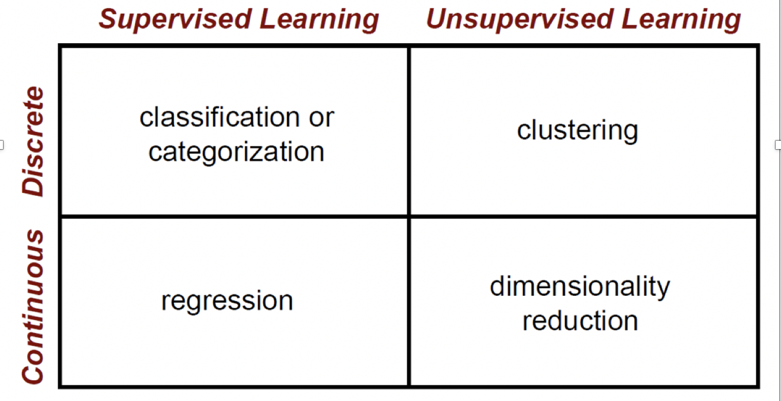
Machine Learning - Topology

Slide 4
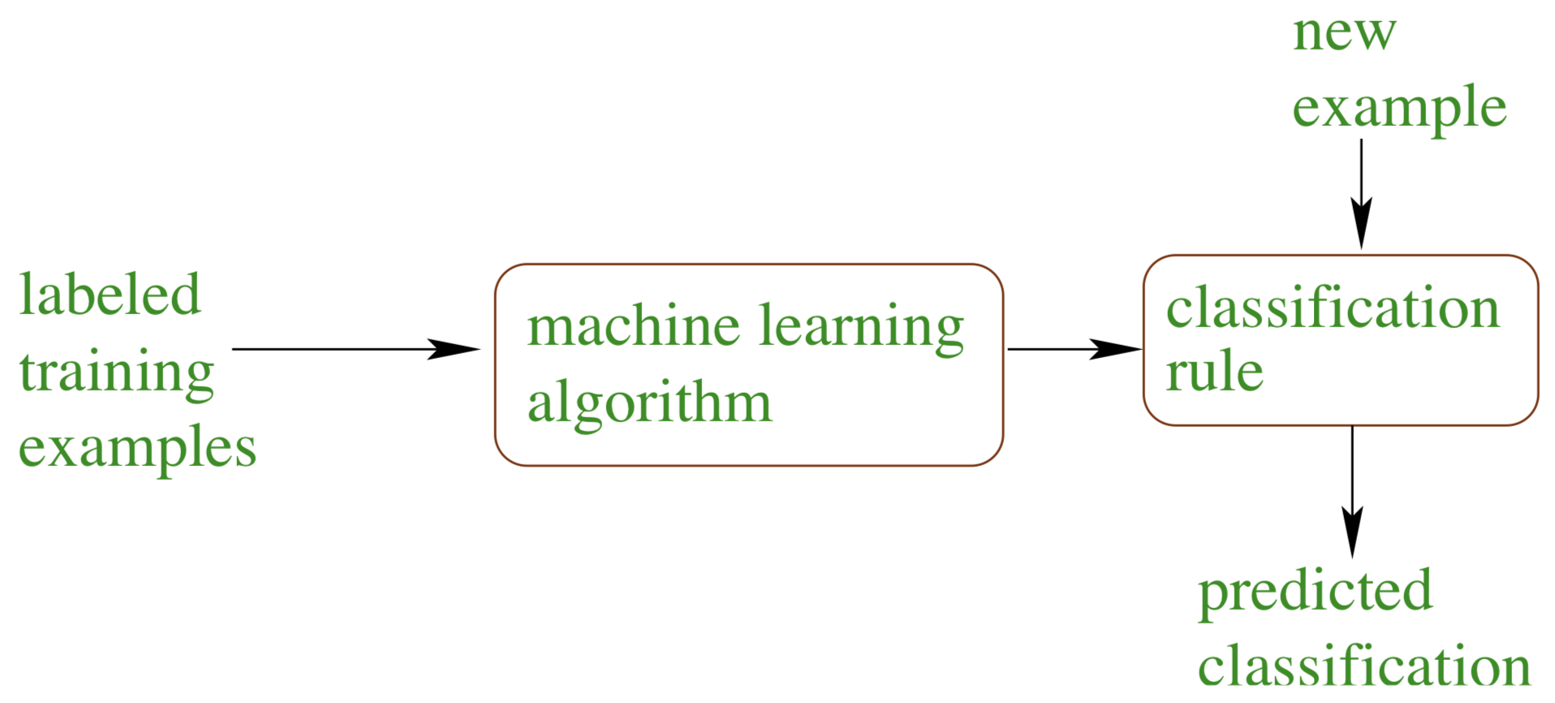
Classification
Studies how to automatically learn to make accurate predictions i.e. label data into given categories, based on past observations.
Slide credit: R.Schapire

Slide 5
Classification
f(x) = y
Training: Given a training set of labeled examples:
{(x₁,y₁), …, (x_{N},y_{N})}
Estimate the prediction function f by minimizing the prediction error on the training set.
Testing: Apply f to a unseen test example x_{u} and output the predicted value y_{u} = f(x_{u}) to classify x_{u}.
Prediction function or classifier
Instance
Output (label)
Slide credit: L. Lazebnik

Slide 6
Classification
Assign x to one of two (or more) classes.
A decision rule divides input space into decision regions separated by decision boundaries.
L. Lazebnik

Slide 7
Classifiers: Nearest neighbor (NN)
Test example
Training examples from class 2
Training examples from class 1
f(x) = label of the training example nearest to x
All we need is a distance function for our inputs.
No training required!
What does the decision boundary look like?
Slide credit: L. Lazebnik
Notes:
ASK QUESTION – What does the decision boundary look like in this case?

Slide 8
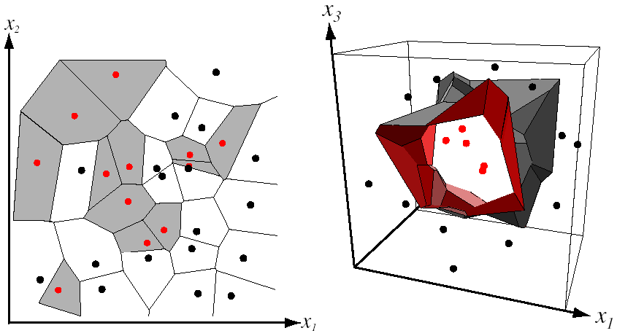
NN Classifier decision boundary
Divides input space into decision regions separated by decision boundaries – Voronoi.
Voronoi partitioning
of feature space
for two-category
2D and 3D data
from Duda et al.
Source: D. Lowe

Slide 9
k-NN
1-nearest
x
x
x
x
x
o
x
x
x
o
x
x
x
x
+
o
x
+
o
x
o
x
o
x
o
o
+
o
o
+
o
o
x2
o
x2
o
x1
x1
3-nearest
5-nearest
x
x
x
x
x
o
x
o
x
x
x
x
x
x
+
o
x
+
o
x
o
x
o
x
o
o
+
o
o
+
o
o
x2
o
x2
o
x1
x1
Notes:
Simple, a good one to try first
With infinite examples, 1-NN provably has error that is at most twice Bayes optimal error

Slide 10
Classifiers: Linear
Training examples from class 2
Training examples from class 1
Find a linear function to separate the classes.
Slide credit: L. Lazebnik

Slide 11
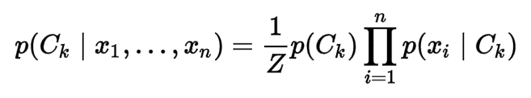
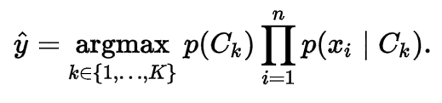
Classifier: Naïve Bayes
Conditional probability model over classes
Classifier :
y
x₁
x₂
x₃
Notes:
https://en.wikipedia.org/wiki/Naive_Bayes_classifier
Simple thing to try for categorical data
Very fast to train/test

Slide 12
Classifiers: Logistic Regression
Maximize likelihood of label given data, assuming a log-linear model
x
x
x
x
x
x
male
o
x
x
o
o
Height
o
female
o
x2
x1
Pitch of voice

Slide 13
Using Logistic Regression
Quick, simple classifier (try it first)
Outputs a probabilistic label confidence.
Use L2 or L1 regularization
L1 does feature selection and is robust to irrelevant features but slower to train.

Slide 14
Classifiers: Linear SVM
Find a linear function to separate the classes:
f(x) = sign(w ⋅ x + b)
x
x
x
x
x
x
o
x
x
o
o
o
o
x2
x1

Slide 15
Classifiers: Linear SVM
Find a linear function to separate the classes:
f(x) = sign(w ⋅ x + b)
x
x
x
x
x
x
o
x
x
o
o
o
How?
X = all data points
Define hyperplane tX-b = 0, where t is tangent to hyperplane.
Minimize |t|
s.t. tX -b produces correct labels for all X
o
x2
x1
Notes:
Any hyperplane can be written as the set of points {\displaystyle {\vec {x}}} satisfying
{\displaystyle {\vec {w}}\cdot {\vec {x}}-b=0,\,}
Maximum-margin hyperplane and margins for an SVM trained with samples from two classes. Samples on the margin are called the support vectors.
where {\displaystyle {\vec {w}}} is the (not necessarily normalized) normal vector to the hyperplane

Slide 16
Classifiers: Linear SVM
Find a linear function to separate the classes:
f(x) = sign(w ⋅ x + b)
x
x
x
o
x
x
x
o
x
x
o
o
o
o
x2
x1
What if my data are not linearly separable ?
Introduce flexible ‘hinge’ loss (or ‘soft-margin’)

Slide 17
Nonlinear SVMs
Datasets that are linearly separable work out great:
But what if the dataset is just too hard?
We can map it to a higher-dimensional space:
0
x
0
x
x²
0
x
Slide credit A. Moore

Slide 18
Nonlinear SVMs
Map the original input space to some higher-dimensional feature space where the training set is separable:
Φ: x → φ(x)
Slide credit A. Moore

Slide 19
Nonlinear SVMs
Kernel trick: instead of explicitly computing the lifting transformation φ(x), define a kernel function K such that: K(x_{i} , x_{j}) = φ(x_{i} ) · φ(x_{j})
This gives a non-linear decision boundary in the original feature space:
Common kernel function: Radial basis function (RBF) kernel
C. Burges, A Tutorial on Support Vector Machines for Pattern Recognition
Data Mining and Knowledge Discovery, 1998
Notes:
To be valid, the kernel function must satisfy Mercer’s condition: that the kernel must be equivalent to a dot product in some space.
https://www.quora.com/Why-should-a-kernel-function-satisfy-Mercers-condition
In practical terms, satisfying Mercer’s condition means the kernel matrix is positive semidefinite, which means that the underlying QP for the SVM in dual form has a unique global optimum. In theory, kernels which fail to satisfy the M. Condition are not legitimate dot products in some higher dimensional space.
RBF Kernel: https://en.wikipedia.org/wiki/Radial_basis_function_kernel

Slide 20
Nonlinear kernel: Example
Consider the mapping:
x²

Slide 21
What about multi-class SVMs?
Unfortunately, there is no “definitive” multi-class SVM.
In practice, we combine multiple two-class SVMs
One vs. others
Training: learn an SVM for each class vs. the others
Testing: apply each SVM to test example and assign to it the class of the SVM that returns the highest decision value
One vs. one
Training: learn an SVM for each pair of classes
Testing: each learned SVM “votes” for a class to assign to the test example
Slide credit: L. Lazebnik

Slide 22
SVMs: Pros and cons
Pros
Many publicly available SVM packages
Kernel-based framework is very powerful, flexible
SVMs work very well in practice, even with very small training sample sizes.
Cons
No “direct” multi-class SVM.
During training time, must compute matrix of kernel values for every pair of examples.
Learning can take a very long time for large-scale problems.

Slide 23
Comparison
assuming x in {0 1}
Learning Objective
Training
Inference
Naïve Bayes
Logistic Regression
Gradient ascent
Linear SVM
Linear programming
Kernelized SVM
complicated to write
Quadratic programming
Nearest Neighbor
most similar features → same label
Record data
Slide credit: D. Hoiem

Slide 24
Summary: Classifiers
Nearest-neighbor classifiers
L1 distance, χ² distance, quadratic distance, histogram intersection
SVM classifiers
Linear classifiers
Margin maximization
The kernel trick
Multi-class
Of course, there are many other classifiers out there
Neural networks, boosting, decision trees, …
Slide credit: L. Lazebnik

Slide 25
Classifiers: Decision Trees
x
x
x
o
x
x
x
o
x
o
x
o
o
o
o
x2
x1

Slide 26
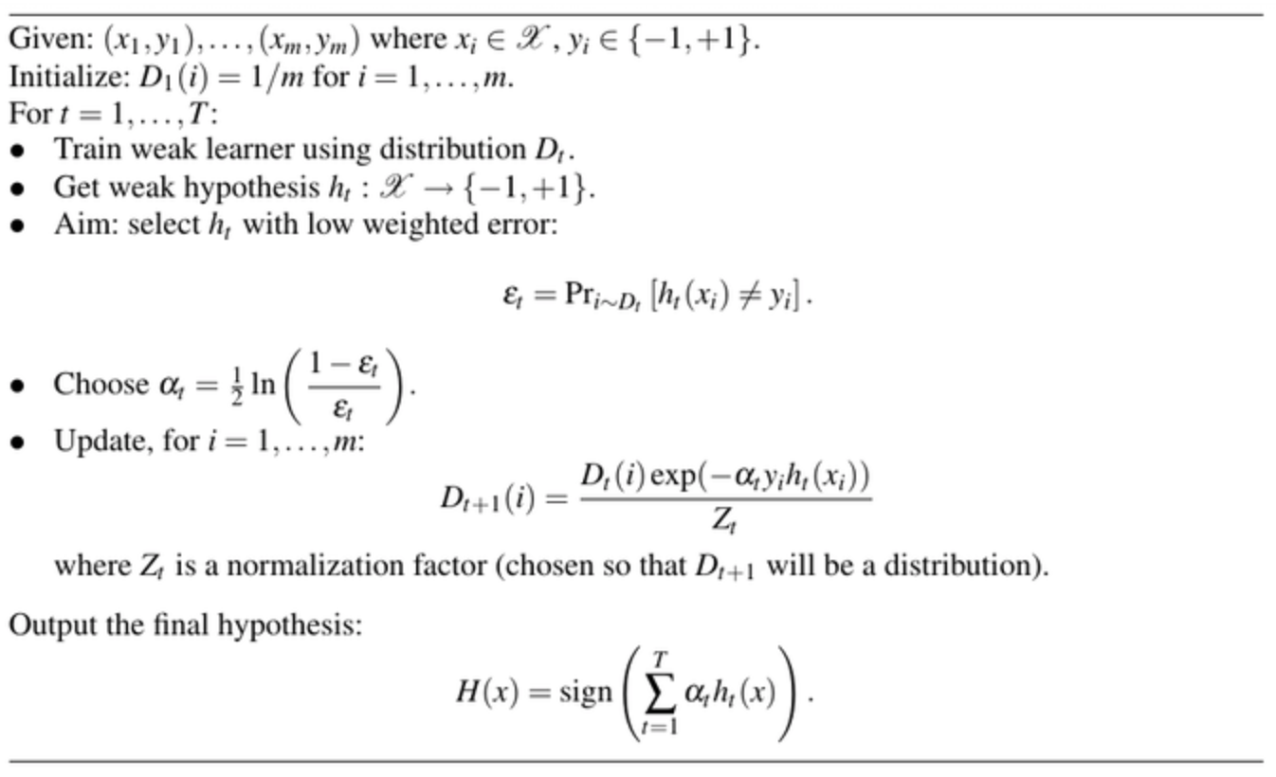
Adaptive Boosting (AdaBoost)

Slide 27
Ideals for a classification algorithm
Objective function: encodes the right loss for the problem.
Parameterization: takes advantage of the structure of the problem.
Regularization: good priors on the parameters.
Training algorithm: can find parameters that maximize objective on training set.
Inference algorithm: can solve for labels that maximize objective function for a test example.

Slide 28
How to think about classifiers
What is the objective? What are the parameters? How are the parameters learned? How is the learning regularized? How is inference performed?
How is the data modeled? How is similarity defined? What is the shape of the boundary?
Slide credit: D. Hoiem

Slide 29
What to remember about classifiers
No free lunch: machine learning algorithms are tools, not dogmas
Try simple classifiers first
Better to have smart features and simple classifiers than simple features and smart classifiers
Use increasingly powerful classifiers with more training data (bias-variance tradeoff)
Slide credit: D. Hoiem

Slide 30
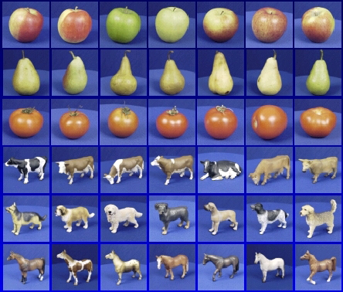

Generalization
Training set (labels known)
Test set (labels unknown)
How well does a learned model generalize from the data it was trained on to a new test set?
Slide credit: L. Lazebnik

Slide 31
Generalization Error
Bias:
Difference between the expected (or average) prediction of our model and the correct value.
Error due to inaccurate assumptions/simplifications.
Variance:
Amount that the estimate of the target function will change if different training data was used.
Slide credit: L. Lazebnik

Slide 32
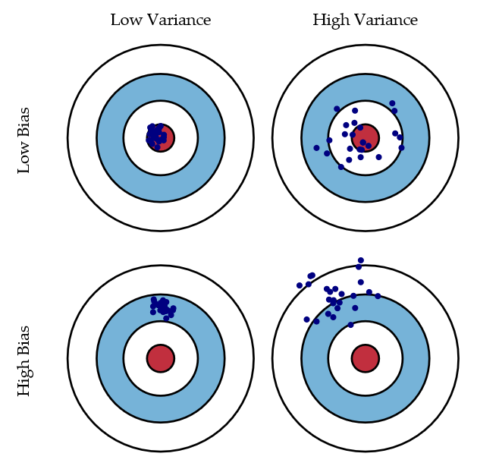
Bias/variance trade-off
Bias = accuracy
Variance = precision
Slide credit: S Fortmann-Roe
Notes:
http://scott.fortmann-roe.com/docs/BiasVariance.html
“Bias: The error due to bias is taken as the difference between the expected (or average) prediction of our model and the correct value which we are trying to predict.
Variance: The error due to variance is taken as the variability of a model prediction for a given data point.”

Slide 33
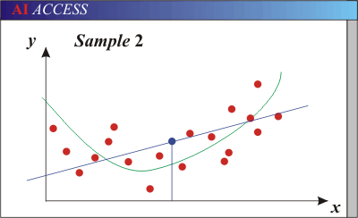
Generalization Error Effects
Underfitting: model is too “simple” to represent all the relevant class characteristics
High bias (few degrees of freedom) and low variance
High training error and high test error
Slide credit: L. Lazebnik

Slide 34
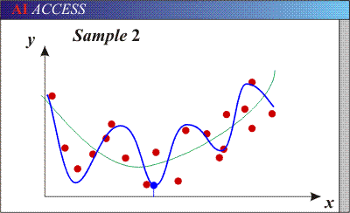
Generalization Error Effects
Overfitting: model is too “complex” and fits irrelevant characteristics (noise) in the data
Low bias (many degrees of freedom) and high variance
Low training error and high test error
Slide credit: L. Lazebnik

Slide 35
Bias-Variance Trade-off
Models with too few parameters are inaccurate because of a large bias.
Not enough flexibility!
Too many assumptions
Models with too many parameters are inaccurate because of a large variance.
Too much sensitivity to the sample.
Slightly different data -> very different function.
Slide credit: D. Hoiem
Notes:
http://www.aiaccess.net/English/Glossaries/GlosMod/e_gm_bias_variance.htm

Slide 36
Bias-Variance Trade-off
E(MSE) = noise² + bias² + variance
Error due to variance of training samples
Unavoidable error
Error due to incorrect assumptions
For explanations of bias-variance (also Bishop’s “Neural Networks” book):
http://www.inf.ed.ac.uk/teaching/courses/mlsc/Notes/Lecture4/BiasVariance.pdf
Slide credit: D. Hoiem
Notes:
From the link above:
You can only get generalization through assumptions.
Thus, in order to minimize the MSE, we need to minimize both the bias and the variance.
However, this is not trivial to do this.
For instance, just neglecting the input data and predicting the output somehow (e.g., just a constant), would definitely minimize the variance of our predictions: they would be
always the same, thus the variance would be zero—but the bias of our estimate
(i.e., the amount we are off the real function) would be tremendously large. On
the other hand, the neural network could perfectly interpolate the training data,
i.e., it predict y=t for every data point. This will make the bias term vanish entirely, since the E(y)=f (insert this above into the squared bias term to verify this),
but the variance term will become equal to the variance of the noise, which may
be significant (see also Bishop Chapter 9 and the Geman et al. Paper). In general,
finding an optimal bias-variance tradeoff is hard, but acceptable solutions can be
found, e.g., by means of cross validation or regularization.

Slide 37
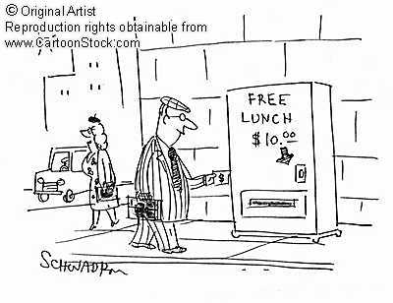
Remember…
No classifier is inherently better than any other: you need to make assumptions to generalize
Three kinds of error
Inherent: unavoidable
Bias: due to over-simplifications
Variance: due to inability to perfectly estimate parameters from limited data
Slide credit: D. Hoiem
Notes:
You can only get generalization through assumptions.

Slide 38
How to reduce variance?
Choose a simpler classifier
Regularize the parameters
Get more training data
Slide credit: D. Hoiem
Notes:
The simpler classifier or regularization could increase bias and lead to more error.

Slide 39
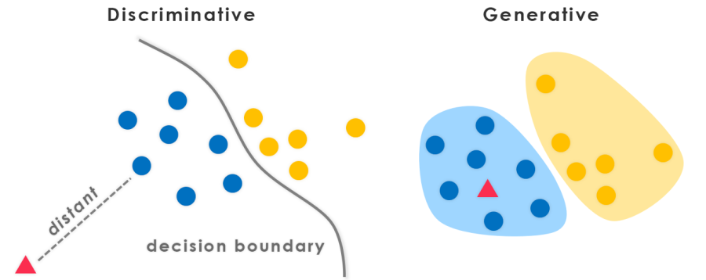
“Learn the data boundary”
“Represent the data + boundary”
Bayesian methods:
Condition model on data probabilistically
Image credit: evolvingai

Slide 40
Generative vs. Discriminative
Discriminative Models
Learn to directly predict the labels from the data
Often, assume a simple boundary (e.g., linear)
Examples
Logistic regression
SVM
Boosted decision trees
Often easier to predict a label from the data than to model the data
Generative Models
Represent both the data and the labels
Often, makes use of conditional independence and priors
Examples
Naïve Bayes classifier
Bayesian network
Models of data may apply to future prediction problems
Slide credit: D. Hoiem
Notes:
Generative classifiers try to model the data. Discriminative classifiers try to predict the label.

Slide 41
Making decisions about data
Important design decisions:
1) What data do I use?
2) How do I represent my data ?
3) What classifier / regressor do I use?
These are in decreasing order of importance
Deep learning addresses 2 and 3 simultaneously (and blurs the boundary between them).
You can take the representation from deep learning and use it with any classifier.

Slide 42
Many classifiers to choose from…
K-nearest neighbor
SVM
Naïve Bayes
Bayesian network
Logistic regression
Randomized Forests
Boosted Decision Trees
Restricted Boltzmann Machines
Neural networks
…
Which is the best?

