Slide 1
Classification using Decision Trees
Suchismit Mahapatra
Slides : S. Lazebnik

Slide 2
Decision Trees and Rules
Goal: classify/predict an outcome based on a set of predictors.
The output is a set of rules
Example:
Goal: classify a record as “will accept credit card offer” or “will not accept”
Rule might be “IF (Income > $500) AND (Education < 4y) AND (Family <= 2) THEN Class = 0 (non-acceptor)
Also called CART, Decision Trees, or just Trees
Rules are represented by tree diagrams.

Slide 3
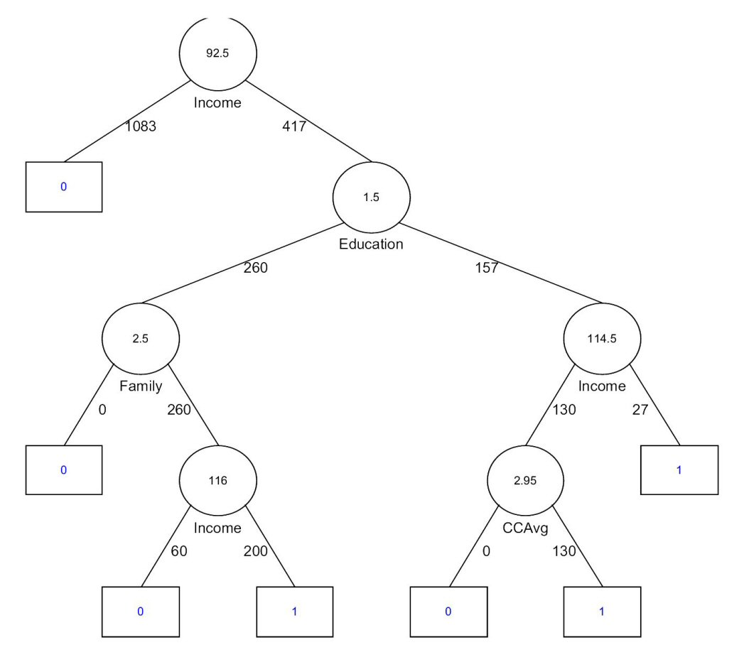

Slide 4
Key ideas
Recursive partitioning: Repeatedly split the records into two parts so as to achieve maximum homogeneity within the new parts.
Pruning the tree: Simplify the tree by pruning peripheral branches to avoid overfitting.

Slide 5
Recursive Partitioning
Pick one of the predictor variables, x_{i}
Pick a value of x_{i,} say s_{i}, that divides the training data into two (not necessarily equal) portions
Measure how “pure” or homogeneous each of the resulting portions are
“Pure” = containing records of mostly one class
Algorithm tries different values of x_{i,} and s_{i} to maximize purity in initial split
After you get a “maximum purity” split, repeat the process for a second split, and so on

Slide 6
Simple example: Mowers
Goal: Classify 24 households as owning or not owning riding mowers.
Predictor variables = Income, Lot Size

Slide 8
How to split
Order records according to one variable, say lot size.
Find midpoints between successive values
For example. first midpoint is 14.4 (halfway between 14.0 and 14.8)
Divide records into those with lotsize > 14.4 and those < 14.4
After evaluating that split, try the next one, which is 15.4 (halfway between 14.8 and 16.0)

Slide 9
Categorical Variables
Examine all possible ways in which the categories can be split.
For example, categories {A, B, C} can be split 3 ways :-
{A} and {B, C}
{B} and {A, C}
{C} and {A, B}
With many categories, possible ways to split becomes huge.

Slide 10
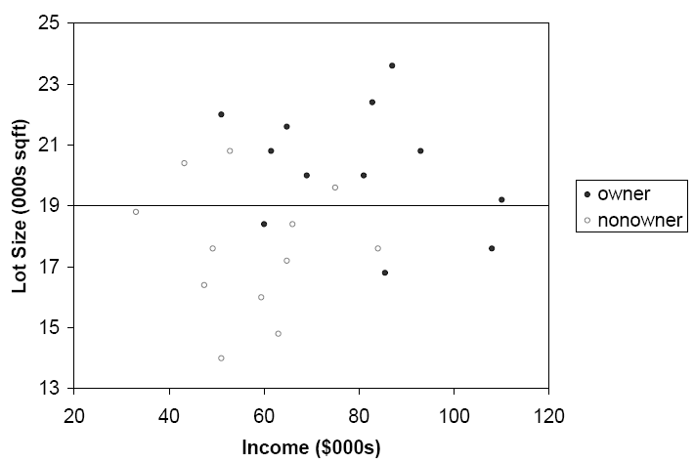
The first split: Lot Size = 19,000

Slide 11
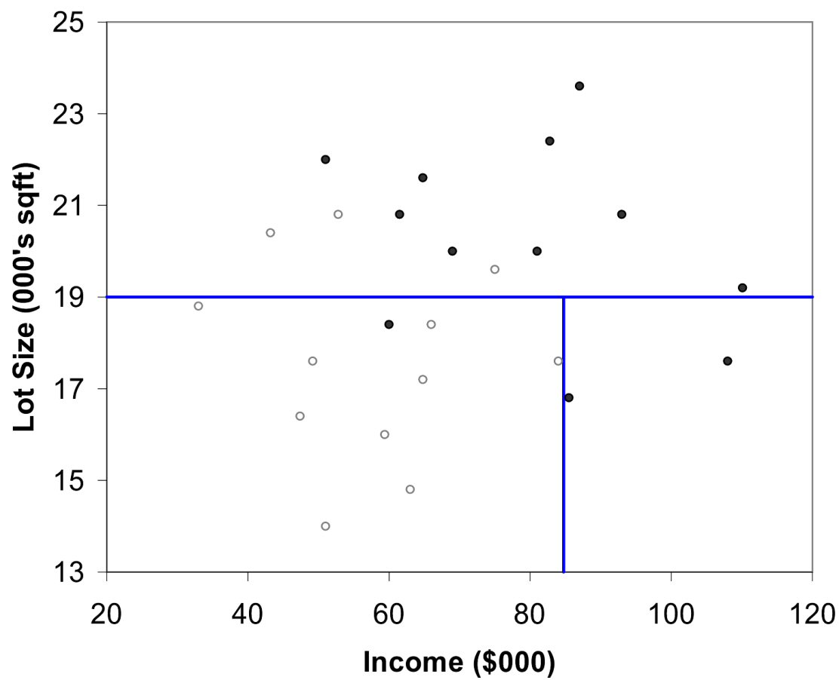
Second Split: Income = $84,000

Slide 12
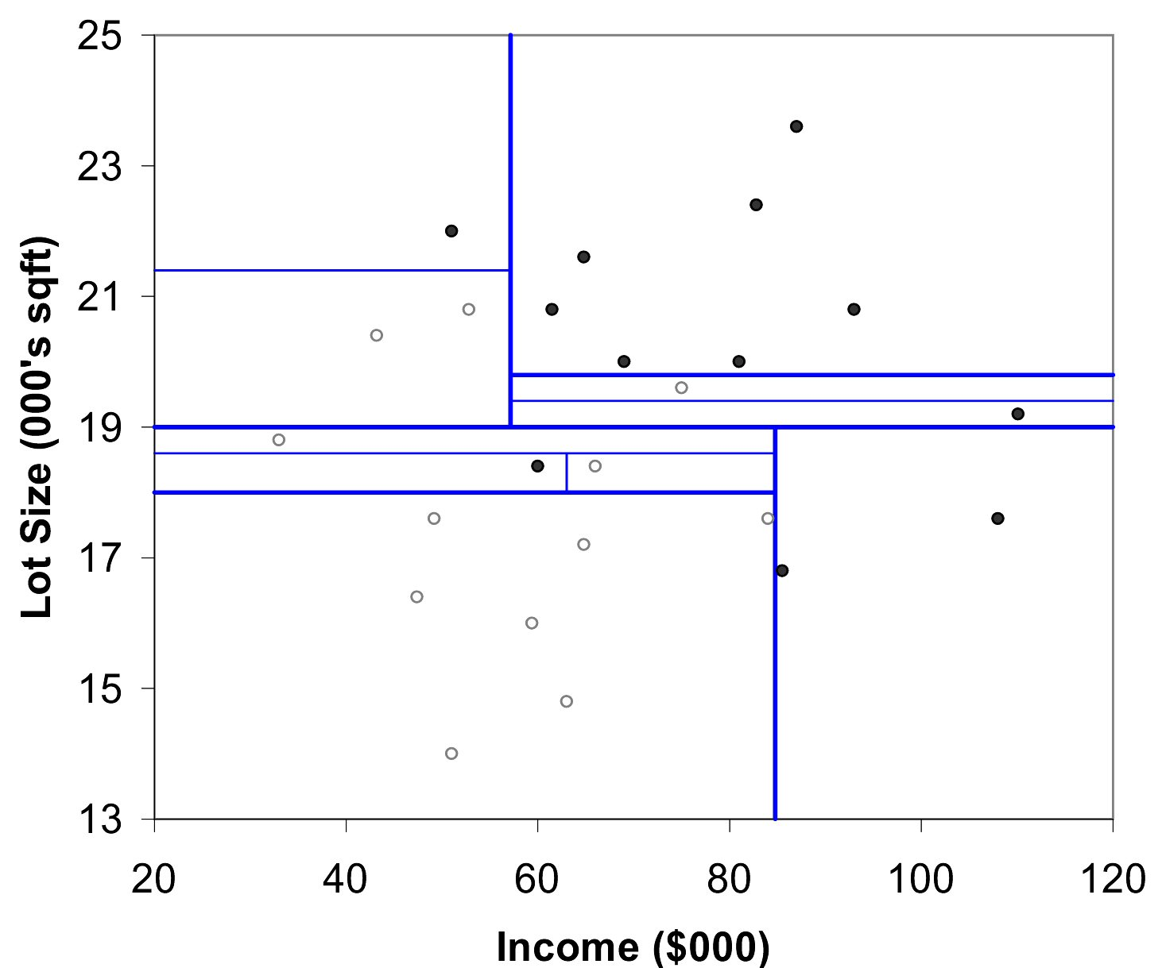
After All Splits

Slide 13
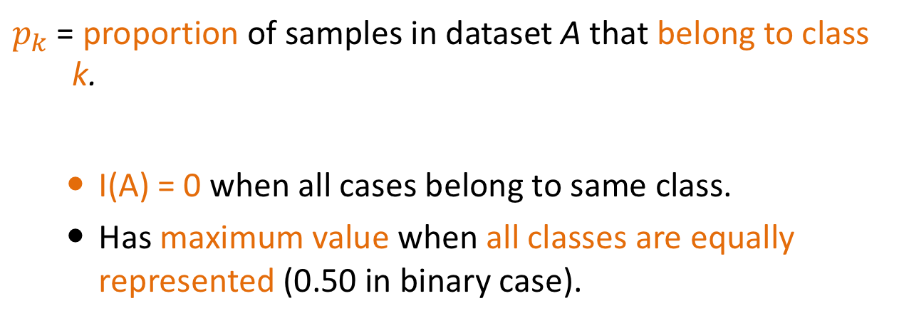
Measuring impurity - Gini Index
Gini Index for dataset A containing m records
$p_{k}$ = proportion of samples in dataset A that belong to class k.
I(A) = 0 when all cases belong to same class.
Has maximum value when all classes are equally represented (0.50 in binary case).

Slide 14
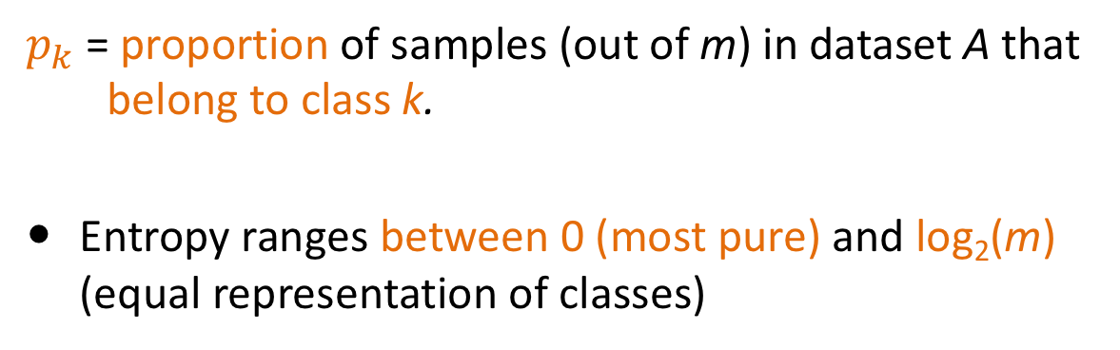
Measuring impurity - Entropy
$p_{k}$ = proportion of samples (out of m) in dataset A that belong to class k.
Entropy ranges between 0 (most pure) and log₂(m) (equal representation of classes)

Slide 15
Impurity and Recursive Partitioning
Obtain overall impurity measure (weighted average of individual rectangles).
At each successive stage, compare this measure across all possible splits in all variables.
Choose the split that reduces impurity the most.
Chosen split points become nodes on the tree.

Slide 16
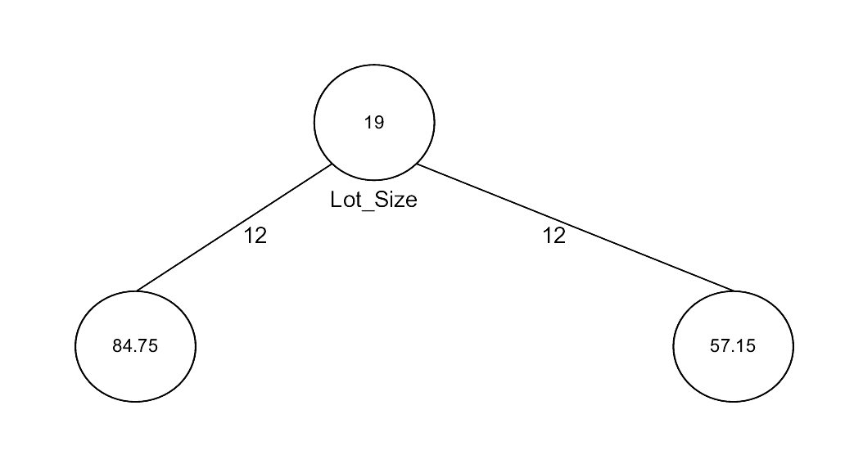
First Split – The Tree

Slide 17
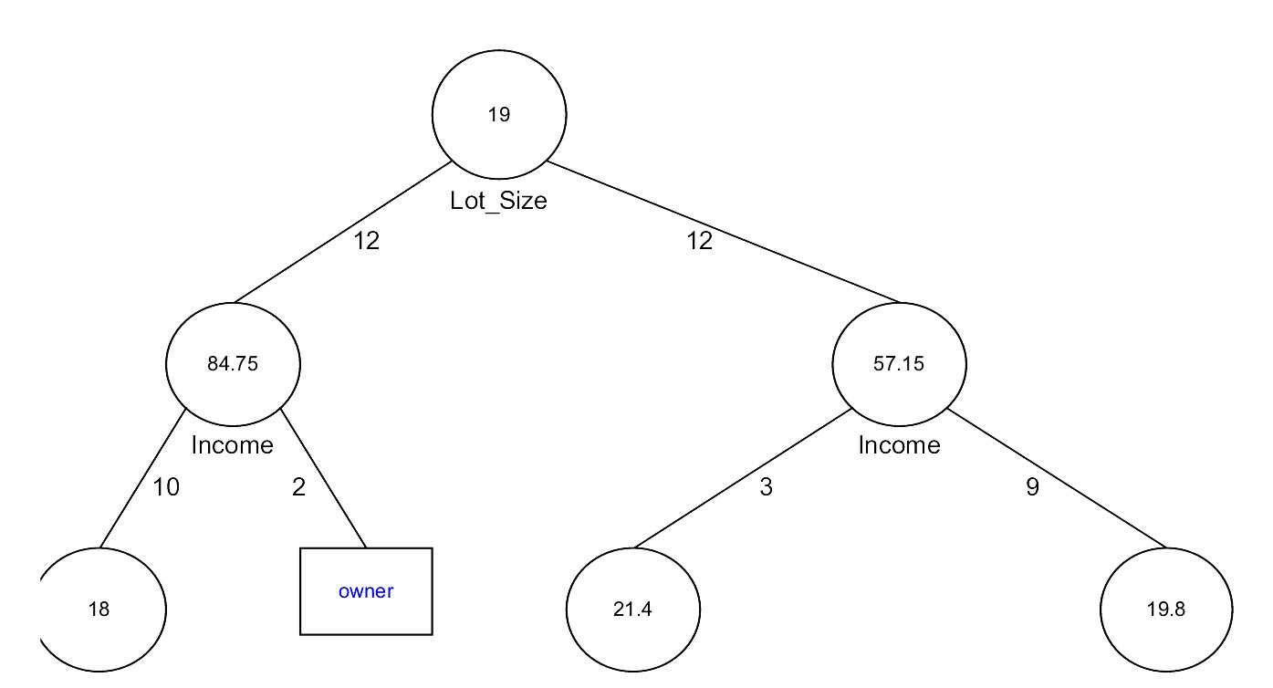
Tree after three splits

Slide 18
Tree Structure
Split points become nodes on tree (circles with split value in center)
Rectangles represent “leaves” (terminal points, no further splits, classification value noted)
Numbers on lines between nodes indicate # cases
Read down tree to derive rule
E.g., If lot size < 19, and if income > 84.75, then class = “owner”

Slide 19
Determining Leaf Node Label
Each leaf node label is determined by “voting” of the records within it, and by the cutoff value
Records within each leaf node are from the training data
Default cutoff=0.5 means that the leaf node’s label is the majority class.
Cutoff = 0.75: requires majority of 75% or more “1” records in the leaf to label it a “1” node

Slide 20
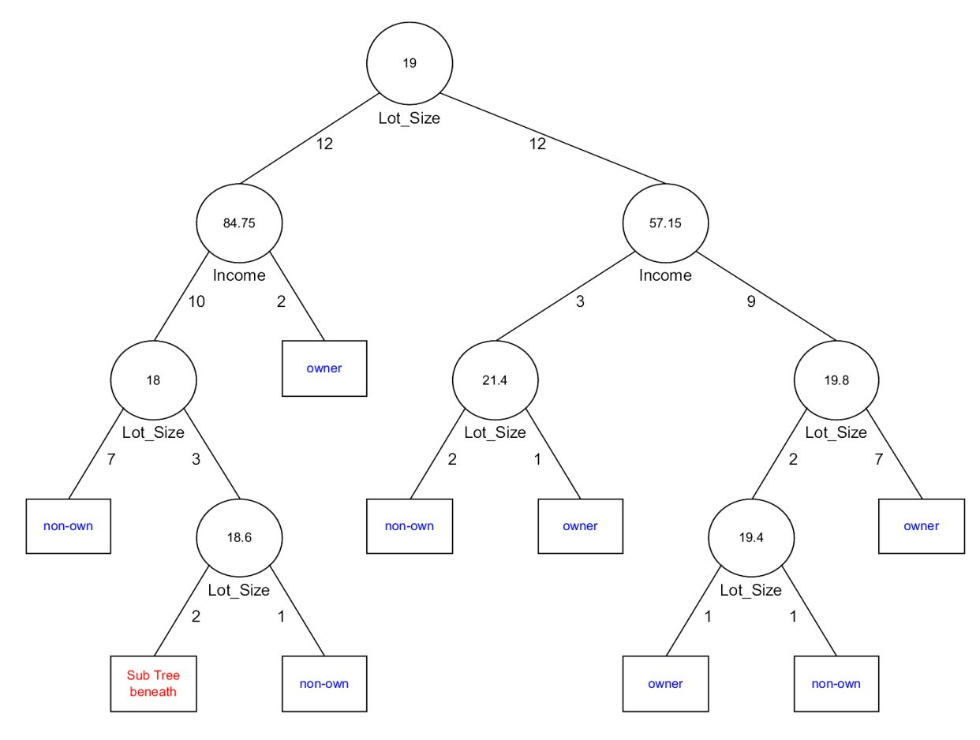
Tree after all splits

Slide 21
Overfitting - Stopping Tree Growth
Natural end of process is 100% purity in each leaf
However this can lead to overfitting the data, which ends up fitting noise in the data
Overfitting leads to low predictive accuracy of new data.
After a certain stage, the error rate for the validation data starts to increase.

Slide 22
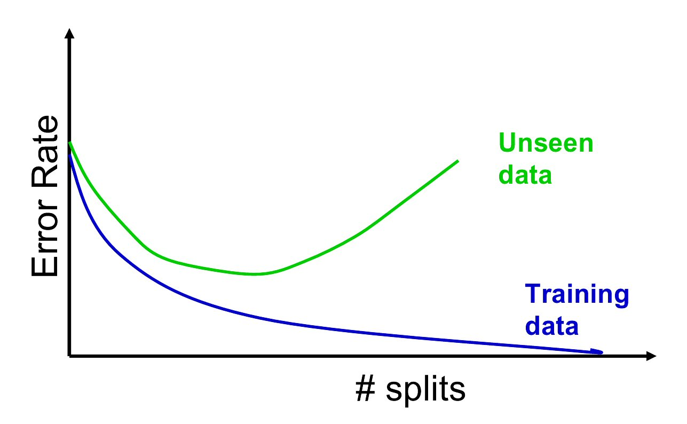
Decision Tree Error Rate

Slide 23
Pruning
CART lets tree grow to full extent, then prunes it back.
Intuition is to find that point beyond which the validation error begins to rise.
Generate successively smaller trees by pruning leaves.
At each pruning stage, multiple trees are possible.
Use cost complexity to choose the best tree at that stage.

Slide 24
Cost Complexity
CC(T) = Err(T) + α L(T)
CC(T) = cost complexity of a tree
Err(T) = proportion of misclassified records
α = penalty factor attached to tree size (set by user)
Among trees of given size, choose the one with lowest CC.
Do this for each size of tree.

Slide 25
Using Validation Error to Prune
Pruning yields a set of trees of different sizes and associated error rates.
Two trees of interest:
Minimum error tree
Has lowest error rate on validation data.
Best pruned tree
Smallest tree within one std. error of min. error.
Adds a bonus for simplicity/parsimony.

Slide 26
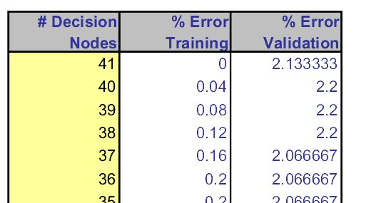
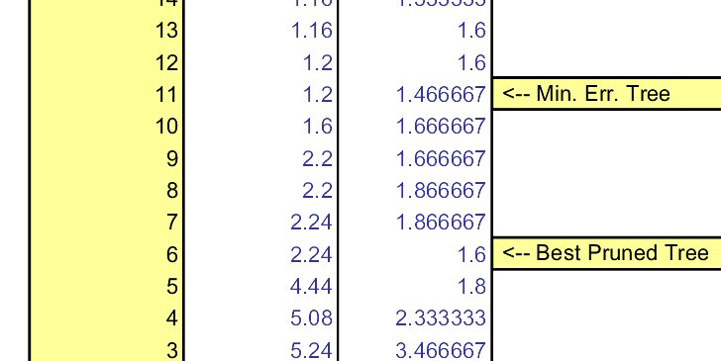
Error rates on pruned trees

Slide 27
Regression Trees for Prediction
Used with continuous outcome variables.
Procedure similar to classification trees.
Many splits attempted, choose the one that minimizes impurity.

Slide 28
Differences from Classification Trees
Prediction is computed as the average of numerical target variable in the data (in CT it is majority vote).
Impurity measured by sum of squared deviations from leaf mean.
Performance measured by RMSE (root mean squared error).

Slide 29
Advantages of trees
Easy to use, understand.
Produce rules that are easy to interpret & implement.
Variable selection & reduction is automatic.
Usually do not require feature scaling.
Can work without extensive handling of missing data.

Slide 30
Disadvantages
May not perform well where there is structure in the data that is not well captured by horizontal or vertical splits.
Since the process deals with one variable at a time, no way to capture interactions between variables.

Slide 31
Summary
Trees are both easily understandable and transparent technique for prediction or classification.
Essentially, a tree is a graphical representation of a set of rules.
Trees must be pruned to avoid over-fitting.
Since trees do not make any assumptions about the data, they usually require large number of samples.

